Slide 1
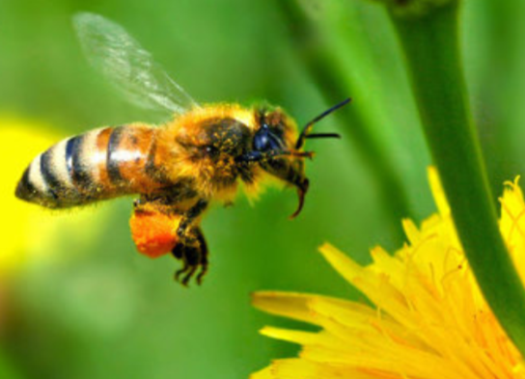
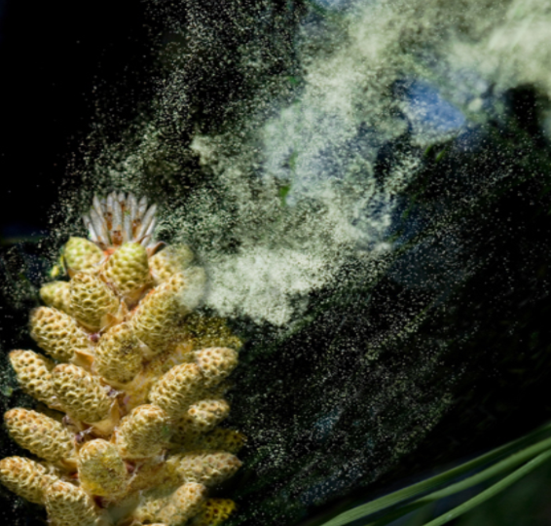
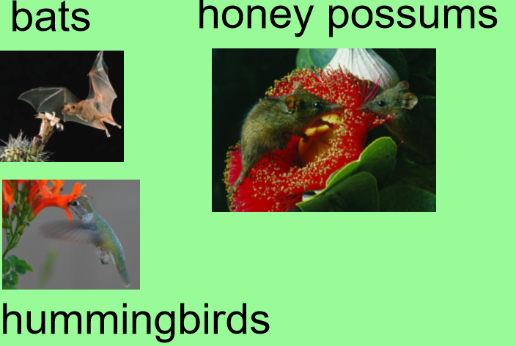
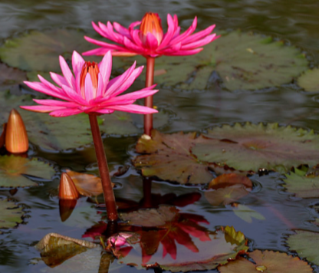

Plants
Lesson 1-2
bees
wasps
ants
butterflies
moths
flies
beetles
Last time you investigated the different parts of a plant and how seeds are pollinated.
Insects
Wind
Pollination
Animals
Water

Slide 2
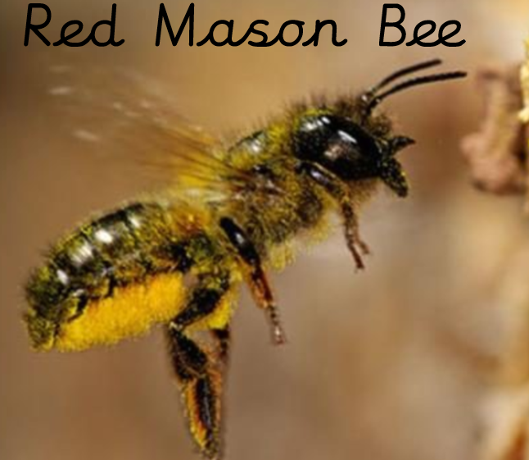
Did you discover which insects are great pollinators?
Here is one of them…
It is a tremendous pollinator. Calculated to be between 120 and 200 times more efficient than the honey bee.
It doesn’t have any pollen sacs, so most of the sticky pollen is deposited on the furry underside of its body.

Slide 3

Today we will look at seed dispersal, one of the stages in the lifecycle of a plant.
Once a flower has been pollinated it is able to produce seeds.
This means the flower is able to produce more of itself.

Slide 4
What does disperse or dispersal mean?
Can you look the word up?

Slide 5
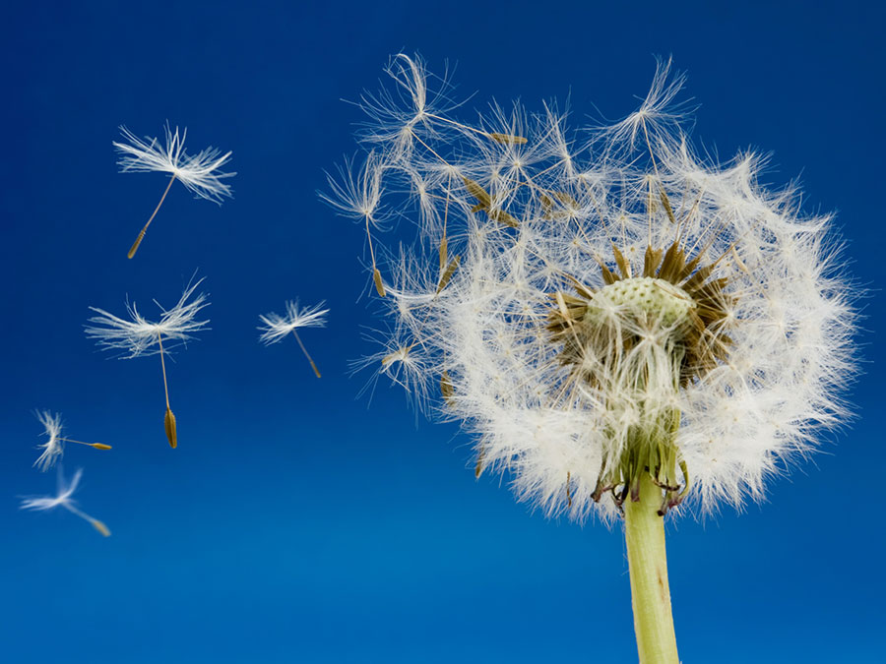
But how do plants disperse their seeds?
Can you think of some ways?
https://www.bbc.co.uk/bitesize/clips/znvfb9q
Can you investigate examples for each method of dispersal?

Slide 6
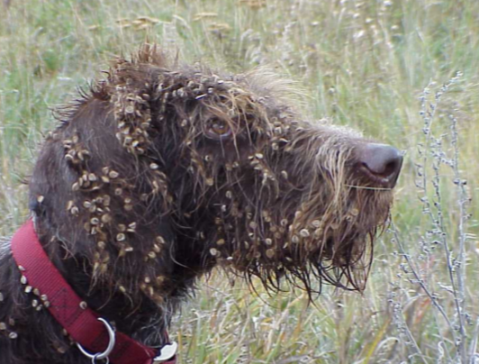
Animals
Some animals eat the fruit but only digest the juicy part. The seeds and pips are excreted and deposited far away from the original plant.
Blackberry, cherry, apple are all e.g.
Some animals will bury seeds for winter food but then forget them.
Some seeds have hooks on them and stick to animals fur and get carried away.

Slide 7
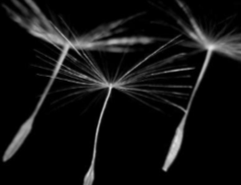
Wind
The seeds are normally very light.
The seeds of an orchid are as fine as dust.
Many have hairy growths which act like parachutes and carry the seeds far away from the parent.

Slide 8
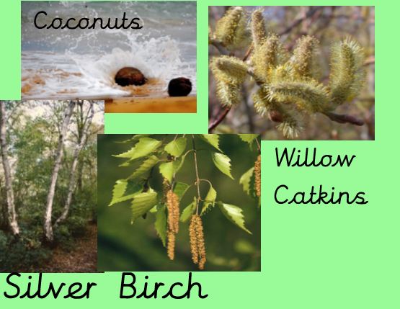
Water
Seeds dispersed by water are contained in light and buoyant fruit, giving them the ability to float.
Coconuts are well known for their ability to float on water to reach land where they can germinate.

Slide 9
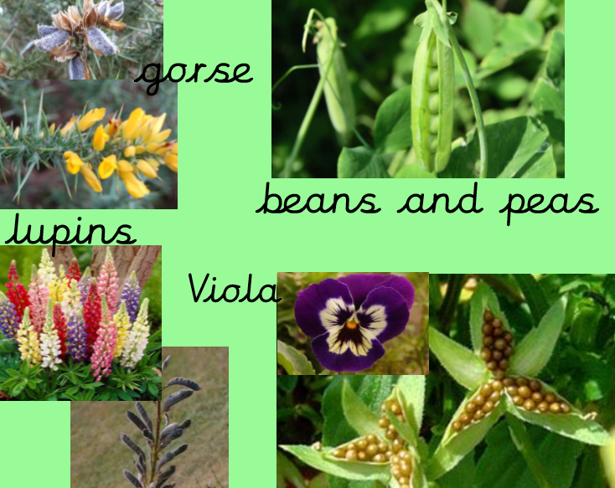
Explosion
Some seeds have pods that explode when ripe.

Slide 10
L.O:I can recognise how seeds can be dispersed as part of the lifecycle of plants
Please complete the seed dispersal sheet. Some of them are tricky so read the descriptions carefully.
Investigate your garden or plants when you go out and exercise. How do they disperse their seeds?

Slide 11
Why might it be important that the seed be depoisited far away from the original parent plant?

