Slide 1



Phase 2
Letters and Sounds

Slide 2
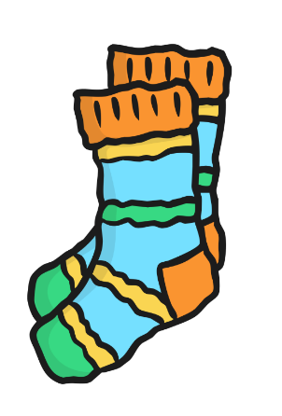
s

Slide 3

a

Slide 4
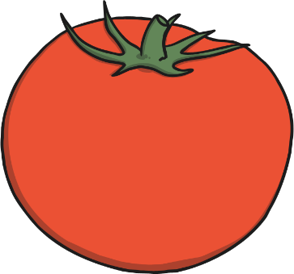
t

Slide 5

p

Slide 6

i

Slide 7
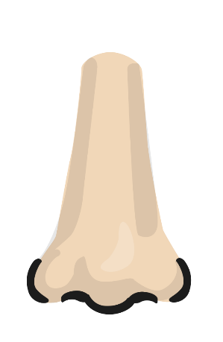
n

Slide 8
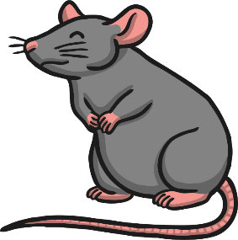
m

Slide 9

d

Slide 10

g

Slide 11

o

Slide 12

c

Slide 13

k

Slide 14

ck

Slide 15

e

Slide 16

u

Slide 17

r

Slide 18

h

Slide 19
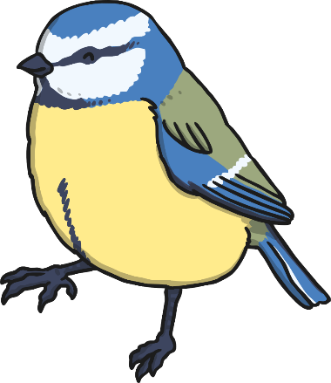
b

Slide 20

f

Slide 21

ff

Slide 22

l

Slide 23

ll

Slide 24

ss

