Slide 1
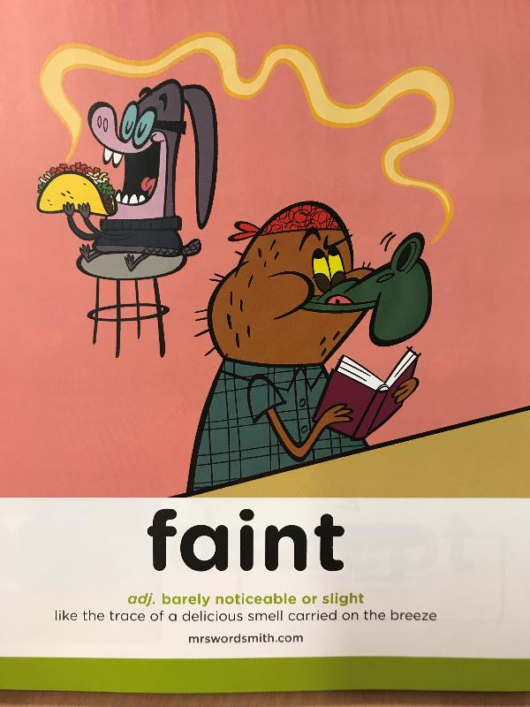

Day 1 Wednesday

Slide 2

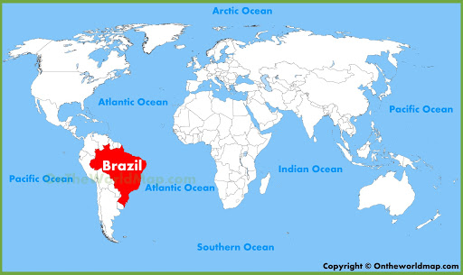
Will it be hot or cold?
UK
Equator

Slide 3
Video clip
Please watch the video attached and follow the link on the learning sheet to watch the other. This will give you an idea of what the Brazil carnival is like.

Slide 4
I hope you liked the videos and got taste of what the carnival is like! So many sequences and music! ☺
Here are our speed words for today. Have a go at reading them out loud and see if you can remember what they mean. If you are not sure and if you can, look them up in a dictionary. If you don’t have one click on to reveal their meanings!
Speed words
fragrant | glistening | sensory
having a pleasant or sweet smell.
of or relating to sensation or to the senses
shine with a sparkling light.

Slide 5
Please read ☺
Brazil Carnival
I can hear the deep rumble of the samba drums.
I can see the twinkling costumes.
I feel the warmth of the fragrant air;
the vibrations of the stomping feet.
The rough sequins brush against my smooth skin.
The spicy sauce fills my mouth and leaves my eyes watering.
The carnival is a sensory delight.

Slide 6
L.O: I can identify adjectives.
I can identify the features of a poem.
L.O: I can identify adjectives and edit adjectives.
I can identify the features of a poem.
L.O: I can use a purple pen to improve a text.
I can identify the features of a poem.

Slide 7
What is its features or ingredients?
What is the purpose this poem?

Slide 8
What did you find?
Modal verbs
Adjectives
Brazil Carnival
I can hear the deep rumble of the samba drums.
I can see the twinkling costumes.
I feel the warmth of the fragrant air;
the vibrations of the stomping feet.
The rough sequins brush against my smooth skin.
The spicy sauce fills my mouth and leaves my eyes watering.
The carnival is a sensory delight.
The senses

Slide 9
What did you find?
What are the features of the poem?
Uses the senses.
Uses exciting adjectives.
Uses modal verbs
Uses a summary sentence at the end to describe how the author feels about the carnival.
What is the purpose this poem?
To help the reader feel and imagine what its like at the carnival.

Slide 10
What is the poem’s structure?
Line 1 - Hear
Line 2 - See
Line 3 - Touch
Line 4 - Taste
(Smell- it doesn’t mention this but you can when you write your own!)
Summary sentence explaining how the writer feels about the carnival.

Slide 11
Video clip
L.O: I can plan my own carnival poem.
Adjectives, adverbs and verbs
Powerful adjectives, adverbs and strong verbs.
Vary sentence length,
Similes
Powerful adjectives, adverbs and strong verbs.
Vary sentence length,
Similes /metaphors
Modal verbs

