Slide 1
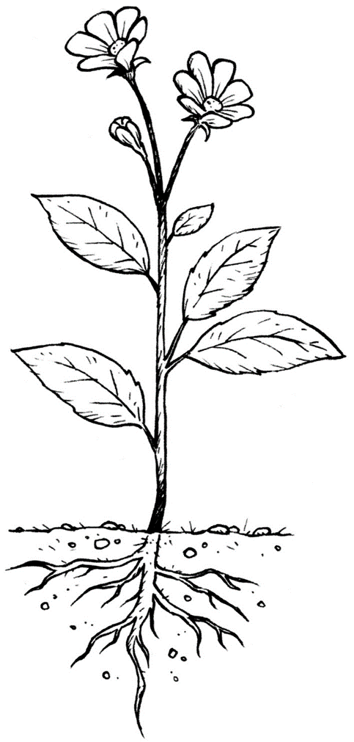

What are these parts of the flower?
What are they for?

Slide 2
Stem: it transports water and nutrients from the roots to the rest of the plant. It also supports the plant.
Flower: brightly coloured to attracted insects.
Leaves: make the food for the plant.
Roots: takes in water and nutrients form the soil. It also helps anchor the plant.

Slide 3
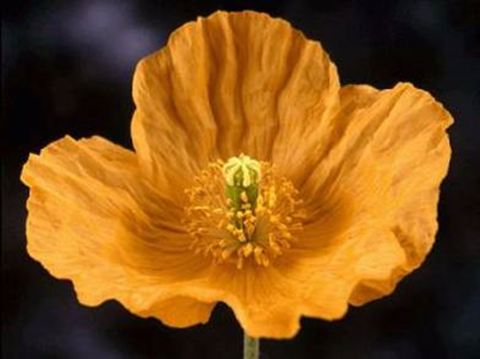
The parts of a flower
Most flowers have five parts:
sepals,
petals,
receptacle
male part - the stamens,
female part - the carpels.

Slide 4
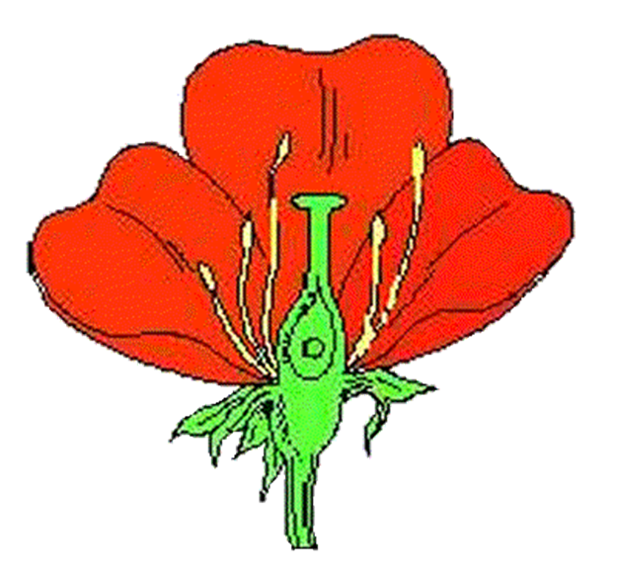
Where all the parts of the flower join together.
receptacle

Slide 5
Usually green, sepals typically function as protection for the flower in bud, and often as support for the petals when in bloom.
Sepal

Slide 6
Petal
Usually brightly coloured to attract insects and other creatures.

Slide 7
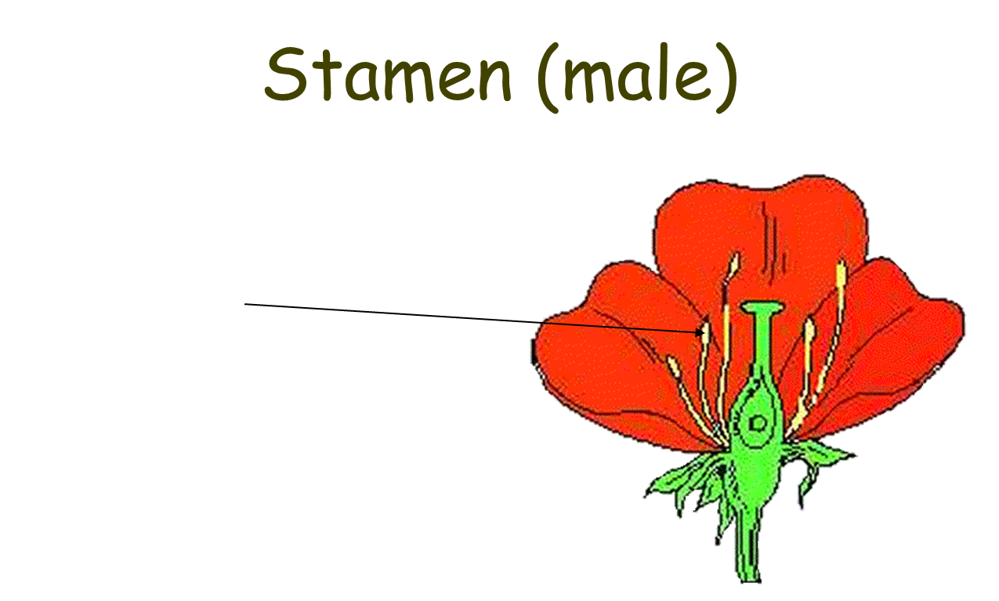
Stamen (male)
Anther: pollen grains grow in the anther.
When the grains are fully grown, the anther splits open.
Filament supports the anther.

Slide 8
Carpel (female)
Stigma-where pollen is trapped (sticky)
Style-supports stigma
Ovary-where eggs are stored
Ovules (eggs)

Slide 9
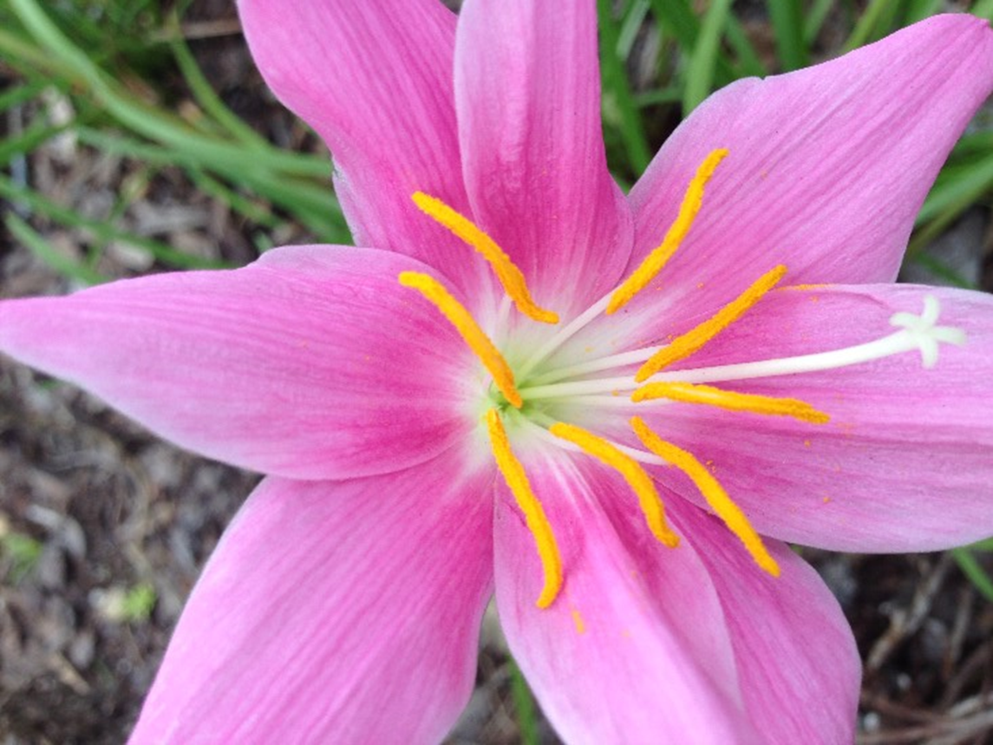
Can you identify the male and female parts of these plants?

Slide 10
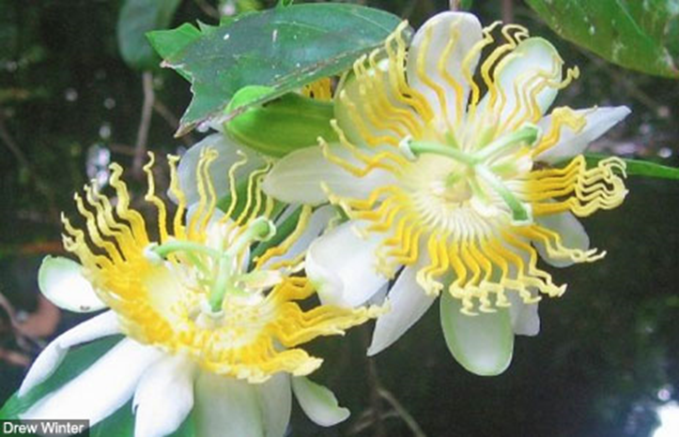

Slide 11
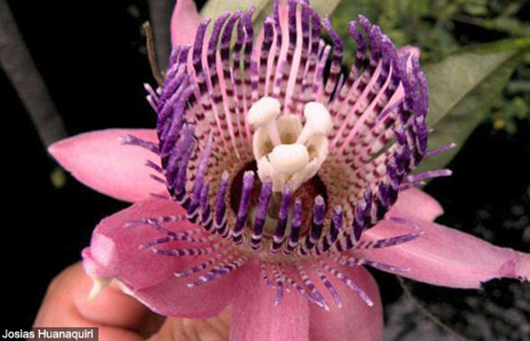

Slide 12
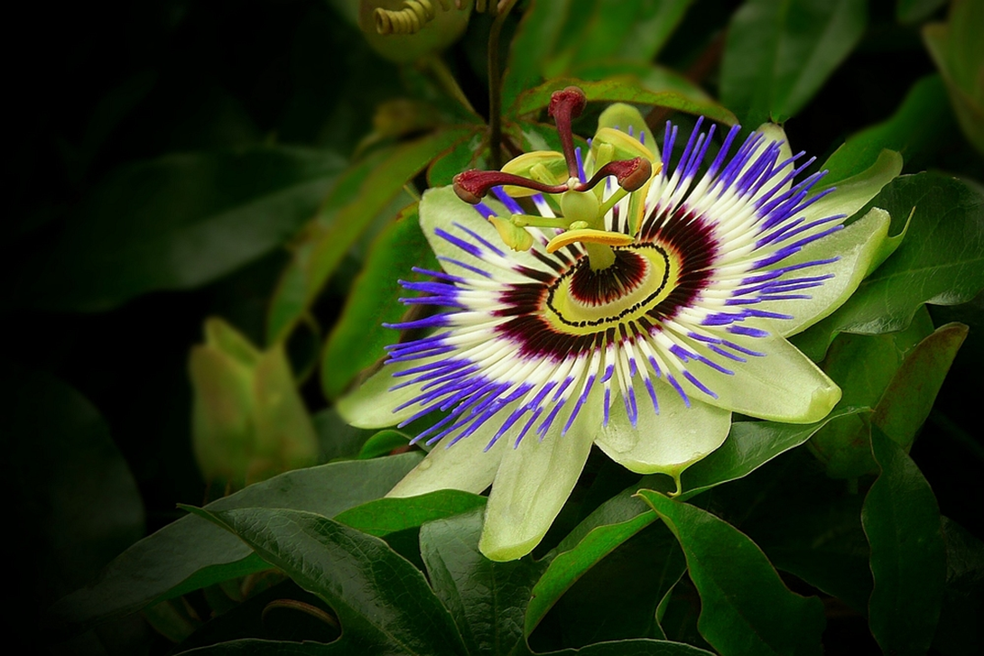

Slide 13
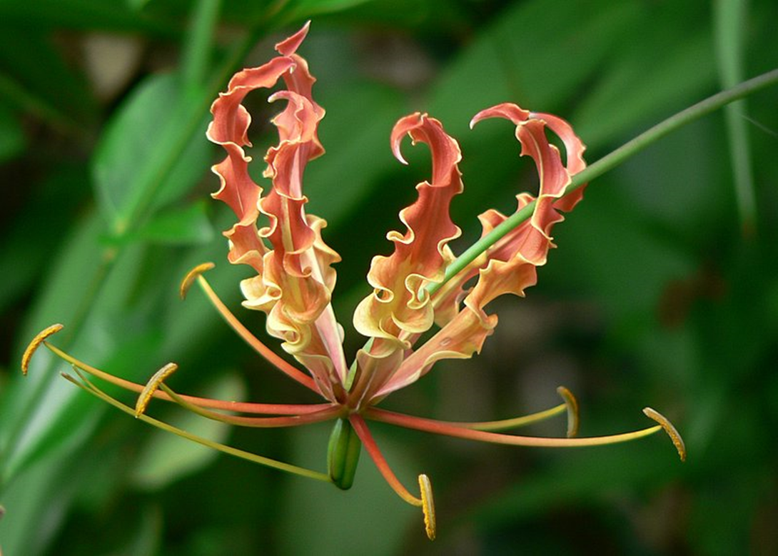

Slide 14
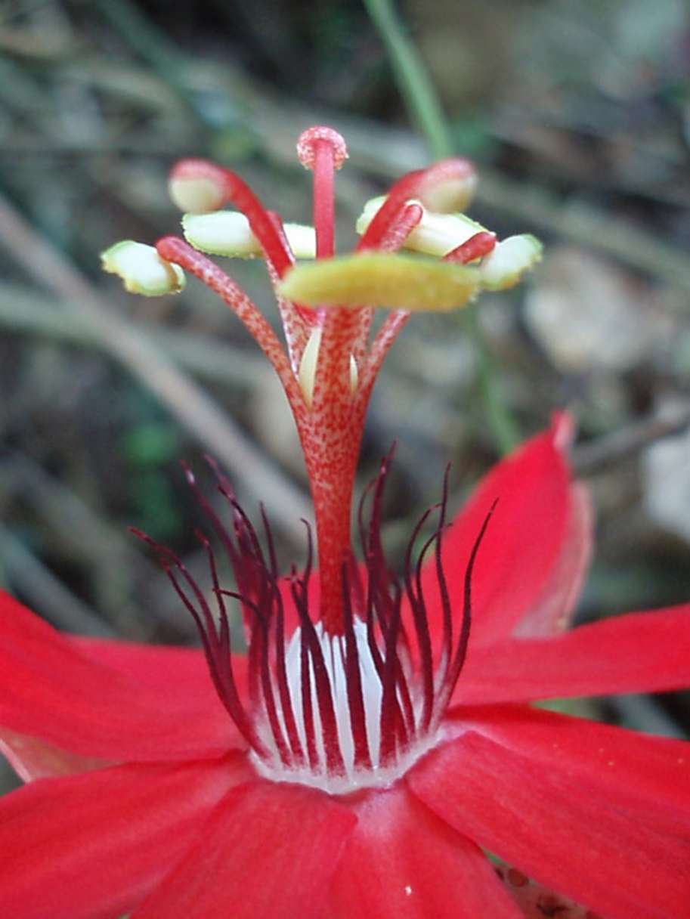

Slide 15
Use the topic sheet and select the appropriate challenge (*, **, ***) and identify the different parts of the flowering plant, label them and explain their role.
L.O: To know the structure of flowering plants.
S.C:To identify and label the different parts of the flower.
To identify and label the male and female parts.
To label the role of each part of the flower.
*
L.O:To know the structure of flowering plants.
S.C:
To identify and label the different parts of the flower.
To identify and label the male and female parts.
To explain the role of each part of the flower using the key vocabulary.
**
L.O: To know the structure of flowering plants.
S.C:
To identify and label the different parts of the flower.
To identify and label the male and female parts.
To explain the role of each part of the flower.
***

