Slide 1
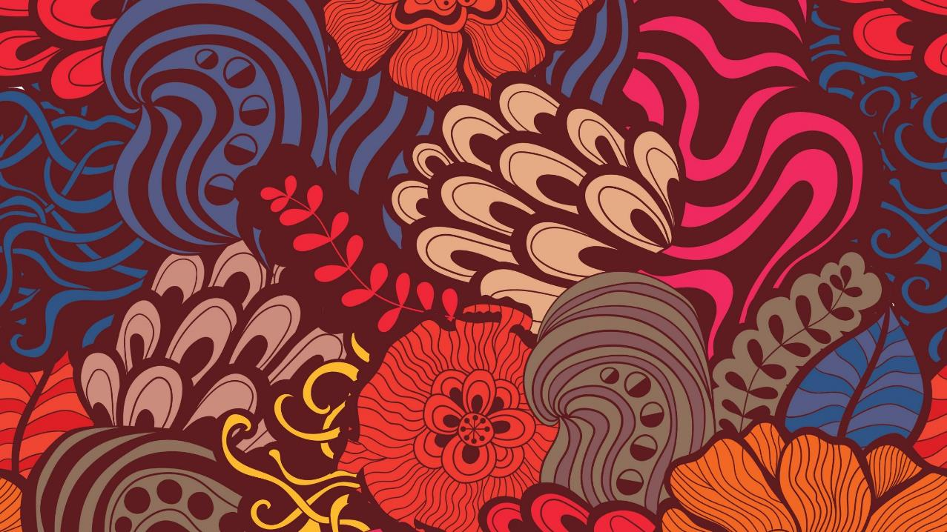
Year 3
ART dAY
Lockdown Inspiration Art

Slide 2
Art
Before we start art is about what the artist feels and thinks when they are creating their art.
We all have different opinions on what ‘looks good’.
Art is personal to you.
Art is a brilliant way to express your feelings.
There are different types of art that I will show you on the new few slides.

Slide 3
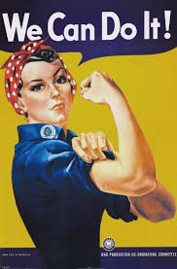
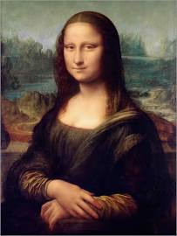
Mona Lisa painted by Leonardo Da Vinci
1503
Figurative Art
World War 2 Propaganda poster

Slide 4
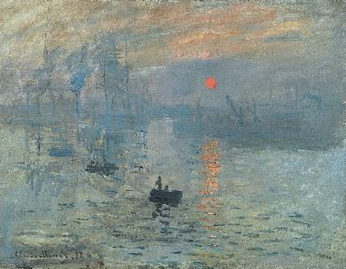
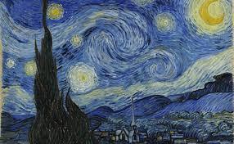
Impressionist art and post-impressionist art
Post-impressionism – vivid colours
Vincent Van Gogh – used big swirling brush strokes to show his emotions.
Starry night - 1889
Impressionism – small brushstrokes, muted palet of colours
Claude Monet
Impression, sunrise
1872

Slide 5
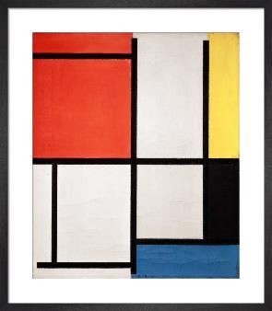
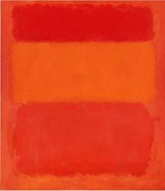
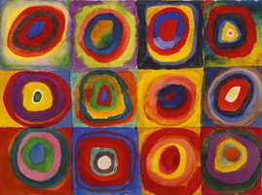
Abstract art
Wassily Kandinksy
Colour Study 960W
1913
Piet Mondrian
Composition
1921
Mark Rothko
Red Orange Yellow
1956

Slide 6
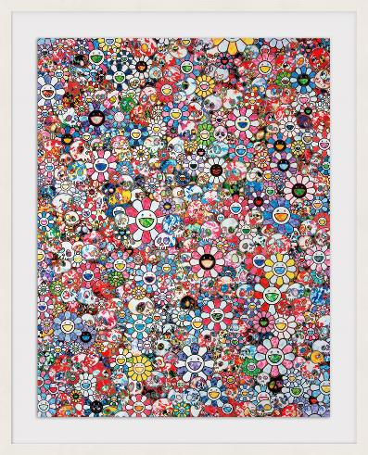
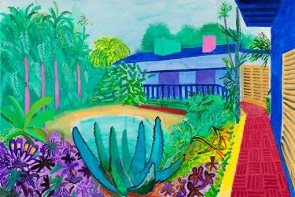
Contemporary
David Hockney
Garden
2015
Takashi Yurakami
Infinity
2020

Slide 7
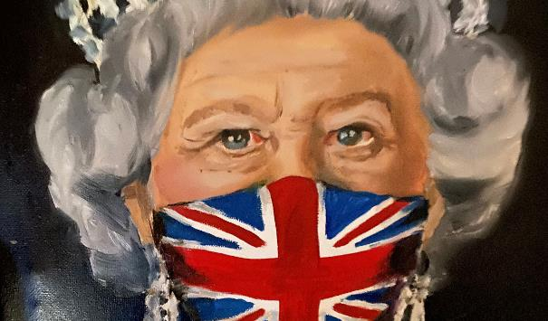
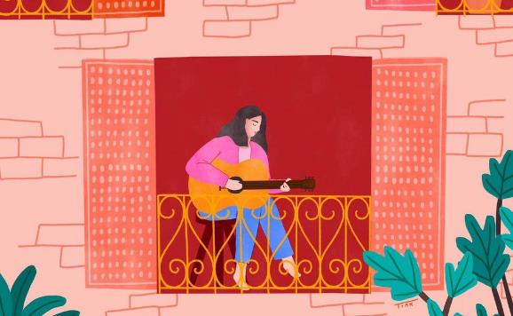
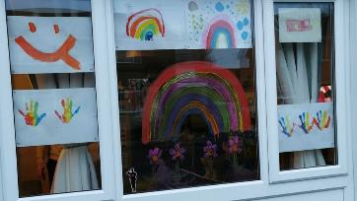
Art created in the last year

Slide 8
Your turn……
Think about your feelings and emotions to do with these unusual/extraordinary times and create a piece of art to reflect those emotions.
You have a template with 150mm x 150 mm square to plan and create your art on.
Session one: plan your piece of art, using sketching to plan (as we would in your school art lessons)
Session two: create your piece of art using any colour you like, any medium (paint, pens, collage) that you like.

Slide 9
These pieces of art may inspire you….

Slide 10
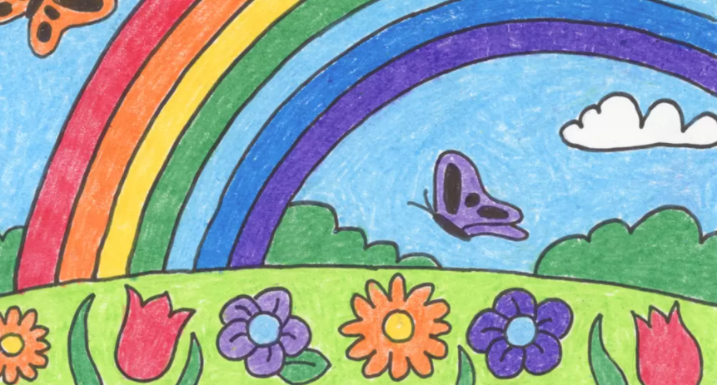

Slide 11
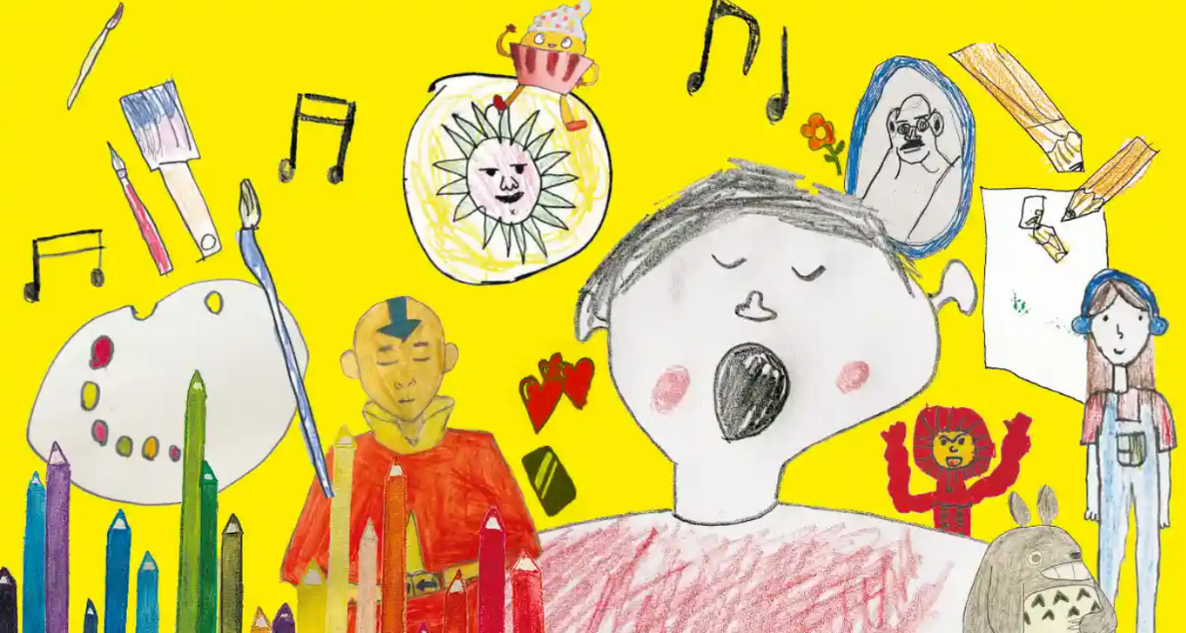

Slide 12
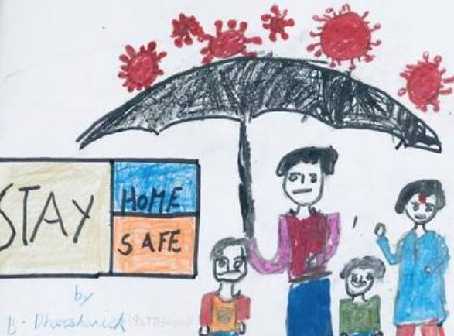

Slide 13
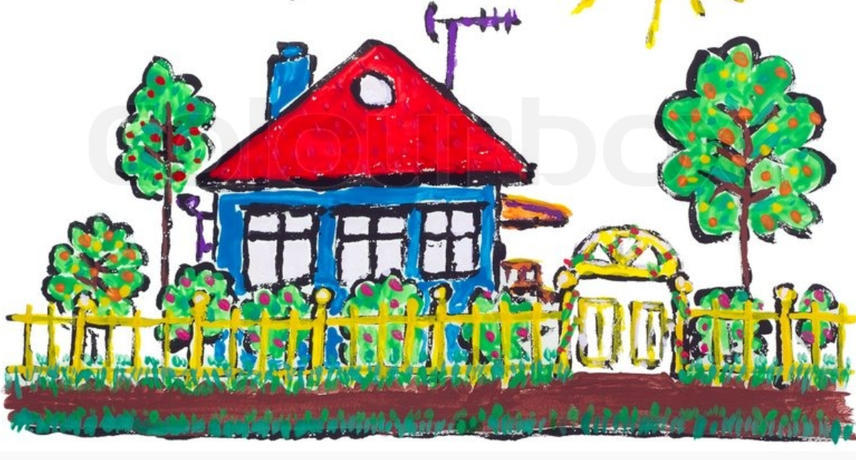

Slide 14
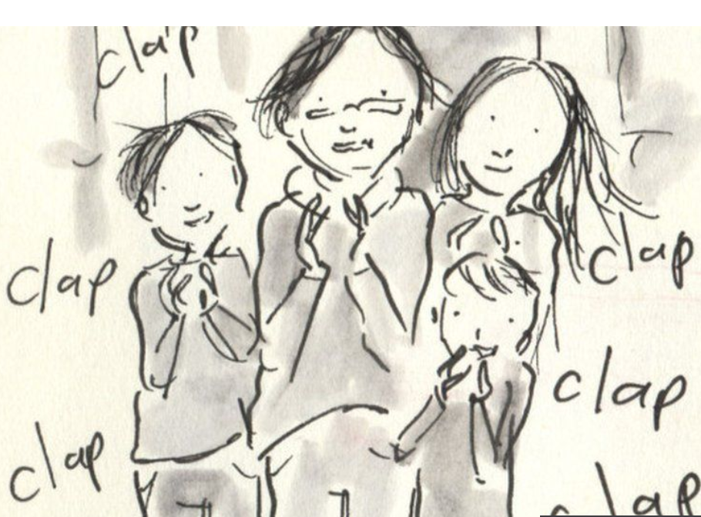

Slide 15
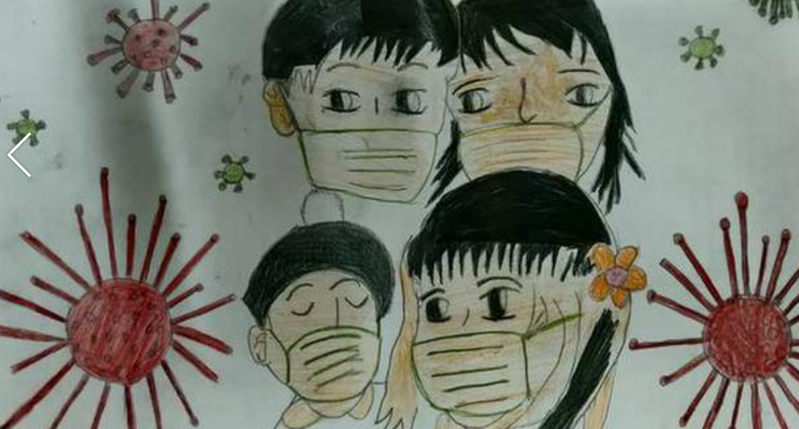

Slide 16
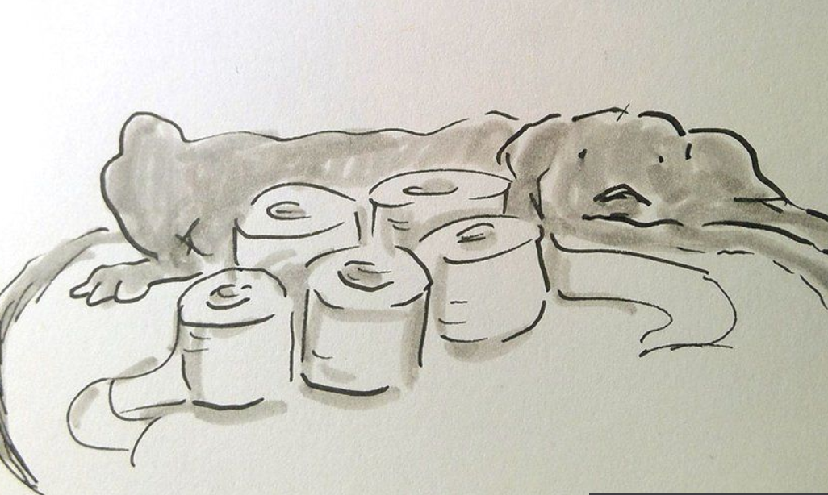

Slide 17
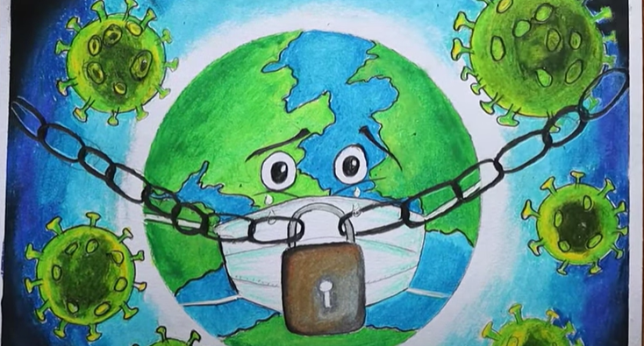

Slide 18
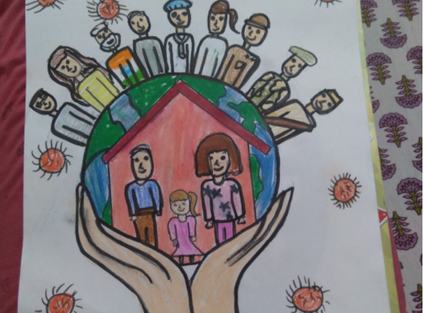

Slide 19
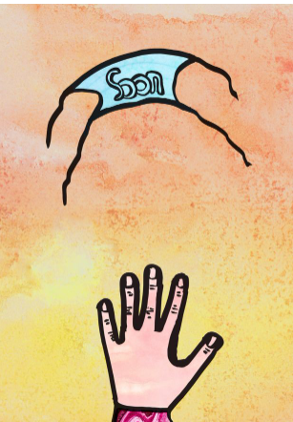

Slide 20
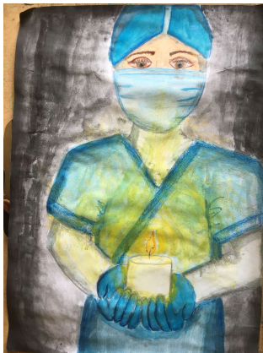

Slide 21
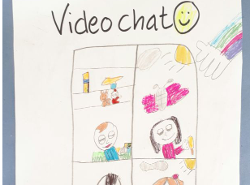

Slide 22
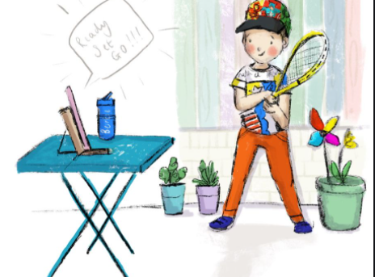

Slide 23


