Slide 1
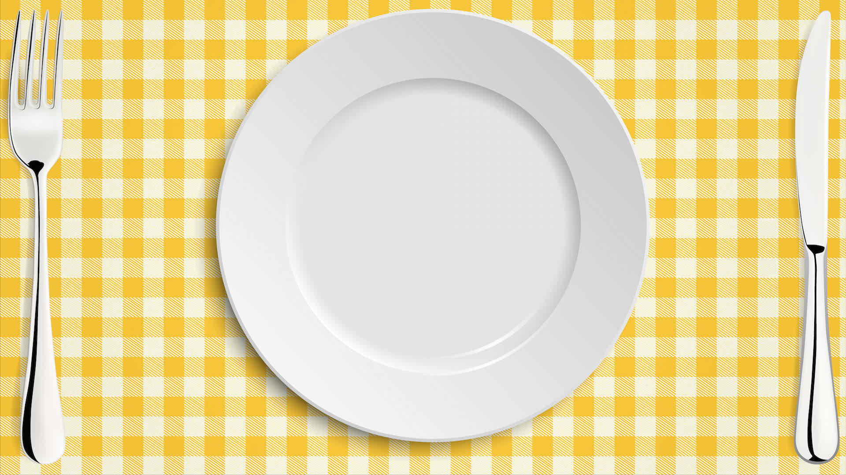



Seasonal Food
Learning Objective:
To know how fish are caught or reared, processed and used in healthy meals.
NEXT
www.planbee.com

Slide 2
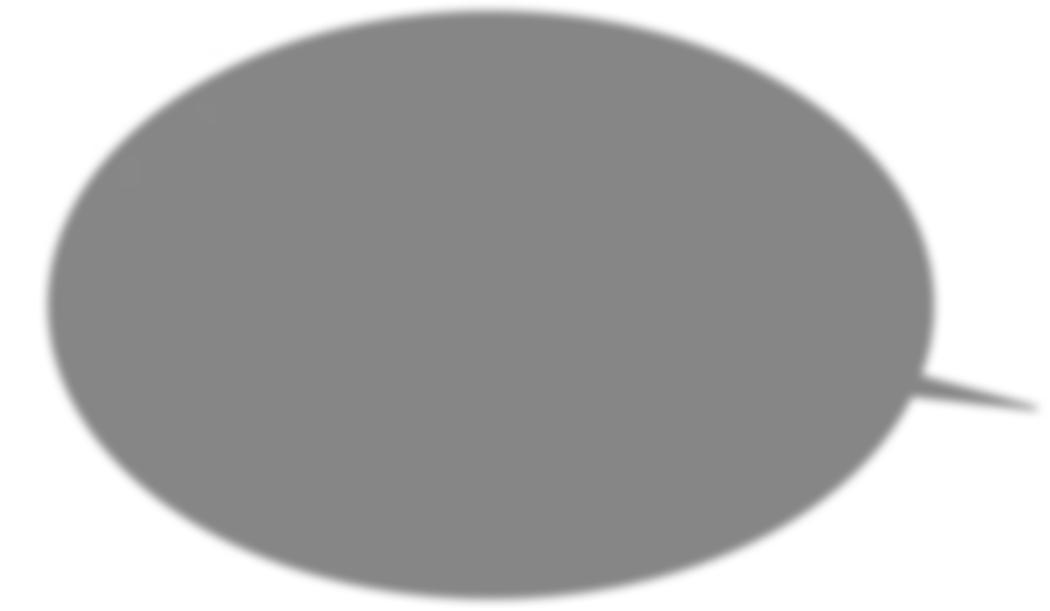
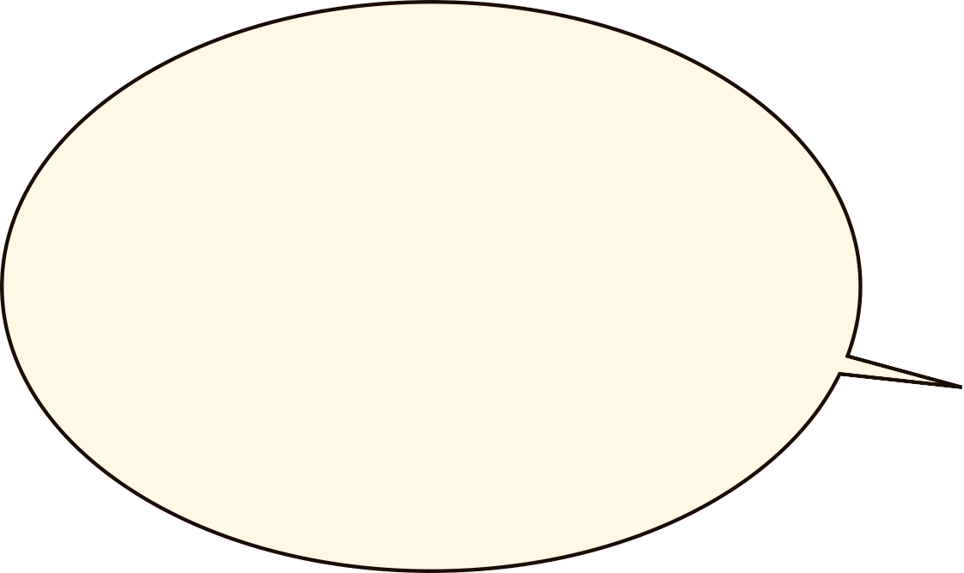

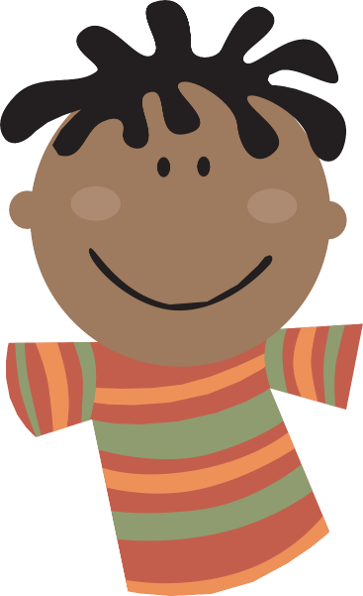
Where does the fish we eat in Britain come from?
BACK
NEXT
www.planbee.com

Slide 3


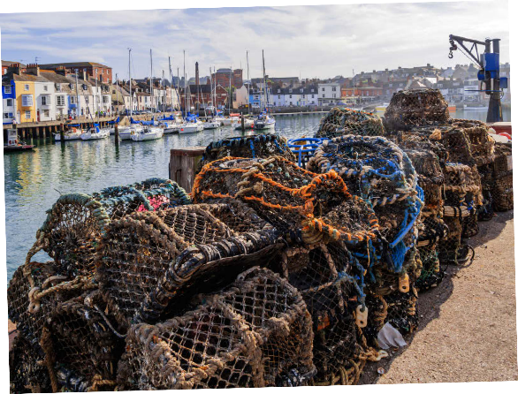
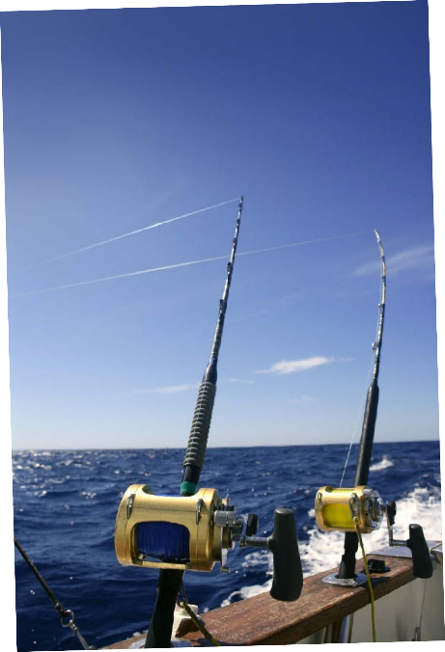

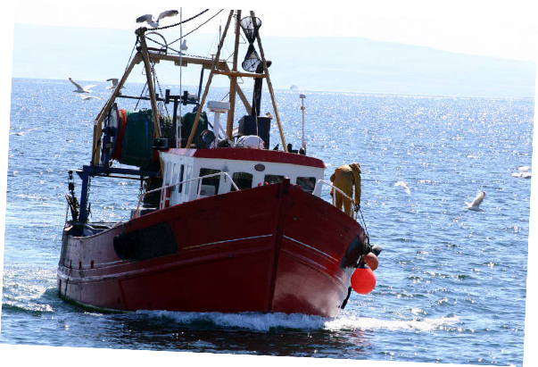
Lots of the fish we eat are caught at sea around the coast of Britain. Some are caught using rods and lines, some with huge nets dragged behind trawlers.
Some seafood such as crabs and lobsters are caught in ‘lobster pots’, which sit at the bottom of shallow sea water.
Some fish is caught in other parts of the world and imported into Britain. Fishing at sea is very hard and dangerous work.
BACK
NEXT
www.planbee.com

Slide 4


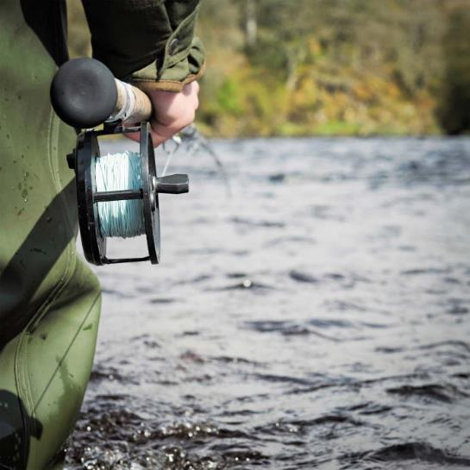
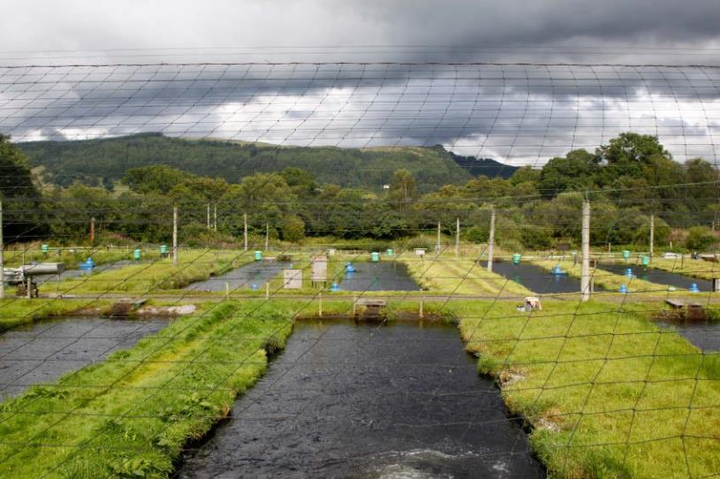

Fresh water fish such as trout and salmon are caught in rivers, lakes and streams around Britain. Lots of fish are farmed, too. The picture on the right is of a trout farm in Scotland. The nets are to stop birds taking the fish!
BACK
NEXT
www.planbee.com

Slide 5


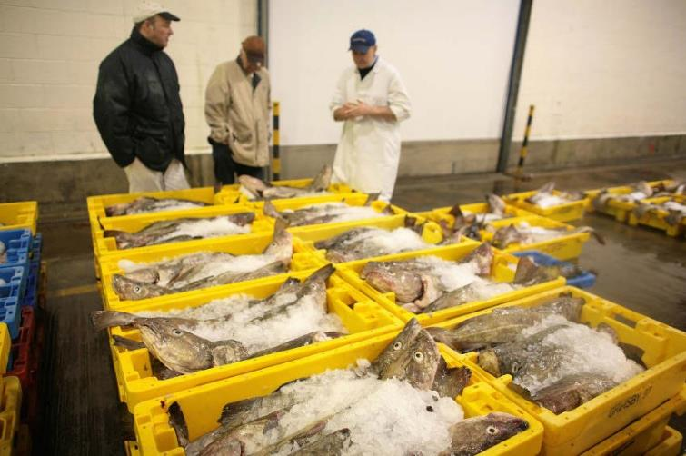


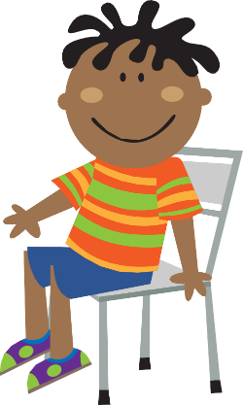
The fish is boxed in ice to keep it fresh and sold at fish markets.
From there, the fish goes to shops and supermarkets, or to factories where it is processed into other food products or tinned.
Not all fishing is done in a way which is good for the fish, the environment and us. Do you know some of the problems caused by fishing?
BACK
NEXT
www.planbee.com

Slide 6







Did you think of these problems?
Some areas are overfished. This means that the fish stocks do not have time to recover. There are fewer fish over time. What might happen eventually?
Fishing with nets can damage the sea bed. Lots of animals live on the sea bed. When the nets are dragged along, their habitat is damaged.
Lots of fish which are too small, or not normally eaten, get caught in fishing nets. Lots of these fish are wasted.
Endangered animals such as turtles can get caught and injured by nets.
BACK
NEXT
www.planbee.com

