Slide 1









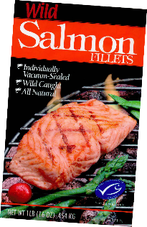


Do you know what to look for when buying fish?
These organisations work with food producers to improve the standard of farming and fishing methods as well as the welfare of animals.
Lots of foods, including fish, will have these labels on their packaging. Look out for them when you go shopping! The Marine Stewardship Council award some fish producers with their logo, which shows that the fish was produced sustainably - not overfished or in a way that is very harmful to the environment.
BACK
NEXT
www.planbee.com

Slide 2



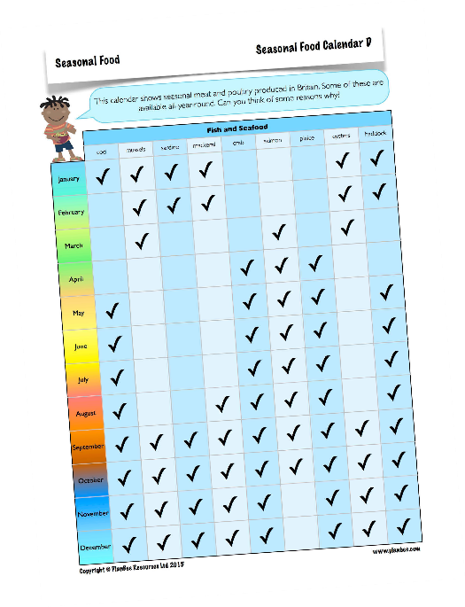


Lets look at the food calendar. What do you notice about some of the fish and seafood. Why do you think some are only available at certain times of year.
BACK
NEXT
www.planbee.com

Slide 3




Fish and Seafood Seasonality
Fish need time to breed - if they are caught during their breeding season, stocks don’t have time to recover.
Many fish have an annual breeding pattern.The young, growing fish are too small to eat.
Did you think of these?
Lots of seafood are smaller after their breeding season because
of travelling long distances or producing offspring.They need time to recover and grow.
You need a license to catch many fish such as wild salmon.The
licenses stop fish being caught all-year-round, giving stocks
time to recover.
BACK
NEXT
www.planbee.com

Slide 4





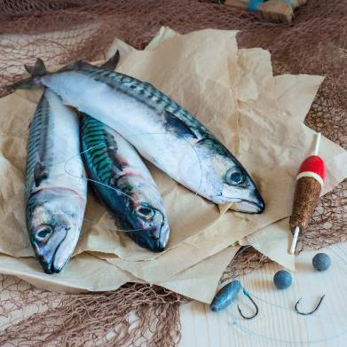











Fish have lots of nutrients which are important for a healthy diet.
Mackerel contain calcium which helps strengthen our bones, and protein which helps build muscles.
They’re also full of vitamins, minerals and fatty acids which keep us healthy.
Vegetarians can get some of these proteins, minerals and some similar fatty acids from eggs, nuts and seeds.
BACK
NEXT
www.planbee.com

Slide 5
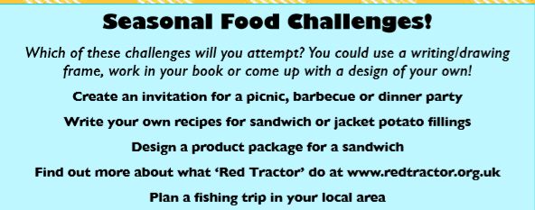


BACK
NEXT
www.planbee.com

Slide 6


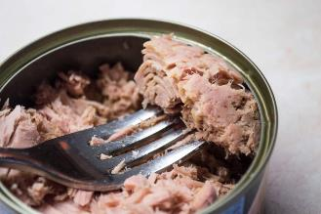


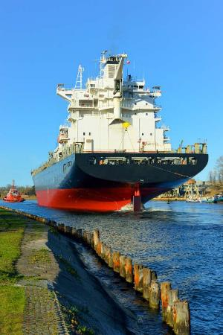
PLENARY
Lots of fish and seafood are available all year round thanks to tinning and freezing.
Canned fish are cooked, then covered in oil or brine (salt water) and sealed.
Canned fish can stay fresh for years!
Some fish, such as tuna or halibut, may be processed and frozen before they reach land! On huge ‘factory ships’ the fish are prepared, boxed, frozen and stored in enormous freezers below deck.
BACK
www.planbee.com

