Slide 1
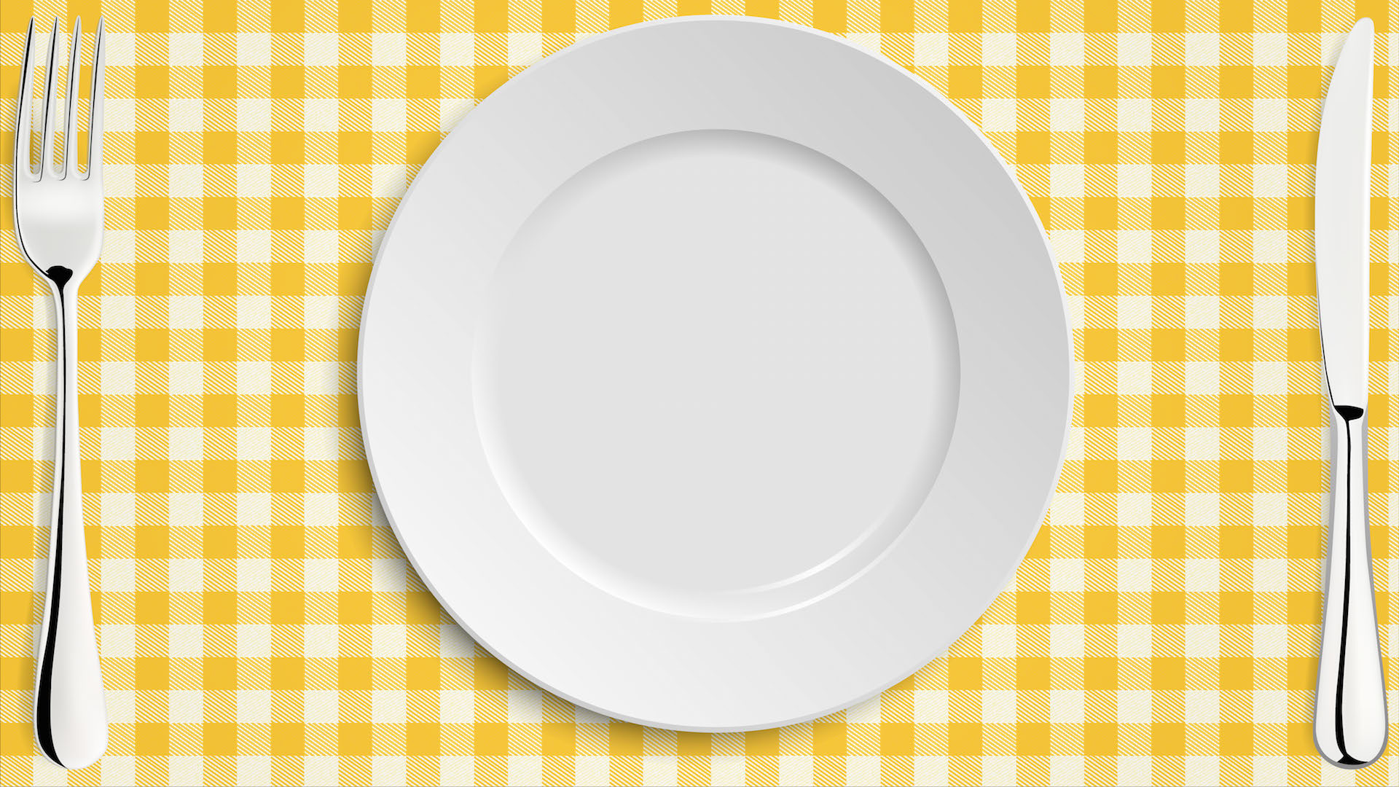



Seasonal Food
Learning Objective:
To find out about how seasonally produced meat can form part of a healthy diet.
NEXT
www.planbee.com

Slide 2






Meat and other products from animals forms an important parts of many peoples diet.
Can you think of some foods we eat that come from animals?
BACK
NEXT
www.planbee.com

Slide 3



Food products from animals
BACK
NEXT
www.planbee.com

Slide 4



They are lots of nutrients in food products from animal's that we need to stay healthy.
What's in these foods that's good for us?
Do you know what any of these nutrients are called?
BACK
NEXT
www.planbee.com

Slide 5



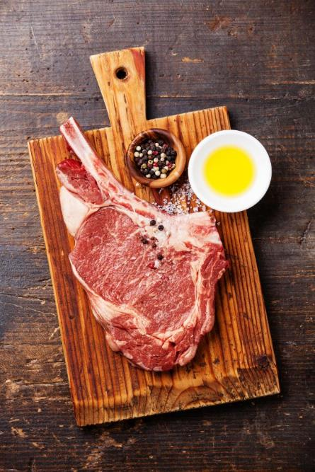
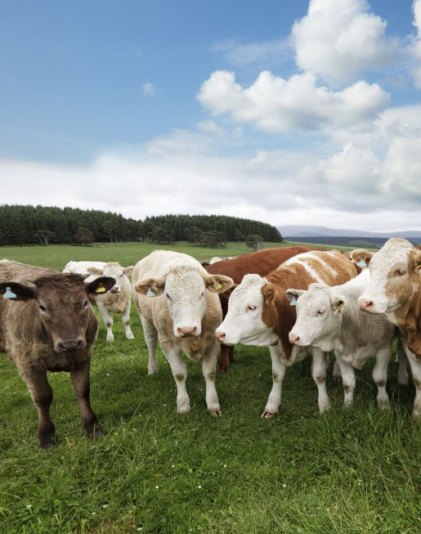
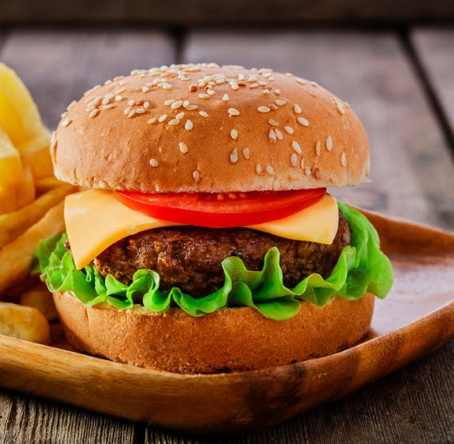





Beef is rich in iron, which is used in our body in lots of different ways.
It also contains protein, which our bodies need to build and repair muscles.
There are lots of other good vitamins and minerals in beef, too!
BACK
NEXT
www.planbee.com

Slide 6



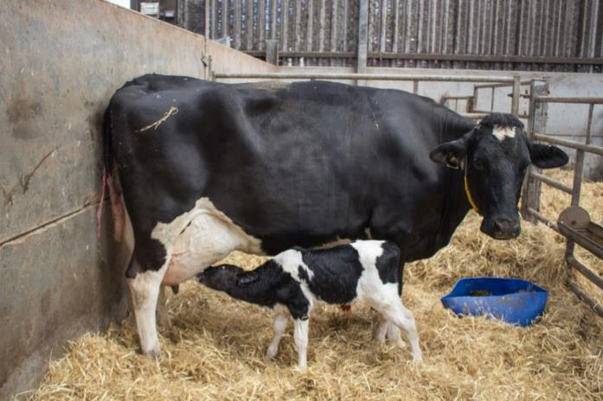
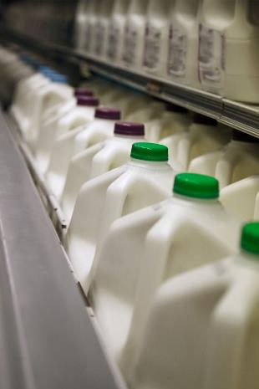
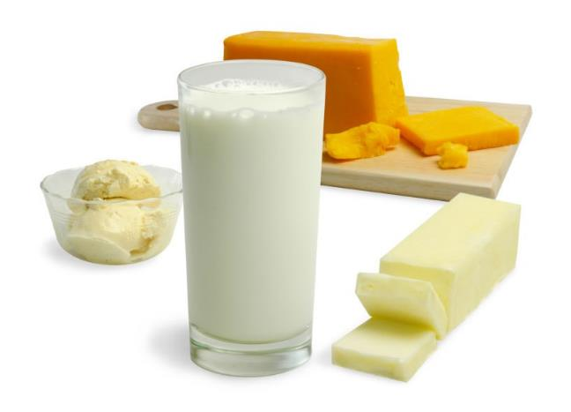


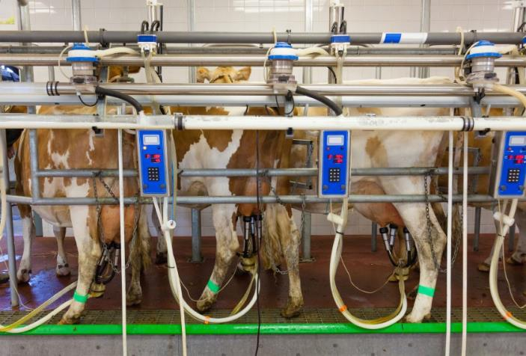






Milk and cheese are full of calcium, which we need for strong, healthy bones.
It also contains some riboflavin and phosphorus, which are helpful for turning food into energy.
BACK
NEXT
www.planbee.com

