Slide 1



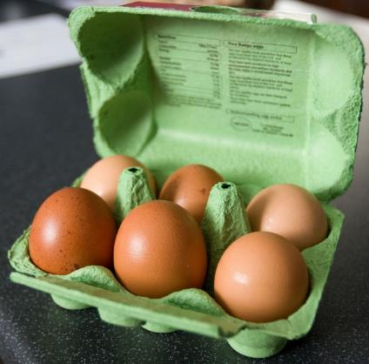
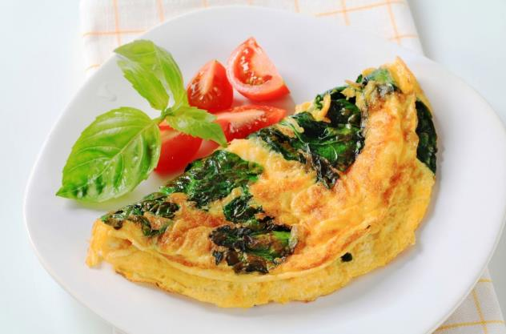









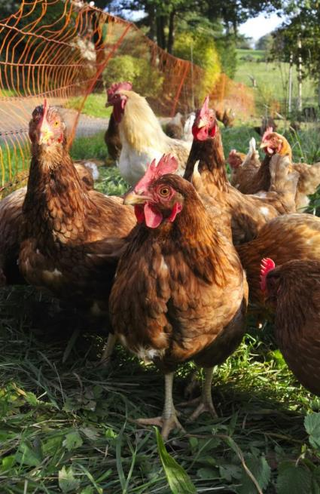










It’s better for the chickens if we all buy free range eggs: The chickens can go outside and they have more room to move around.
It’s amazing how many different nutrients are inside an egg!
Eggs have lots of protein in them.
They also contain vitamin A, vitamin D and lots of B vitamins.
BACK
NEXT
www.planbee.com

Slide 2


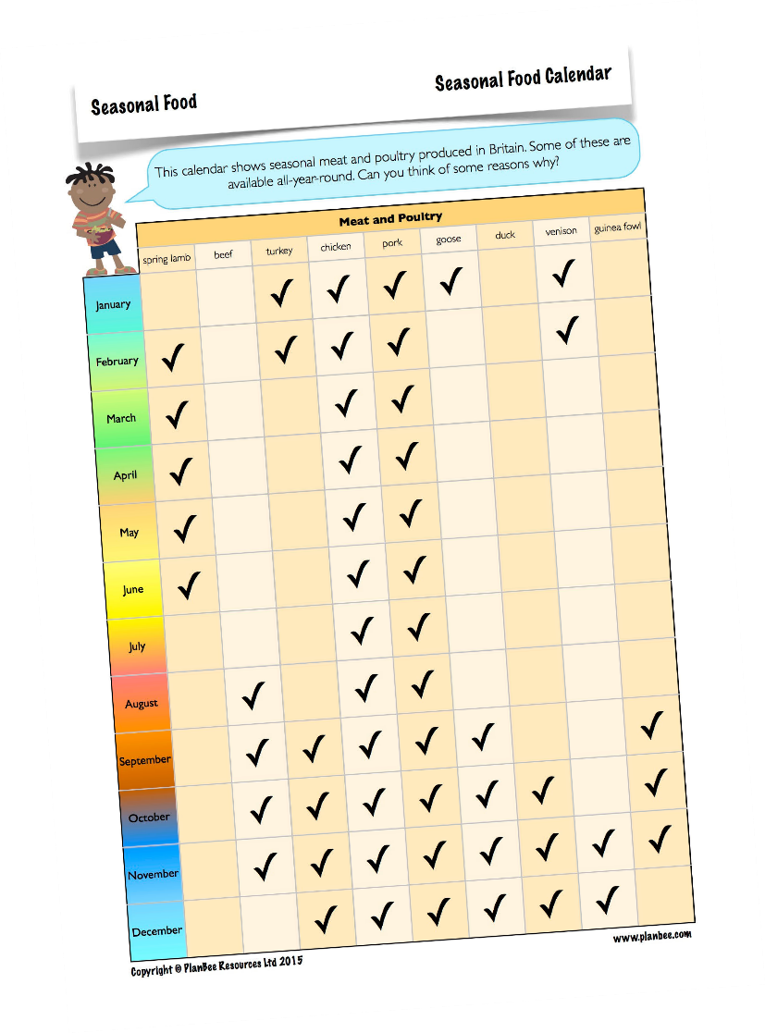


Let’s look at our food calendar.
Some meats are only in season in Britain certain times of the year.
Chicken and pork are in season all year round.
Why do you think this is?
BACK
NEXT
www.planbee.com

Slide 3


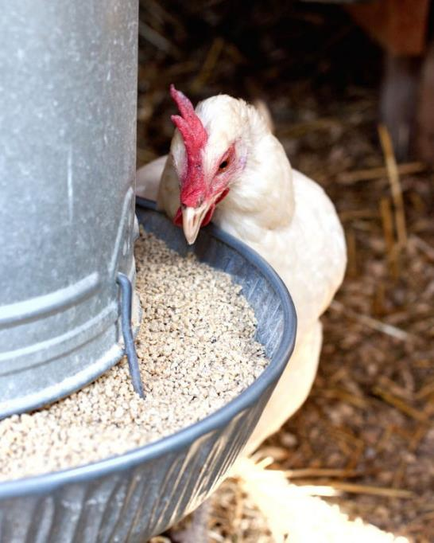





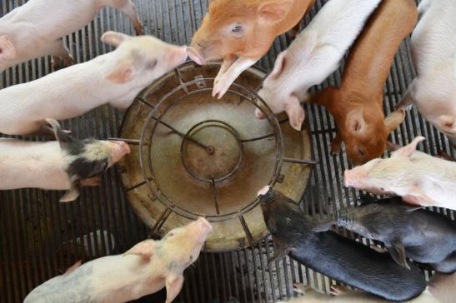

Chickens eat feed (a mix of grains and seeds) which is available all-year-round.
Chickens do not need as much space as other, larger animals. They grow to their full, adult size
quickly, too. This means that farmers can rear and slaughter lots of chickens throughout the year.
Unlike sheep or cattle, pigs do not necessarily need to graze on grass in large fields (although pigs raised outdoors will forage for food).
They eat a type of feed that is available all-year- round. They can be reared and slaughtered at any time of year.
BACK
NEXT
www.planbee.com

Slide 4



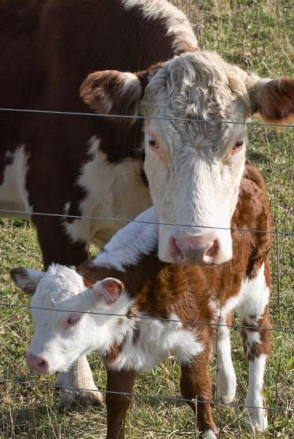
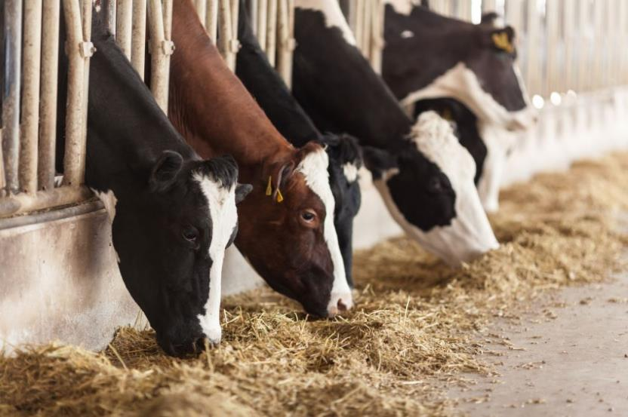














It can take up to 2 ¹/2 years to
produce beef cattle
ready for slaughter. Because of this, and the fact that young calves usually need to graze outside, top-quality beef is at its best for a few months of the year*.
*Some farmers use different rearing and feeding methods to bring us fresh beef
all year round.
Meat from animals that graze on grass is different. Most cattle need to graze on grass outside when they are weaning their calves. Because the grass is only good in the warmer months, cattle must be kept indoors and fed dry grass and feed for some of the year.
BACK
NEXT
www.planbee.com

Slide 5

Animal products are a part of many peoples diets but not everyone’s. I would like you to write down a recipe including a meat product such as spaghetti bolognaise where you would use beef mince. Then think of a vegetarian alternative for example replace the beef mice with mushrooms. You will find a list of alternative ingredients on the next slide.
BACK
NEXT
www.planbee.com

Slide 6
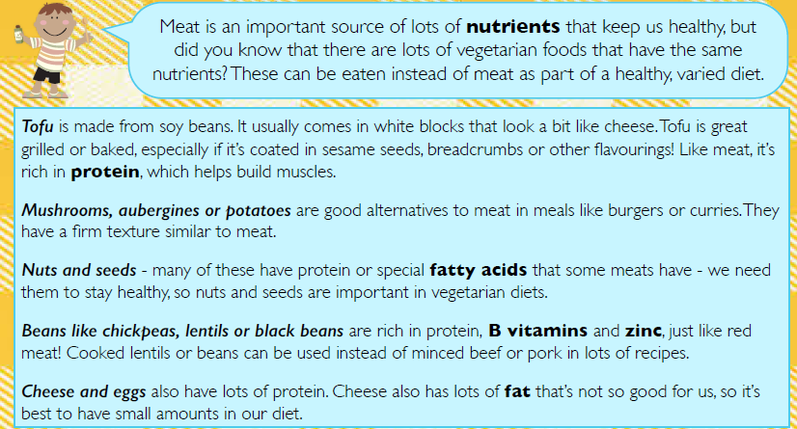

Slide 7


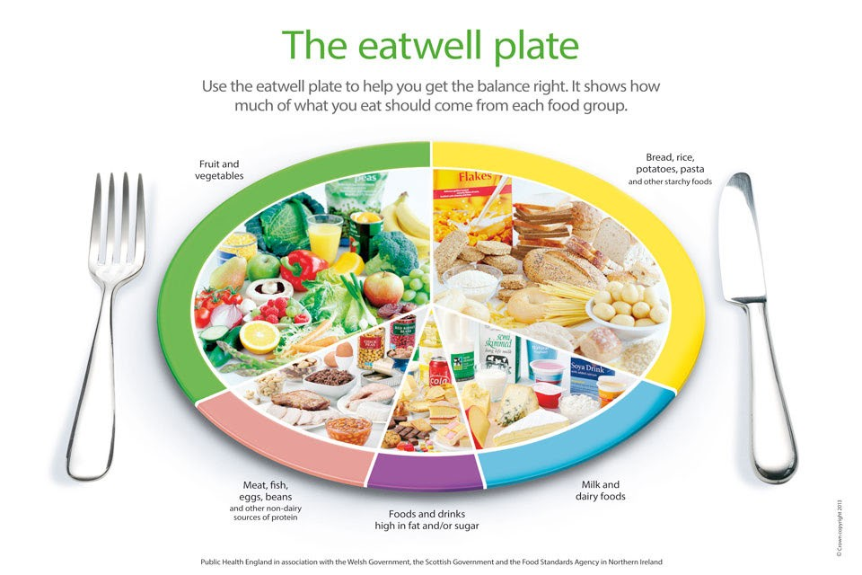
PLENARY
The eatwell plate is a guideline to help you have a healthy diet.
What is the difference between a guideline and a rule or instruction?
BACK
www.planbee.com

