Slide 1


Slide 2
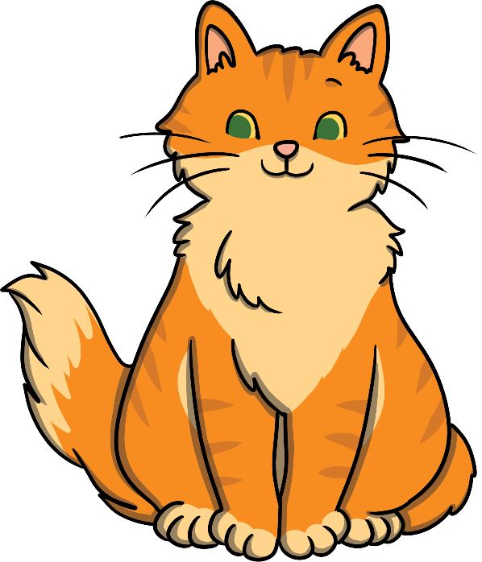
What order should the letters be in?
a
Click on the letters to spell the word
t
c
Next Slide

Slide 3

What order should the letters be in?
f
Click on the letters to spell the word
n
a
Next Slide

Slide 4

What order should the letters be in?
a
Click on the letters to spell the word
t
h
Next Slide

Slide 5
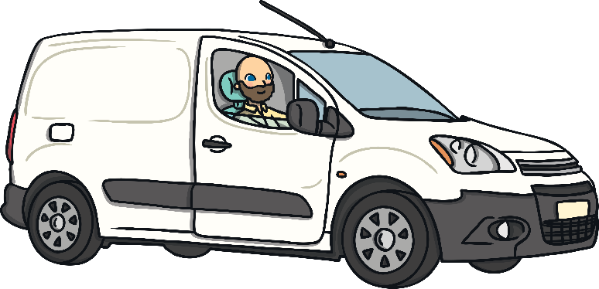
What order should the letters be in?
n
Click on the letters to spell the word
a
v
Next Slide

Slide 6
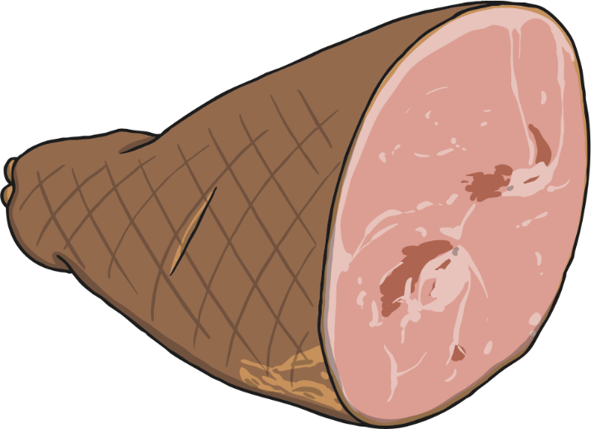
What order should the letters be in?
h
Click on the letters to spell the word
m
a
Next Slide

Slide 7
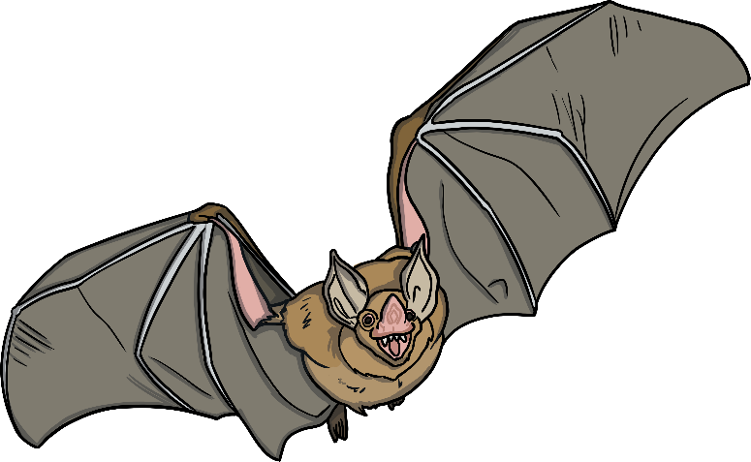
What order should the letters be in?
a
Click on the letters to spell the word
t
b
Next Slide

Slide 8
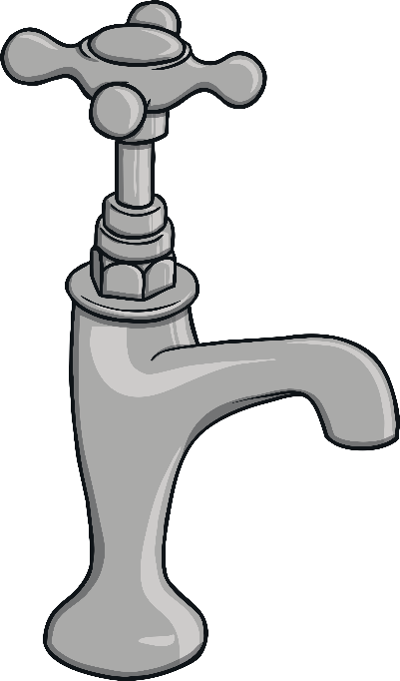
What order should the letters be in?
a
Click on the letters to spell the word
t
p
Next Slide

Slide 9
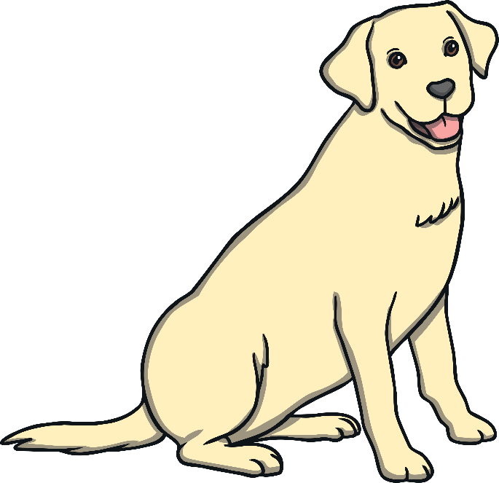
What order should the letters be in?
o
Click on the letters to spell the word
g
d
Next Slide

Slide 10
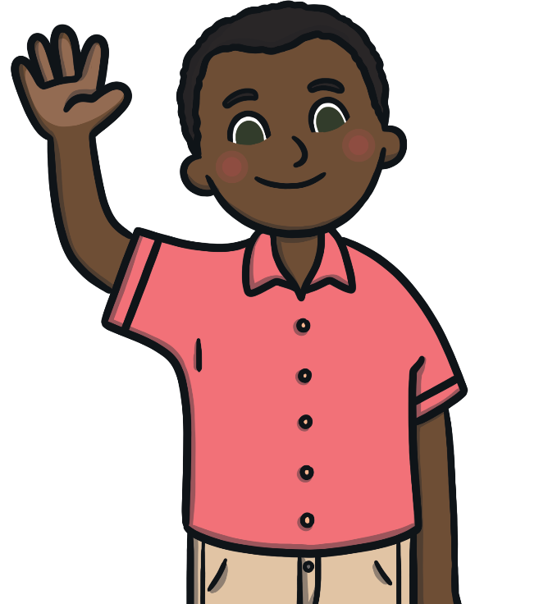
What order should the letters be in?
m
Click on the letters to spell the word
n
a
Next Slide

Slide 11
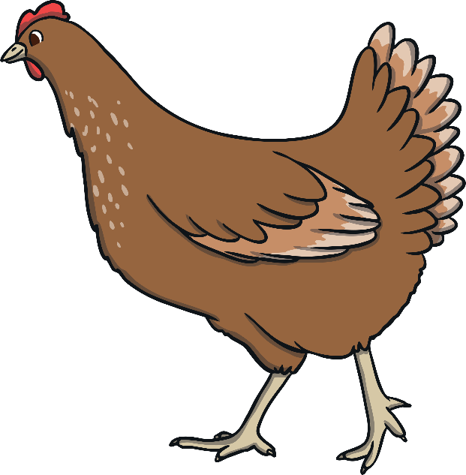
What order should the letters be in?
n
Click on the letters to spell the word
h
e
Next Slide

Slide 12
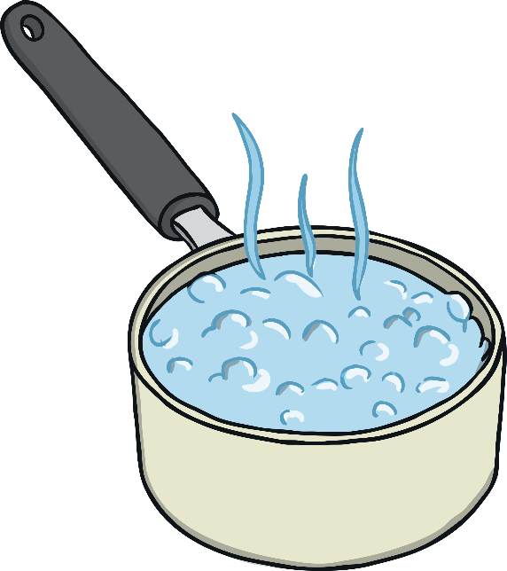
What order should the letters be in?
a
Click on the letters to spell the word
n
p
Next Slide

