Slide 1
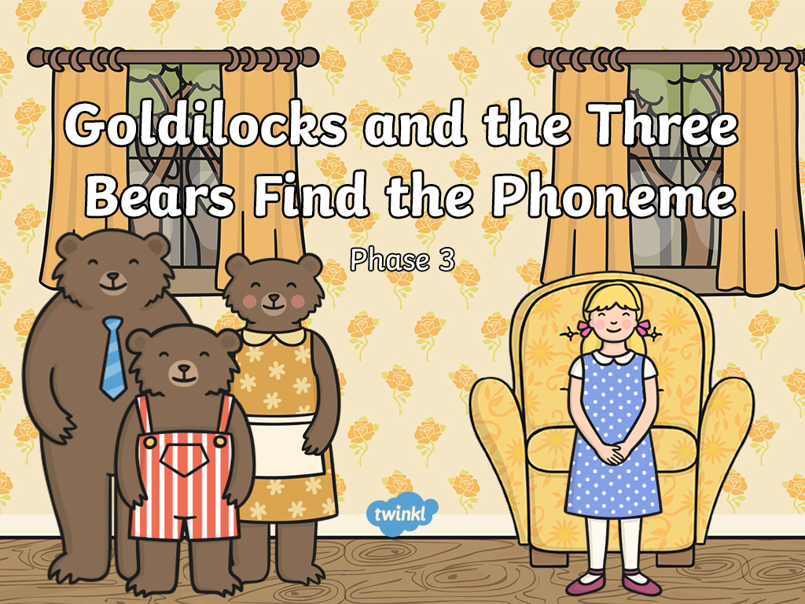


Slide 2
Oh no! Goldilocks has dropped
porridge on lots of things in our house. Can you help us clean up all of the spilt porridge?
Look at the picture and work out which phoneme has been covered in porridge. Choose the correct phoneme to complete the word.

Slide 3
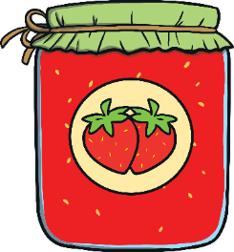
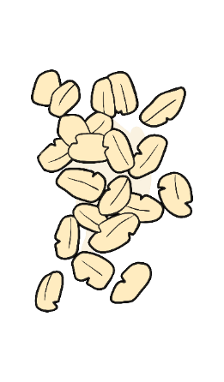


j
a
m
Try again.
Correct!
Which phoneme is hidden by the porridge?
t
j
k
next

Slide 4

v
a
n
Try again.
Correct!
Which phoneme is hidden by the porridge?
v
s
l
next

Slide 5

b
o
x
Try again.
Correct!
Which phoneme is hidden by the porridge?
r
n
x
next

Slide 6
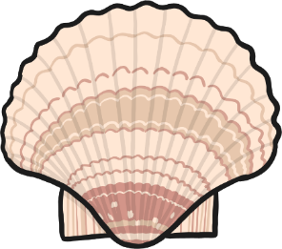
sh
e
ll
Try again.
Correct!
Which phoneme is hidden by the porridge?
c
sh
m
next

Slide 7

b
oa
t
Try again.
Correct!
Which phoneme is hidden by the porridge?
ee
ai
oa
next

Slide 8

r
i
ng
Try again.
Correct!
Which phoneme is hidden by the porridge?
t
ng
s
next

Slide 9

c
ar
d
Try again.
Correct!
Which phoneme is hidden by the porridge?
oi
ar
ee
next

Slide 10

b
oo
k
Try again.
Correct!
Which phoneme is hidden by the porridge?
oo
ee
a
next

Slide 11

t
or
ch
Try again.
Correct!
Which phoneme is hidden by the porridge?
oi
ee
or
next

Slide 12
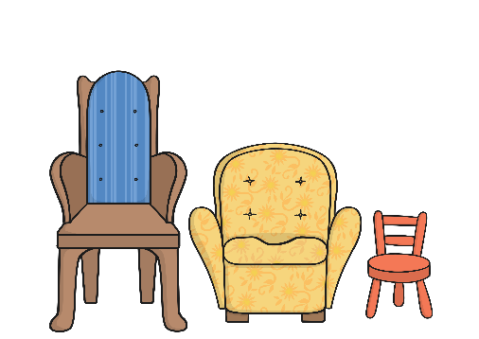
ch
air
s
Try again.
Correct!
Which phoneme is hidden by the porridge?
ee
oo
air
next

Slide 13
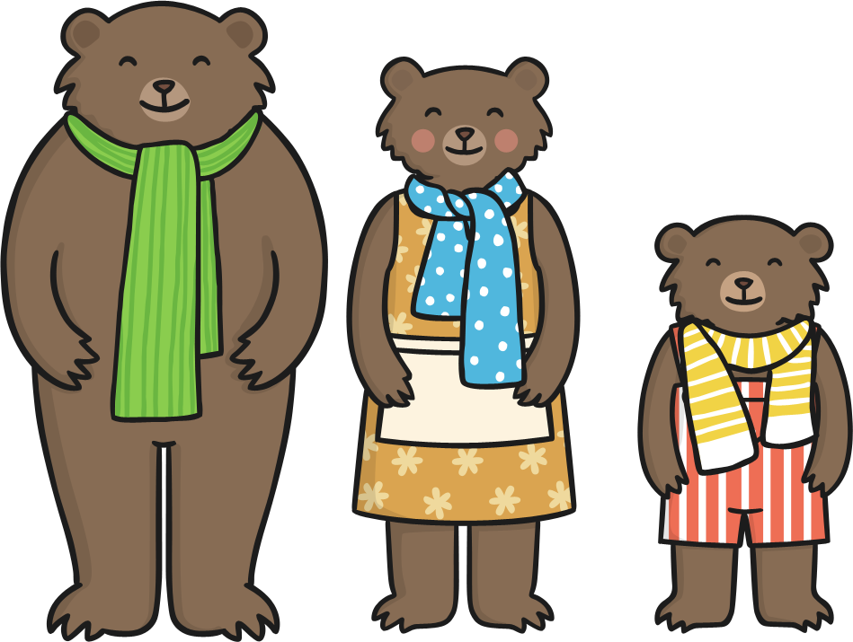
Well done!
You found all the missing phonemes and helped clean up
the porridge.
Click here to
return to the start.

Slide 14


