Slide 1





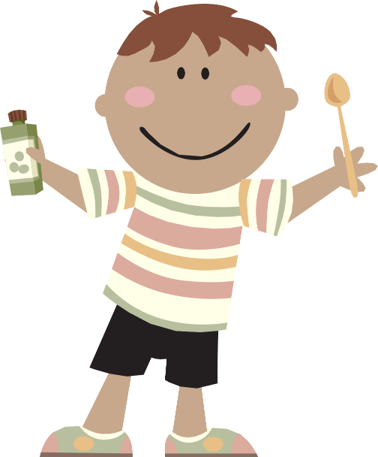
They should form a large piece of your diet. .
Vegetables are important for keeping healthy.
Why?
BACK
NEXT
www.planbee.com

Slide 2

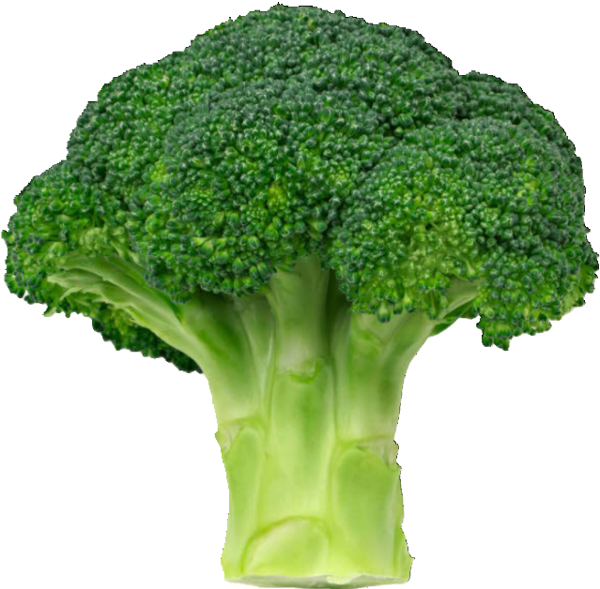
Vegetables are a fantastic source of the good things we need in our diet! Just look at what’s in broccoli; all these things help us stay healthy.
fibre
vitamin K
vitamin C
vitamin A
calcium
folic acid
BACK
NEXT
www.planbee.com

Slide 3


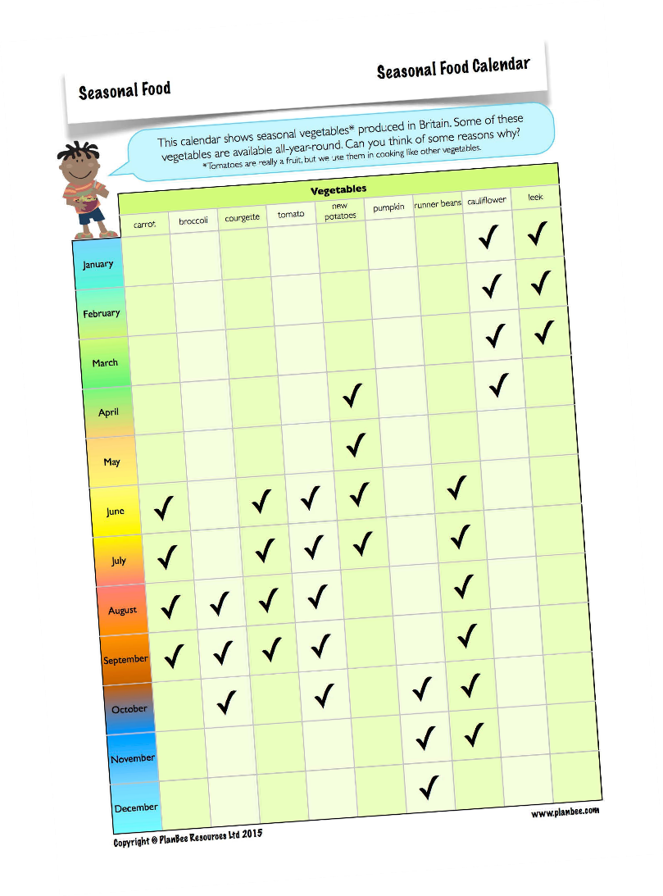

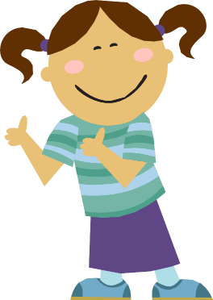
Take a look at the vegetable seasonal food calendar. Which vegetables are currently in season in Britain now?
When are your favourite vegetables in season?
At what time of the year are lots of vegetables in season? Why is this?
BACK
NEXT
www.planbee.com

Slide 4
Vegetables are versatile! They can be eaten raw or cooked, on their own or as ingredients in a meal.
BACK
NEXT
www.planbee.com

Slide 5
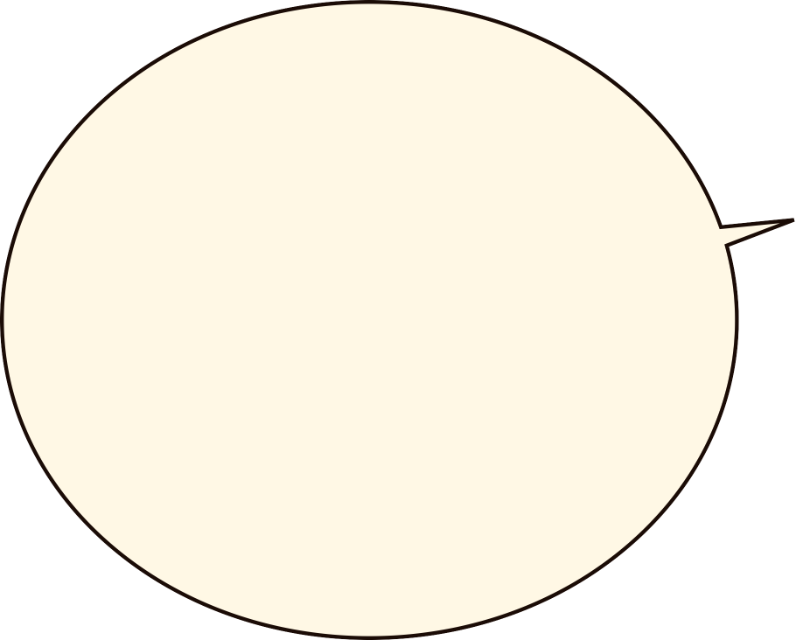


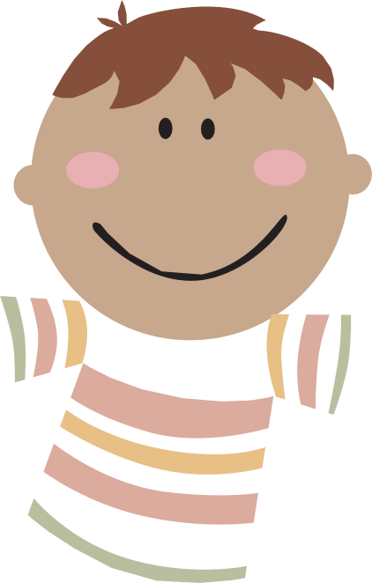

What are you having for dinner tonight? Will it include vegetables? If so perhaps you can ask a parent if you can join in and help.
Todays activity I would like you to make a collage of seasonal vegetables on your chosen season. You can get photos from magazines, newspapers or the internet. If you do not have access to the above then you can make a poster of seasonal vegetables from the season of your choice.
BACK
www.planbee.com

