Slide 1
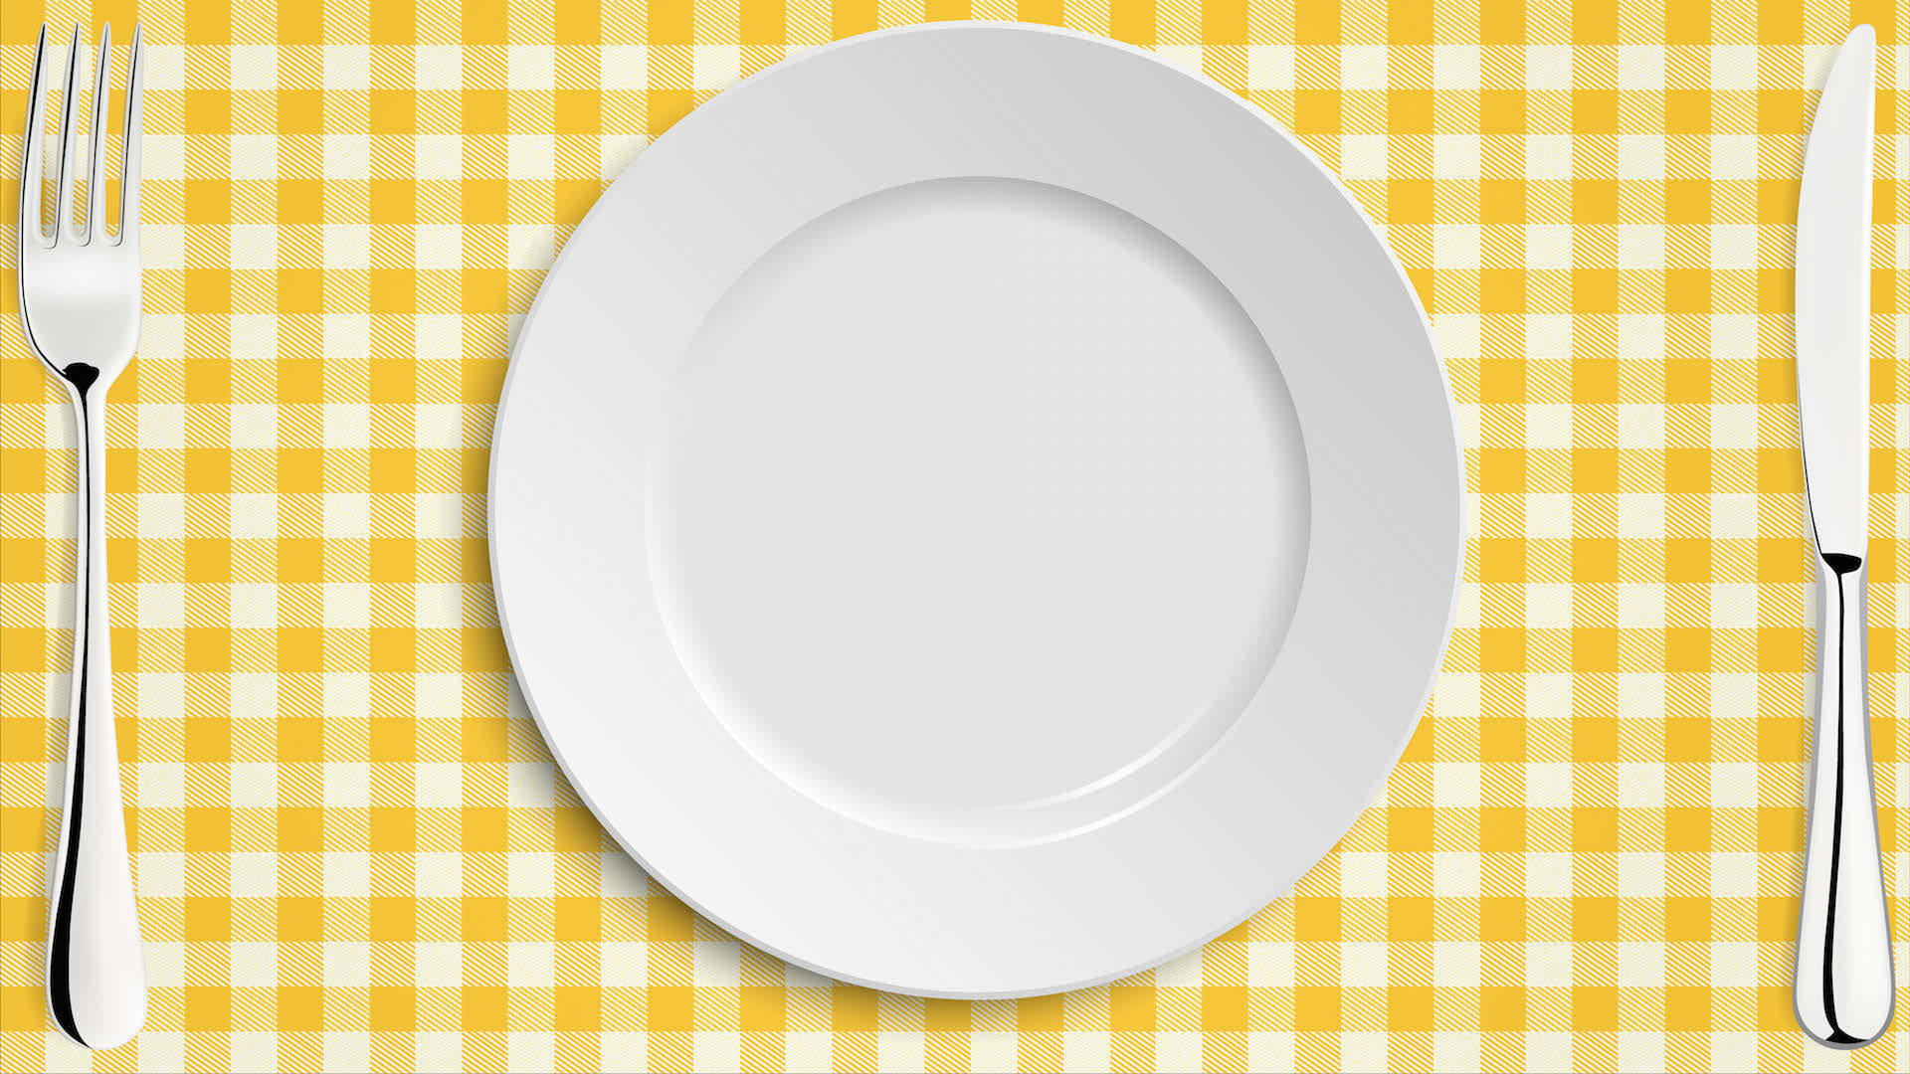



Seasonal Food
Learning Objective: To know where and how seasonal British fruits are
grown and processed.
NEXT
www.planbee.com

Slide 2






Do you remember what ‘seasonal food’ means?
Can you think of words to describe the seasons in Britain?
BACK
NEXT
www.planbee.com

Slide 3



What are the different seasons like in Britain?
Spring
Summer
Winter
Autumn
BACK
NEXT
www.planbee.com

Slide 4



plums oranges
apples
figs
cherries
strawberries
dates
pears
mangoes
watermelons
pineapples
bananas
raspberries
Do you know which of these fruits are grown commercially in Britain?
BACK
NEXT
www.planbee.com

Slide 5







apples
plums
oranges
strawberries
figs
cherries
dates
pears
mangoes
watermelons
pineapples
bananas
raspberries
Did you get any right? The fruits in PURPLE grow well in the British climate and weather conditions.
BACK
NEXT
www.planbee.com

Slide 6






Most of the British fruits are grown in areas where there is the right amount of rain and sunshine, and where it doesn’t get too cold in winter.
Lots of fruit is grown commercially in the counties of Kent, Hertfordshire and Worcestershire. The conditions are just right here!
Fruits such as oranges, dates, figs mangoes and pineapples need much more sunlight and warmth to grow well. These are grown in other parts of the world.
BACK
NEXT
www.planbee.com

Slide 7



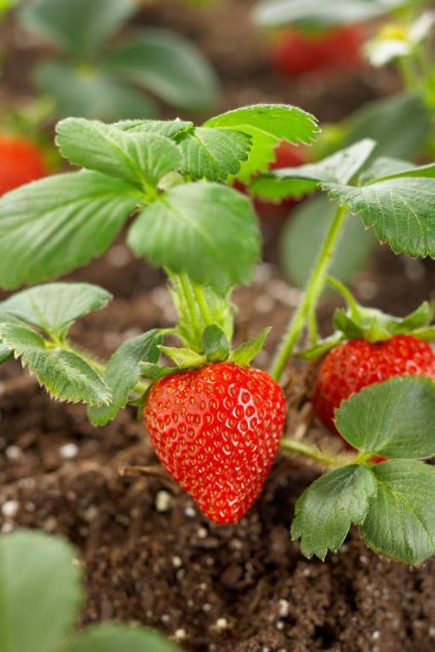
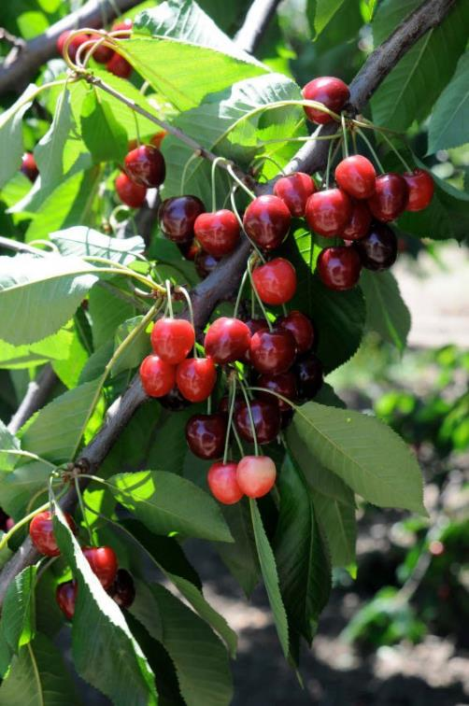








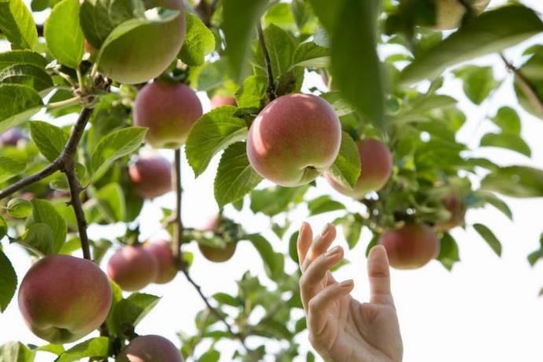


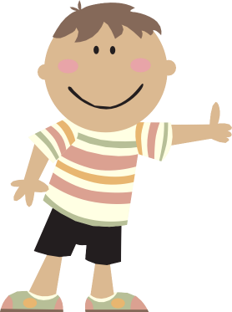

When fruits are ‘in season’, it means that they are at their best.
In which season are these fruits harvested?
Why?
BACK
NEXT
www.planbee.com

