Slide 1
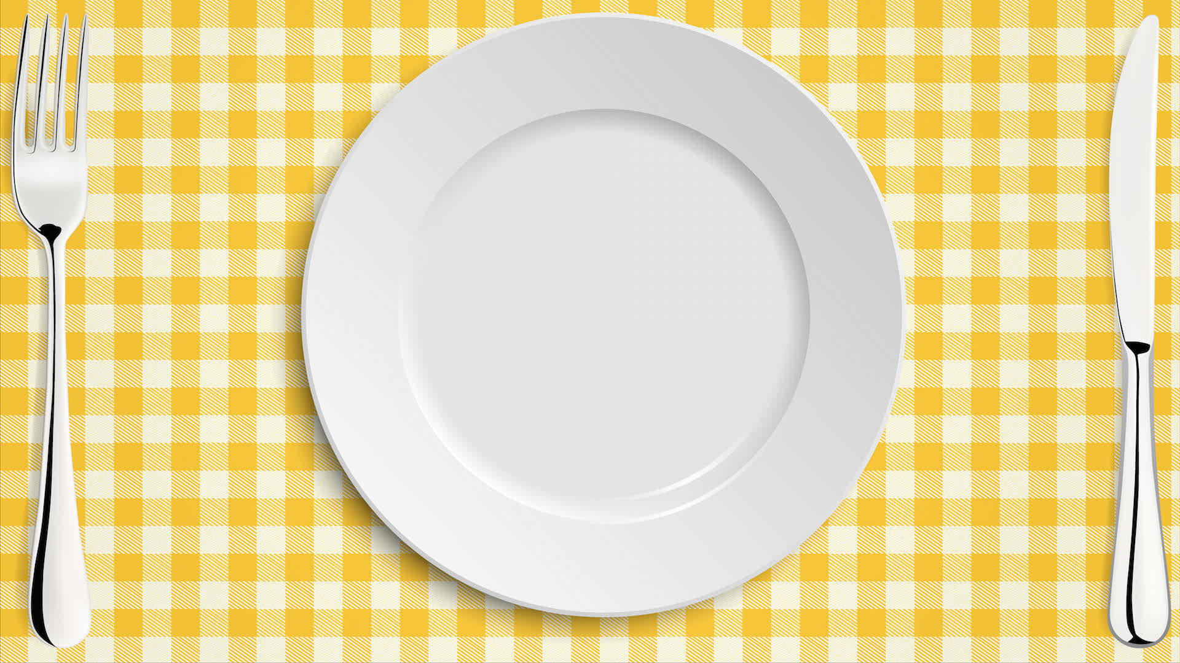



Seasonal Food
NEXT
www.planbee.com

Slide 2
Seasonal Food
Learning Objective: To find British ingredients/foods available all year round.
NEXT
www.planbee.com

Slide 3

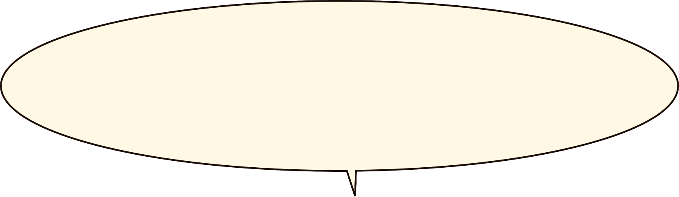


What does Seasonal food mean?
BACK
NEXT
www.planbee.com

Slide 4


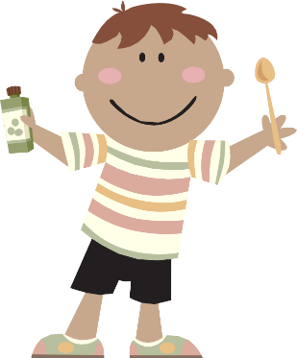



‘Seasonal Food’ is food that is ready and available
at certain times of the year in the area where you
live. Even though we can get lots of food all year
round at a supermarket, they are not necessary
‘seasonal’ in your area.
Seas
Seasonal food is not the same in other parts of the world. Some foods that are in season where you live will not be ready and available in other parts of the world.
BACK
NEXT
www.planbee.com

Slide 5





Britain is in the Northern hemisphere. When it is summer in Britain, it is winter in the Southern hemisphere.
Northern hemisphere
Fruits such as peaches and plums are in season in Britain during the summer months.
At the same time, there are very few places in the Southern hemisphere where these fruits are in season because it is winter.
Southern hemisphere
BACK
NEXT
www.planbee.com

Slide 6







Why are some foods that are not in season in Britain still available in the supermarkets?
Explain or write down your idea.
BACK
NEXT
www.planbee.com

Slide 7





Did you think of these?
Food can be grown ‘out of season’ in greenhouses, where the climate can be controlled
Food that is not in season in Britain can be grown in other countries
Food grown in other countries is imported to Britain and delivered to supermarkets
Can you think of some benefits of out of season foods being available all year round in supermarkets? Can you think of some problems to?
BACK
NEXT
www.planbee.com

