Slide 1



Slide 2


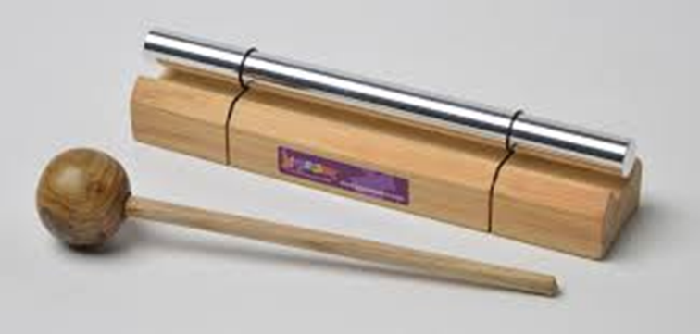

Slide 3
Event Planning
At your opening event for your garden do you also want to raise money for a charity? Maybe a charity linked to the garden such as and what will you plan to raise money.
How will we make this event fun? Can we organise fun activates and charge people and then the money goes to the charity?
Is there anyone special that can open your garden. Perhaps a celebrity?
Will your event have refreshments? Food and drink?
How will you introduce your garden…. “Welcome to ……” Does you garden have a name?
How will you let people know you are having a garden opening? Advertisement on local radio perhaps?
What time and date and how long for?

Slide 4
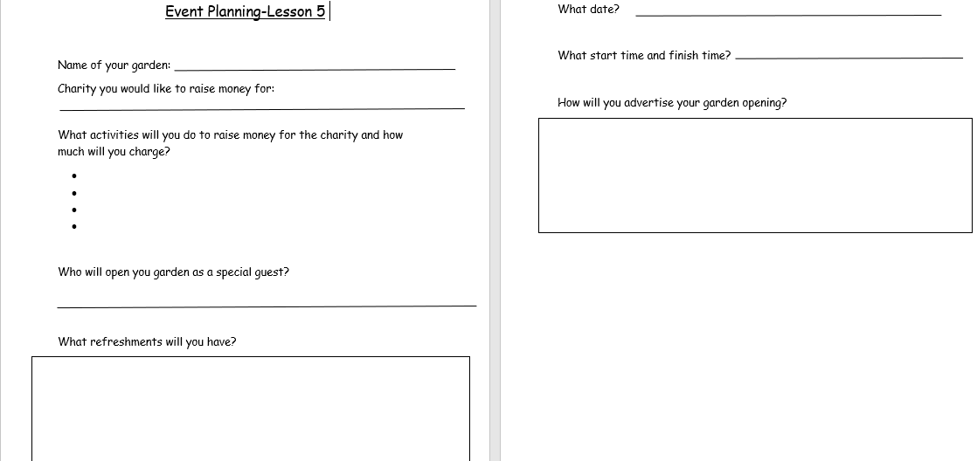

Slide 5



Slide 6


