Slide 1



Slide 2

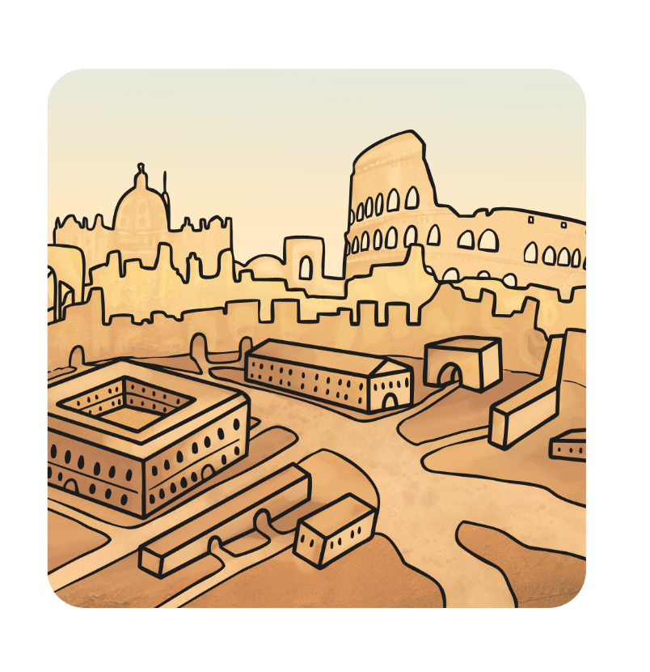
Saint Valentine was a priest who lived a long, long time ago in Rome.

Slide 3
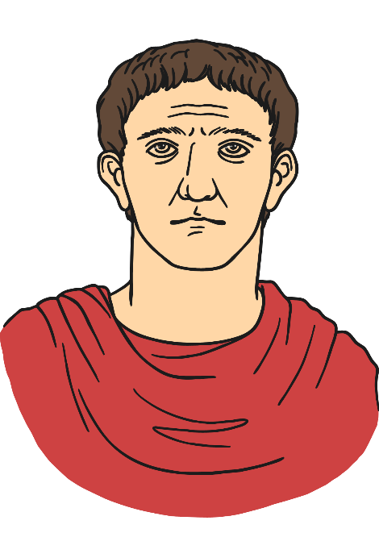
At the time Rome was ruled by an emperor called Claudius.

Slide 4
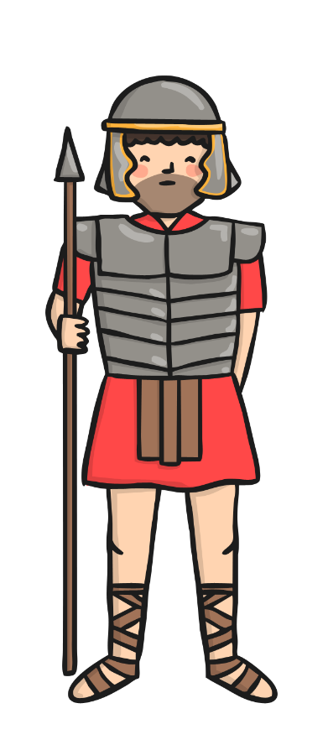
Claudius was angry because nobody wanted to join his army.
All of the men wanted to stay at home with their wives and children.

Slide 5
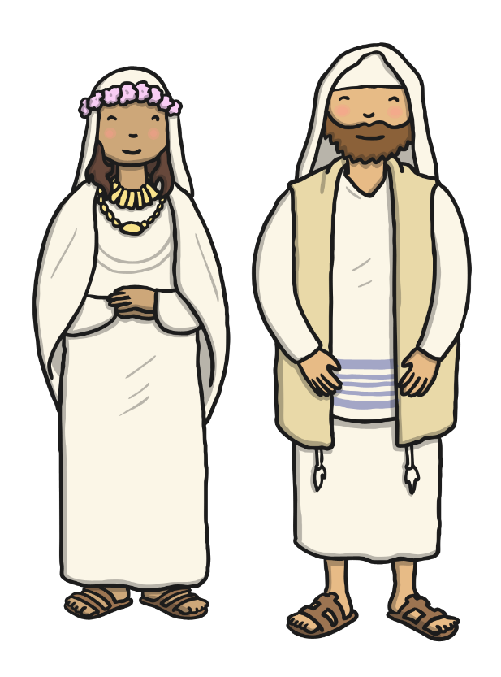
Claudius said that nobody could get married.
He thought that this way the men would have no families and they would come and join his army.
A kind priest named Valentine helped the men by letting them marry their sweethearts in secret.

Slide 6
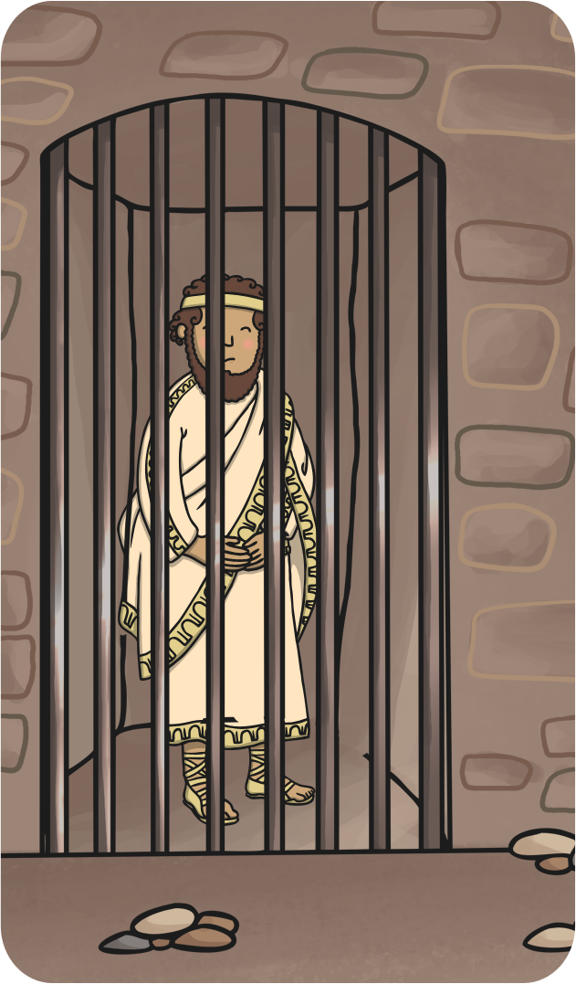
When Emperor Claudius found out about this he was very angry.
He sent his soldiers to arrest Valentine and throw him into prison.

Slide 7
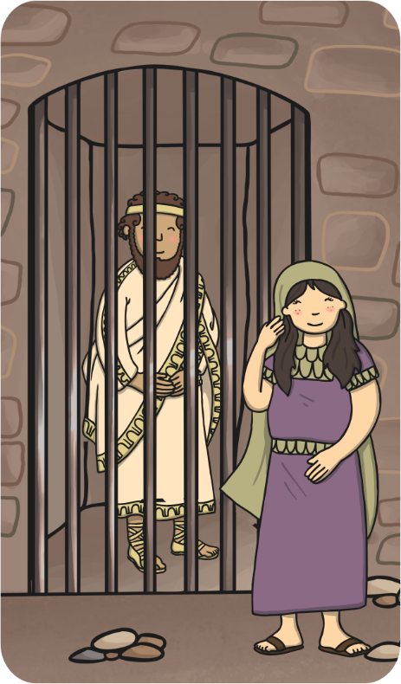
Whilst he was in prison, Valentine began to teach the blind daughter of his jailer. She was called Julia.

Slide 8

Julia and Valentine became great friends and Valentine cured Julia’s blindness with a miracle.

Slide 9

On the day that Valentine died, he wrote a letter to Julia and signed it from ‘Your Valentine’.

Slide 10

?
The story says that Valentine died on February 14th. Now every year on this date people send cards to their loved ones. It is called Valentine’s Day.
Cards are often signed with “Your Valentine” or a question mark so that the person has to guess who the sender is.

Slide 11


