Slide 1

Beech English
Monday 8th February
LO: I can write a quest myth.

Slide 2
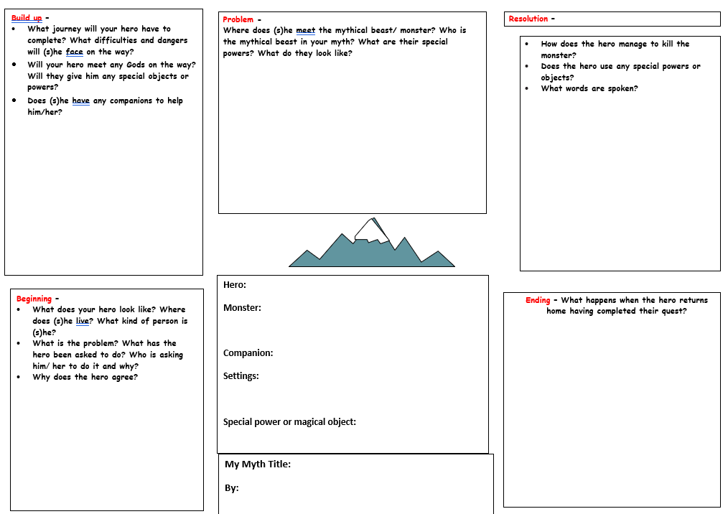
Today, you are going to write the quest myth which you planned on Friday.
On you planning sheet, you should have noted down your ideas for plot, characters, special items, settings, vocabulary and dialogue. So, make sure you refer to your plan as you write!

Slide 3
Your myth plot
Your myth should be written in 5 parts or chapters (one for each section of the story hill).
Opening: Characters and setting are introduced. Quest given.
Build-up: Hero/ine sets out on a long journey with challenges.
Problem: Hero/ine faces the final challenge, takes on the monster and is almost defeated.
Resolution: With help, hero/ ine achieves final goal.
Ending: Hero/ine returns home to claim their reward.

Slide 4
Today’s Task
On lined paper, you will write (or begin to write) your quest myth.
Writing a good quality myth is more important than writing lots or getting your myth finished today. For that reason:
- You should write for at least 20 minutes, but no more than 30 minutes.
- When you have done that, you can draw a picture to illustrate your myth.
- Do not worry if you have not finished your myth today. You will be able to finish it in tomorrow’s lesson. I will set an alternative task tomorrow for those who finish their quest myths today.

Slide 5
Success Criteria
I have written a quest myth. My myth:
Uses suitable ideas.
Is written in 5 parts or chapters.
Makes sense to others.
Has capital letters at the start of names and sentences, and full stops at the end of all sentences.
Is neat and well-presented.
Has been checked for correct spelling.
Has speech marks (inverted commas) around any words which are spoken by characters.

