Slide 1


Slide 2

The Letter B Looks like This…
b
Click on the pencil to see the letter formation.
Can you draw it with your finger?

Slide 3

The Letter B Sounds like This…
B, B, B
Teaching note: Say the sound /b/ and have children repeat it back multiple times.

Slide 4

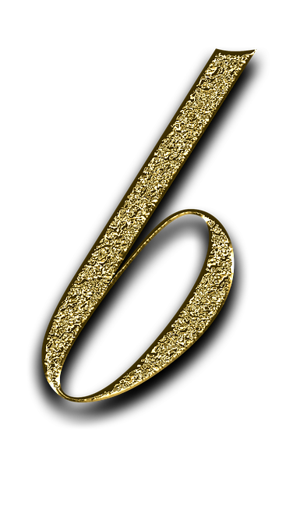
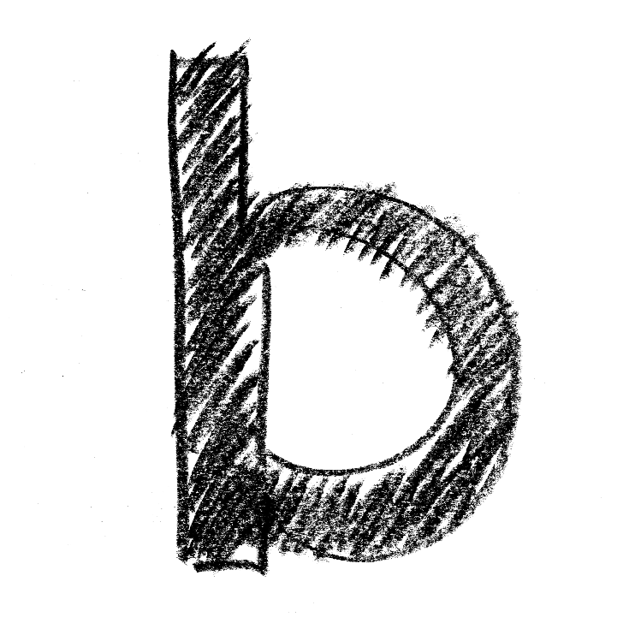

It Can Also Look like This…

Slide 5


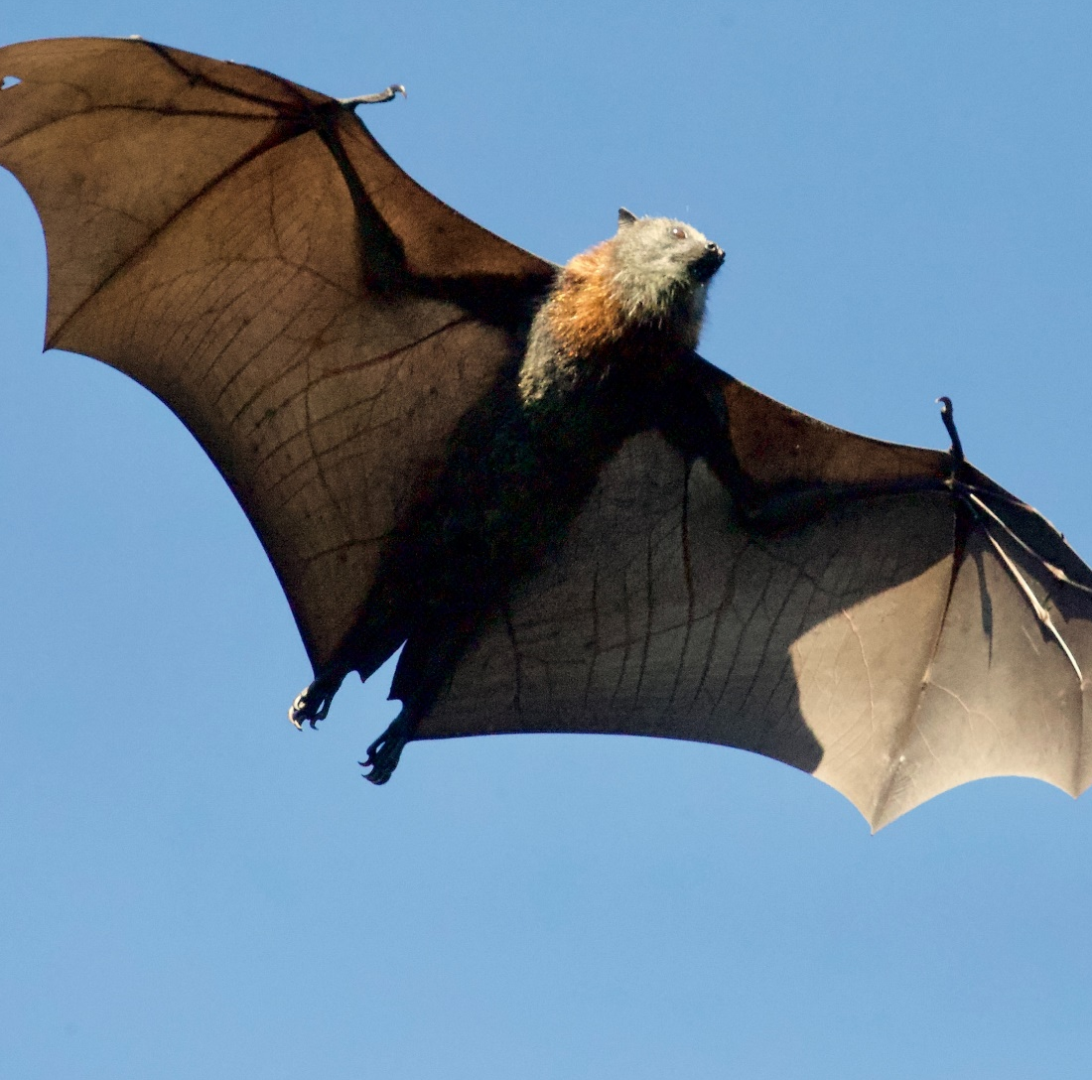
Some Things That Start with B Are…

Slide 6

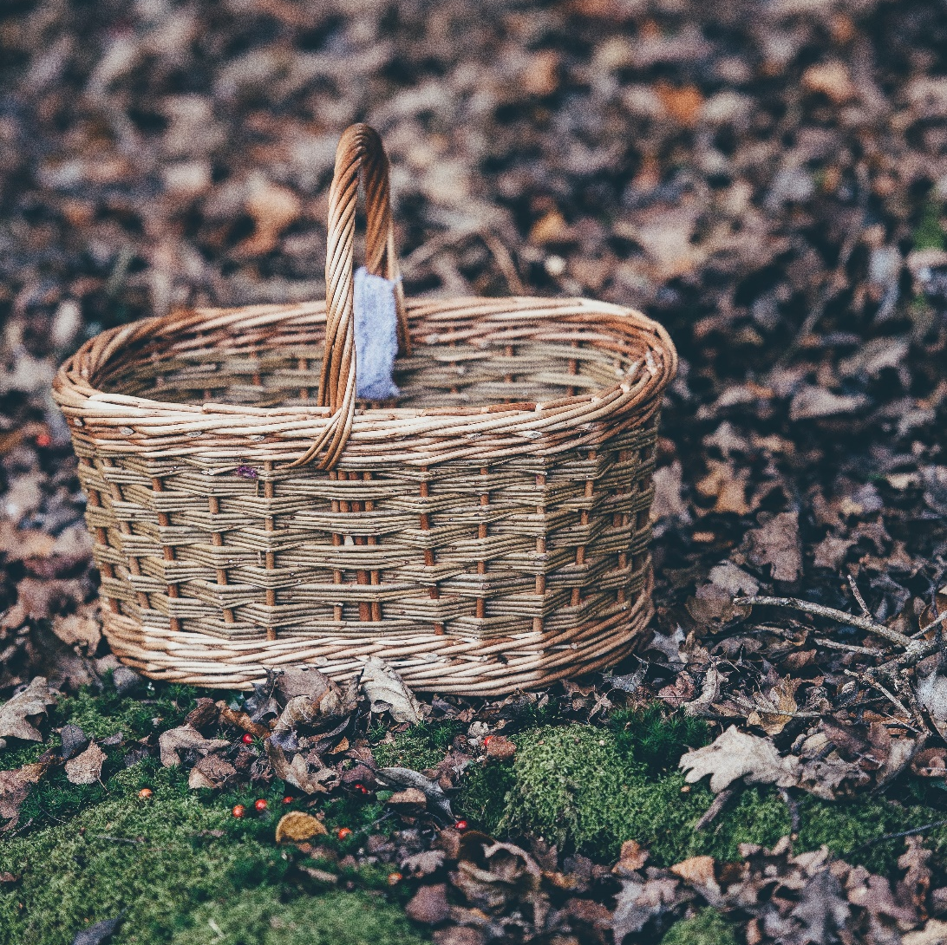
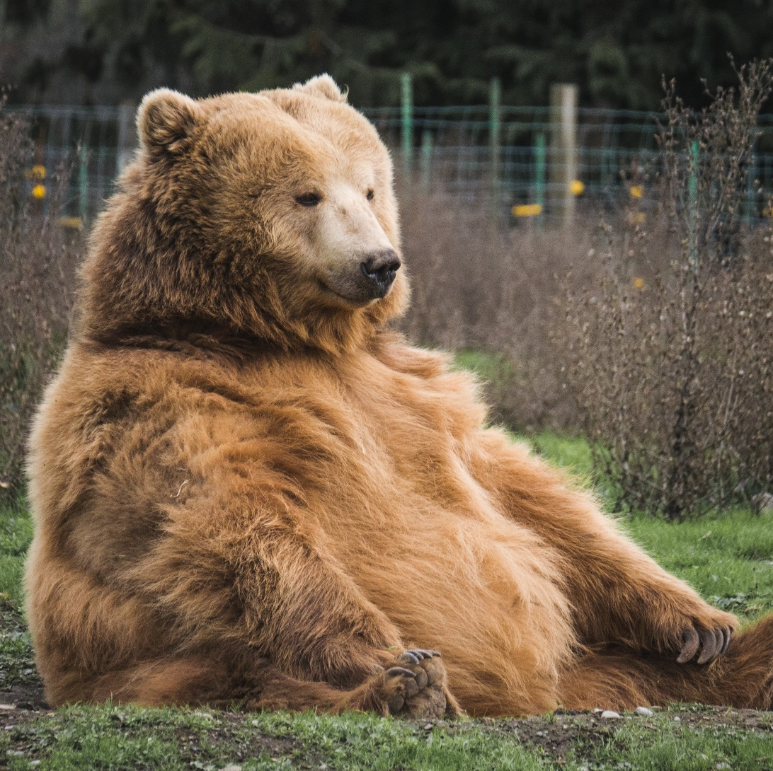
Some Things That Start with B Are…

Slide 7

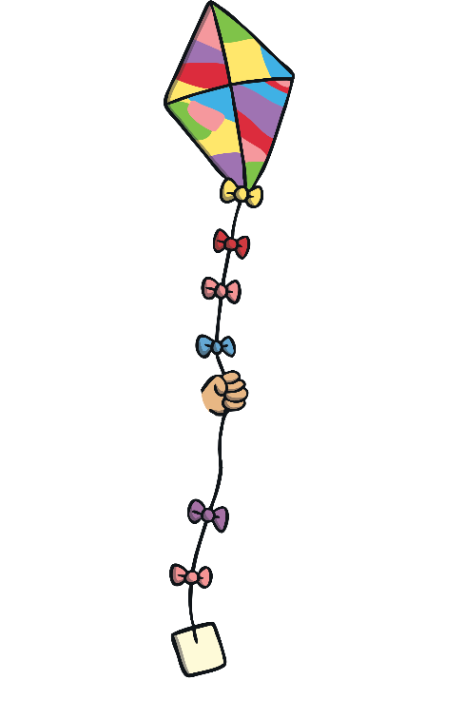

Which of These Start with B?
TRY AGAIN!
YES!
Teaching note: Pause briefly after the initial sound of each word to assist students to identify the sounds.

Slide 8


Which of These Start with B?
TRY AGAIN!
YES!
Teaching note: Pause briefly after the initial sound of each word to assist students to identify the sounds.

Slide 9


Which of These Start with B?
TRY AGAIN!
YES!
Teaching note: Pause briefly after the initial sound of each word to assist students to identify the sounds.

Slide 10

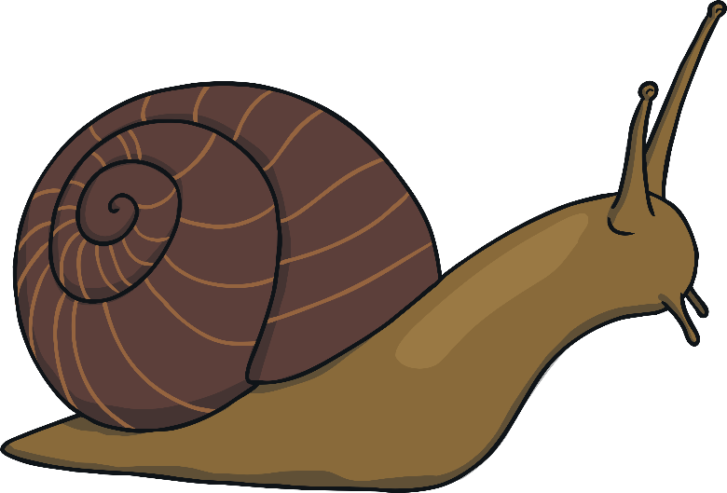
Which of These Start with B?
TRY AGAIN!
YES!
Teaching note: Pause briefly after the initial sound of each word to assist students to identify the sounds.

