Slide 1


Slide 2
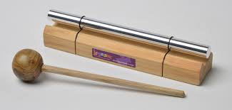
Calm me time
Please listen and follow the instructions

Slide 3
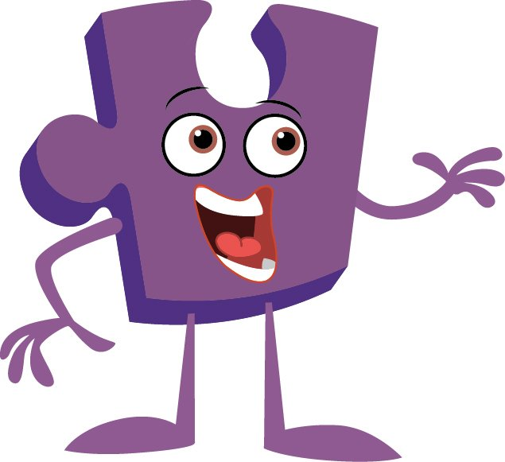

Slide 4
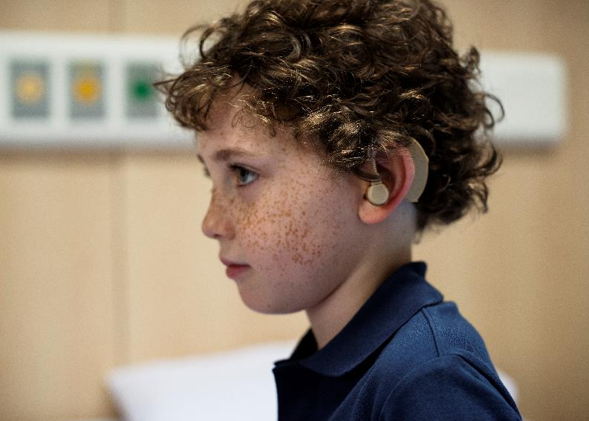

Slide 5
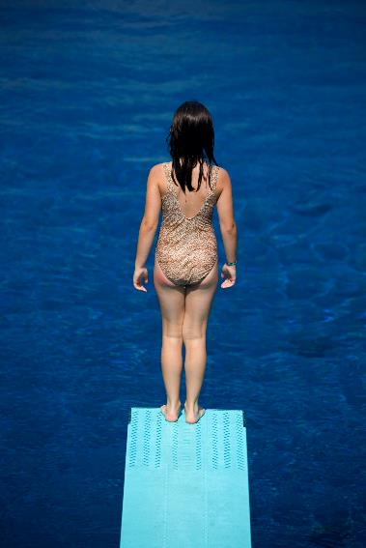

Slide 6


Slide 7


Slide 8
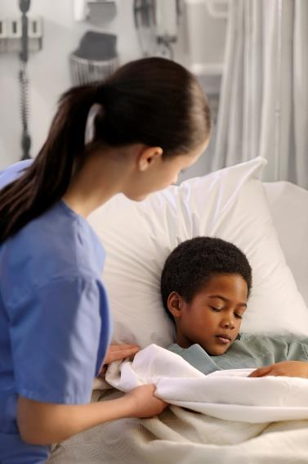

Slide 9


Slide 11


