Slide 1

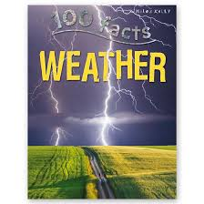


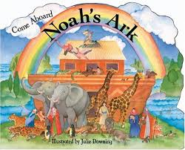
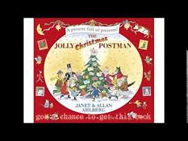
Term: Autumn 2
Topic:The weather
Some of our focussed books will be
Some activities we will be doing:
Making a rain gauge making our own rainbows painting a giant ark
Listing the animals on the ark weather bottles rain pictures
Stained glass kites creating pictures on the computer rehearsing for our Christmas panto
Writing letters to father Christmas posting our letters acting out stories
Attending church service

