Slide 1



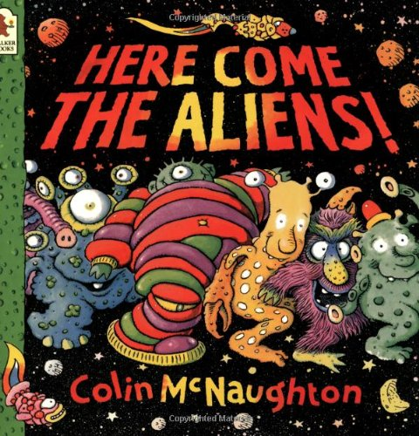
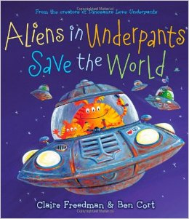


Term:Spring 1
Topic:Space
Our Focussed books will be
Some activities we will be doing:
Papier Mache planets exploring the space station and dark den moving to space music
Painting aliens making rockets with 3D materials designing underpants
Tasting space food making up alien language using alliteration discussing healthy food
Learning about the solar system using Ipads cooking rock cakes

