Slide 1





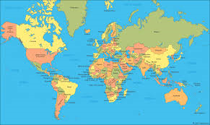
Term:Spring2
Topic: All Around the World
Our Focussed books will be
Some activities we will be doing:
School trip to Pizza Express Making friendship bracelets Cooking food from around the world
Learning about other cultures Learning traditional songs Saying hello and goodbye in other languages
Internet investigations Writing non fiction fact files Making magic carpets

