Slide 1

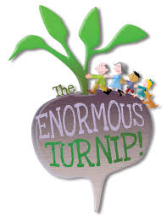
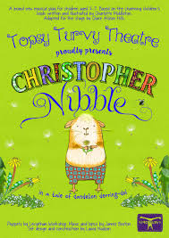


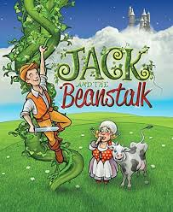
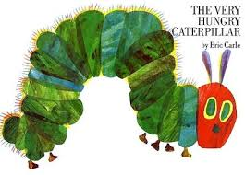
Term:Summer 1
Topic:Growing & Fairy Tales
Our Focussed books will be
Some activities we will be doing:
Diary of a broad bean Story openers/endings
Comparing size and weight Healthy eating Learning about life cycles
Comparing bulbs/seeds Planting flowers/herbs/vegetables Plant growing experiments
Butterfly printing Growing butterflies Looking at famous painters
Learning to tell the time Fruit and veg printing Making patterns with seeds
Observational drawing Baking Measuring plant height
Life needs Naming parts of a flower

