Slide 1

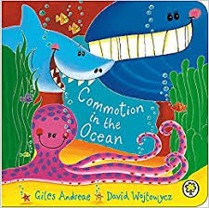
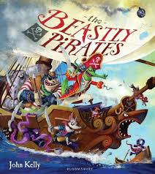
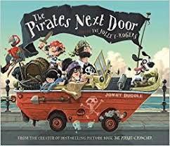
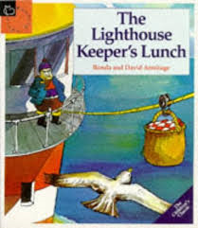

Term:Summer 2
Topic:Journeys
Some of our Focussed books will be
Some activities we will be doing:
using adjectives to describe sea creatures making jelly fish wax paintings
writing alliteration poems discussing what makes us unique moving like animals
using musical instruments to represent animals discussing holidays sports day preparation
seaside role play writing postcards comparing different environments
Making sand pictures comparing healthy and unhealthy lunches making pirate flags
Making treasure maps cooking/baking

