Slide 1
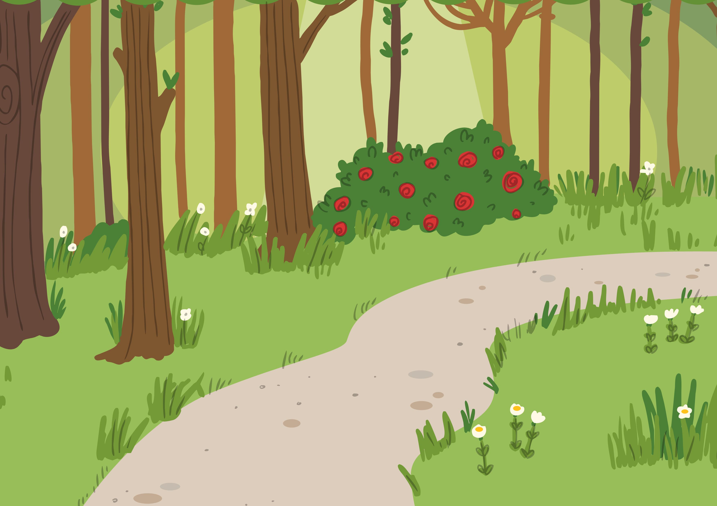
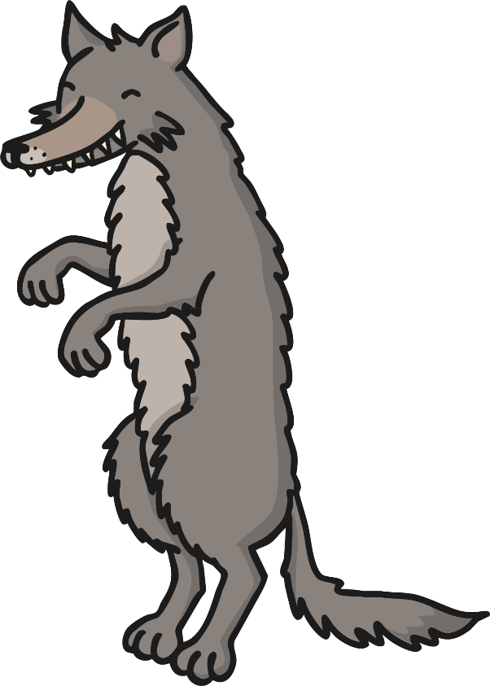
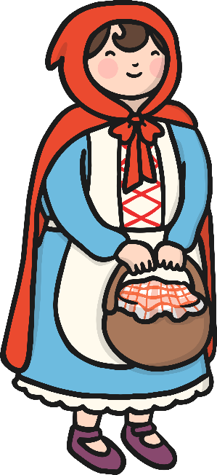


Little Red Riding Hood Character Description Sorting Activity
gentle
scary
evil
kind
cruel
caring
nice
mean
scared
friendly
wicked
cunning

