Slide 1

What Rhymes with What?
Phase 2
bug

Slide 2
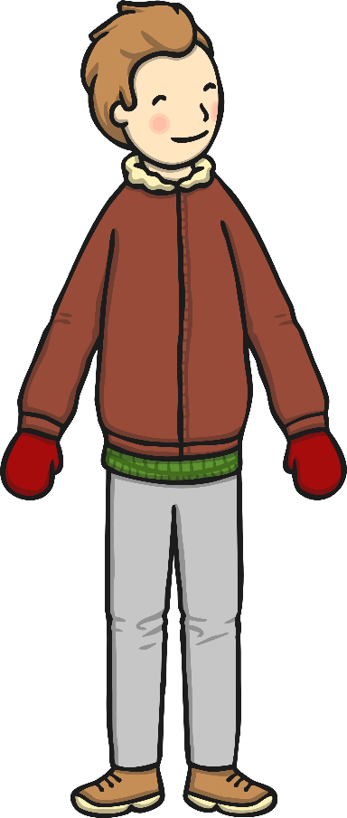



What rhymes with man?
sun
cup
pan

Slide 3
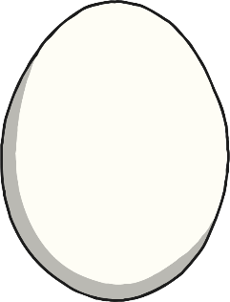
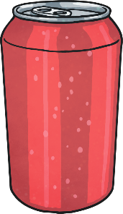
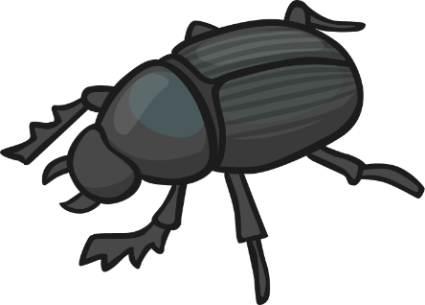
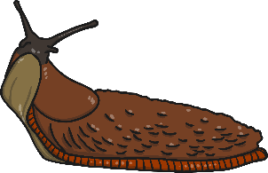
What rhymes with bug?
slug
egg
can

Slide 4
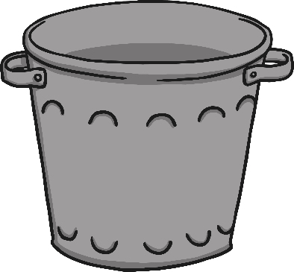
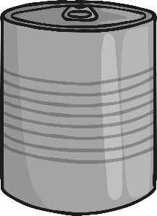

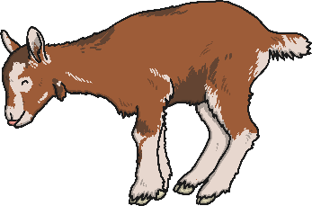
What rhymes with bin?
tin
kid
cap

Slide 5
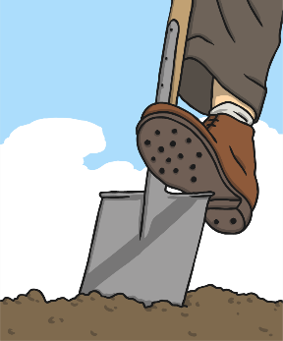
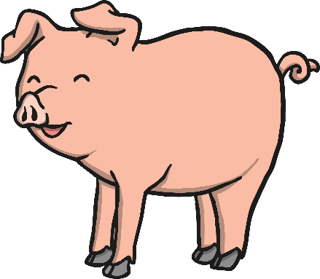

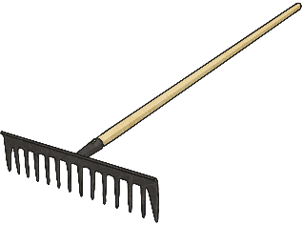
What rhymes with pig?
slug
rake
dig

Slide 6
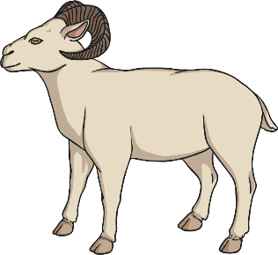
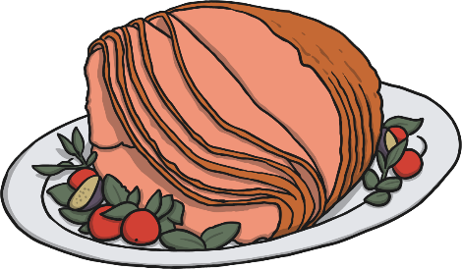


What rhymes with ham?
log
ram
wall

Slide 7
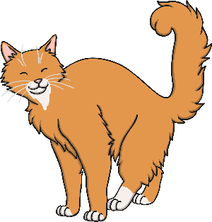
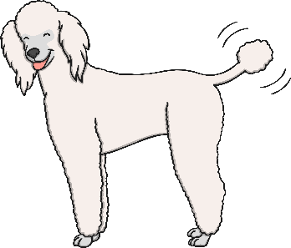

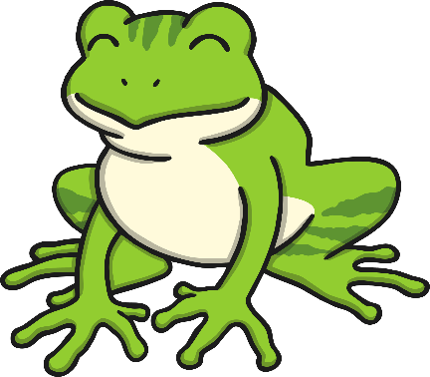
What rhymes with frog?
cat
dog
man

Slide 8
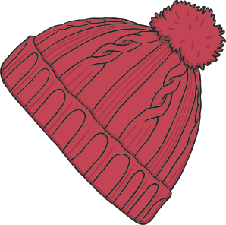
What rhymes with cat?
cap
dog
hat

Slide 9
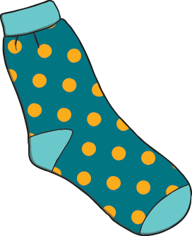
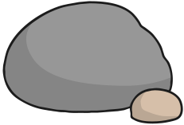
What rhymes with rock?
sock
log
cup

Slide 10
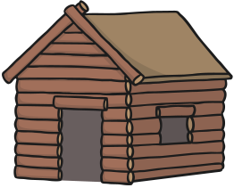


What rhymes with hut?
bug
sock
nut

Slide 11



What rhymes with mug?
bag
rug
nut

Slide 12
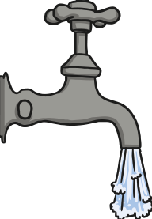
What rhymes with cap?
tap
cup
can

