Slide 1

We are learning
To create a piece of art work that represents (shows) how I have felt during these strange times.
To think about what I have enjoyed since I’ve been at home.
OR
To think about what I have enjoyed since I’ve been at Key Worker school.

Slide 2
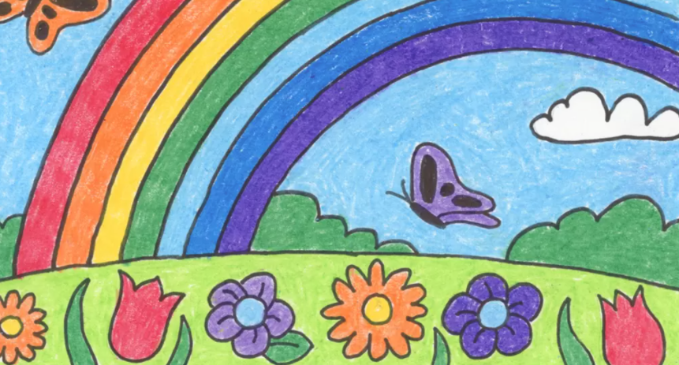

Slide 3
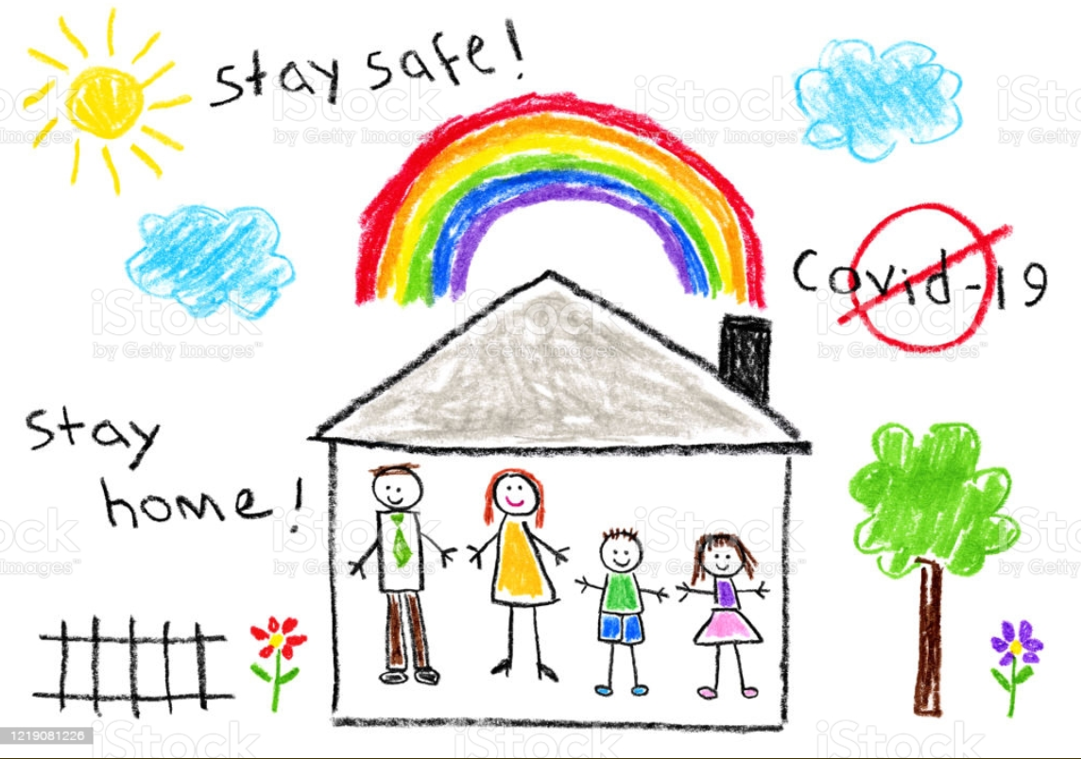

Slide 4
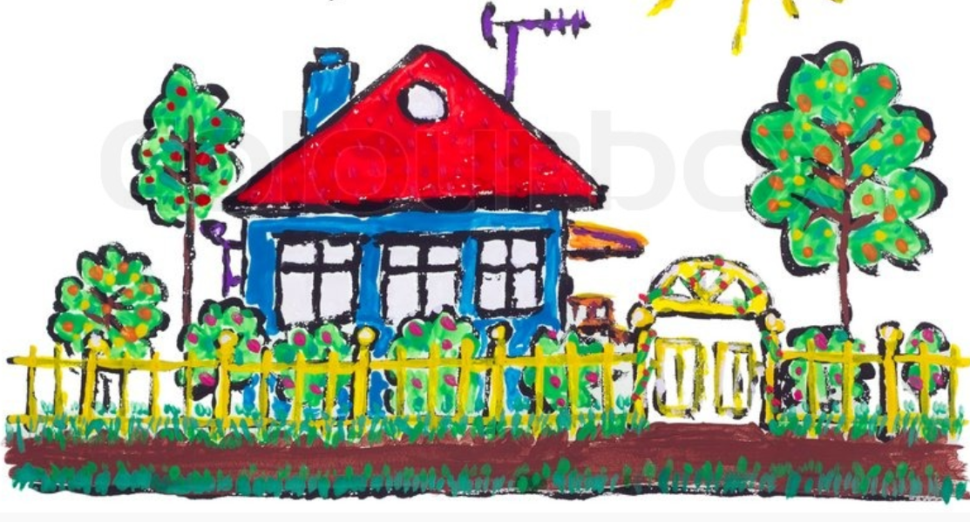

Slide 5
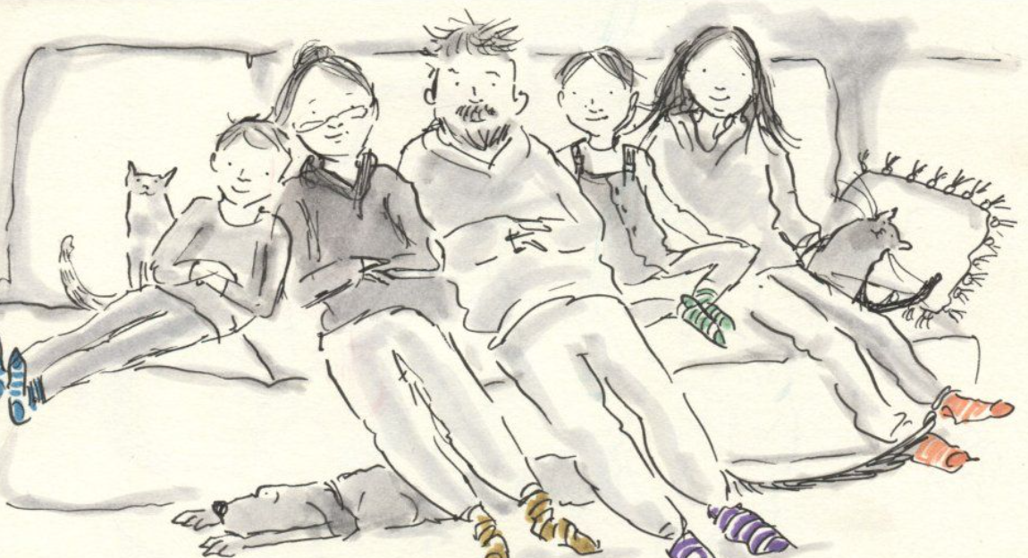

Slide 6
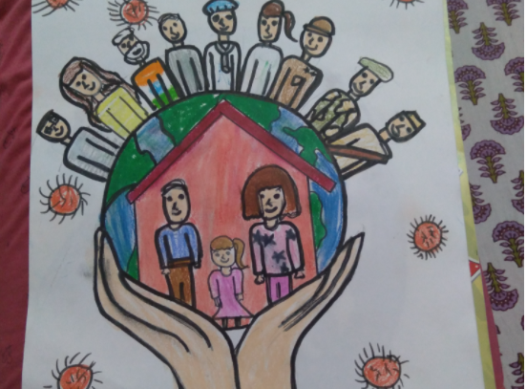

Slide 7
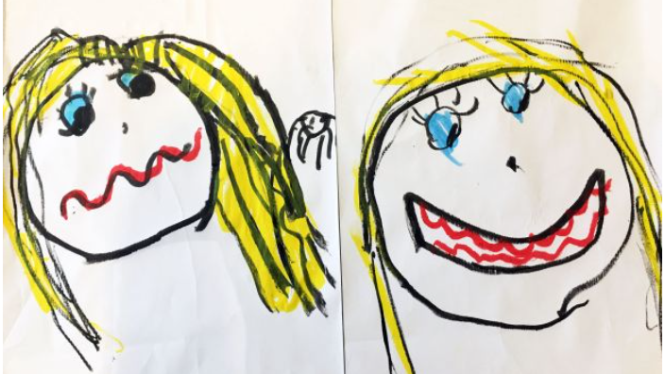

Slide 8


Slide 9


Slide 10


Slide 11
These are just some ideas of what you may wish to draw or paint.
I can’t wait to see what you produce.

