Slide 1

We are learning
To write our own version of ‘The Elephant and the Bad Baby’ using a story board.

Slide 2
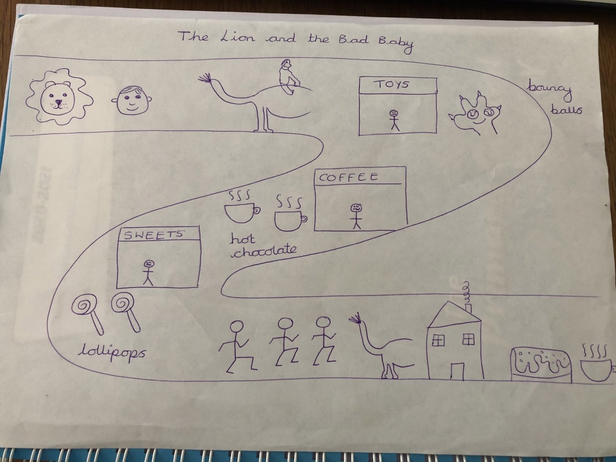

Slide 3


