Slide 1
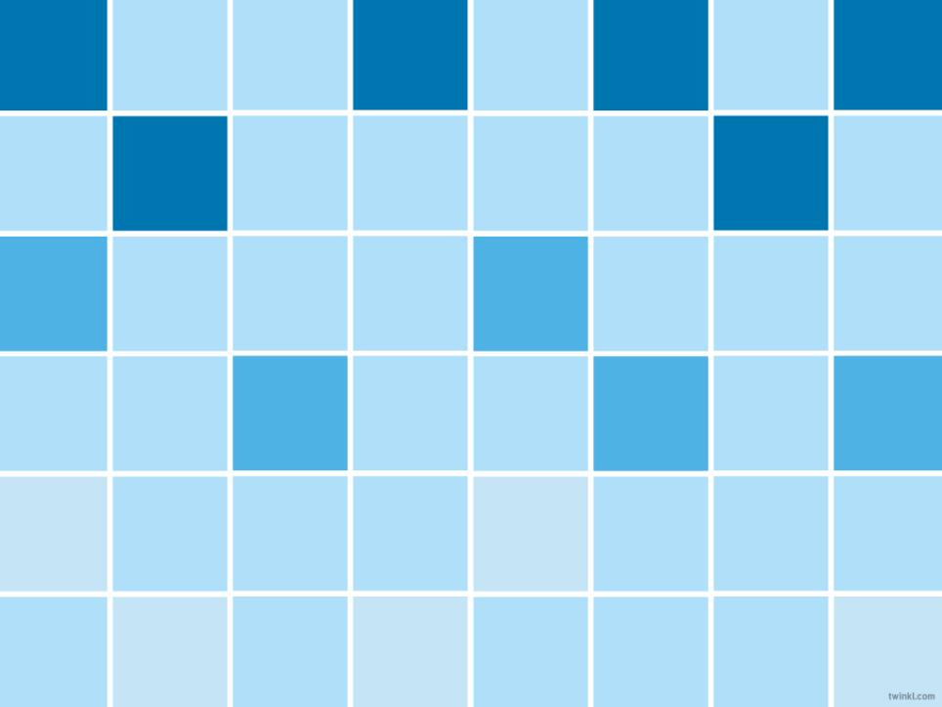

We are learning
To move a quarter turn, half turn, three-quarter turn and whole turn.

Slide 2
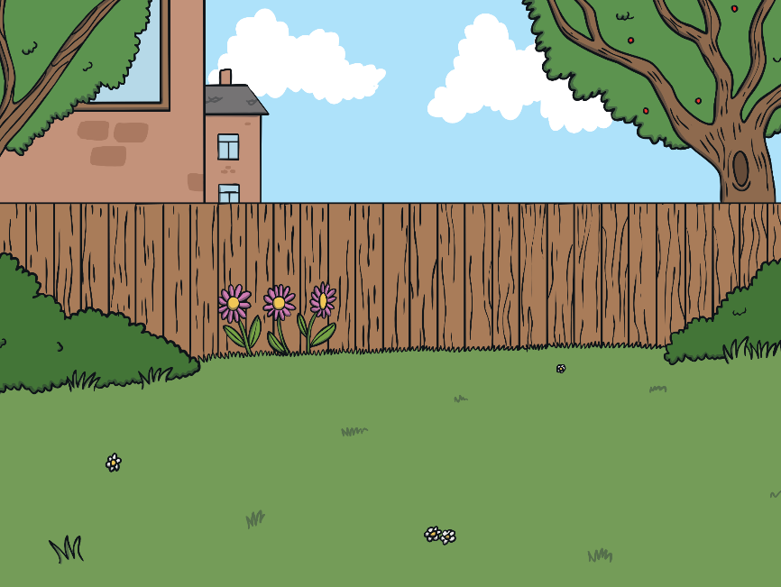



Left and Right Mice
Which direction are the mice running to?
Click here for the next mouse

Slide 3



Listen and Move
Face the front and march on the spot.
Turn in a full circle.
Step to the left then step to the right.
Jump backwards and jump forwards.
Slide to the left and slide to the right.
Turn half way round in a circle.
Face the front and march on the spot.

Slide 4

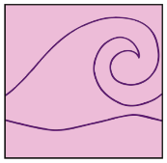
Tile Explore
Click the tiles to reveal turns!
a full turn or a whole turn
a half turn
a three-quarter turn
a quarter turn
What patterns you can make using turns with your Tiling Together Cards? All of these tiles have been turned in a 'clockwise' direction.

Slide 5
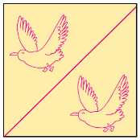
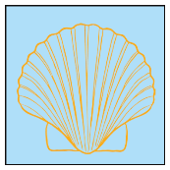
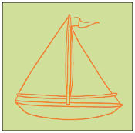
Tile Explore
Click the tiles to reveal the turns!
A full turn or a whole turn.
A half turn.
A quarter turn.
A three-quarter turn.
What patterns you can make using turns with your Tiling Together Cards?

Slide 6


