Slide 1



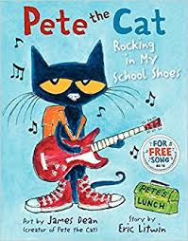
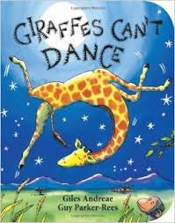
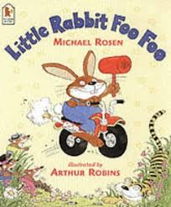
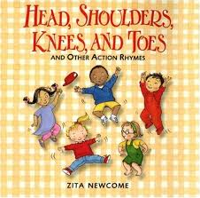
Term: Autumn 1
Topic:This is me
Some of our focussed books will be
Some activities we will be doing:
Getting to know our new friends Making class books Writing captions Looking at initial sounds
Making up our class rules Learning about our senses
Dressing independently for PE Describing popcorn using our senses Making Skelton pictures Learning about Harvest
Continue a rhyming string Visiting the church

