Slide 1

We are learning
To think about what we are most looking forward to when we return to school.

Slide 2
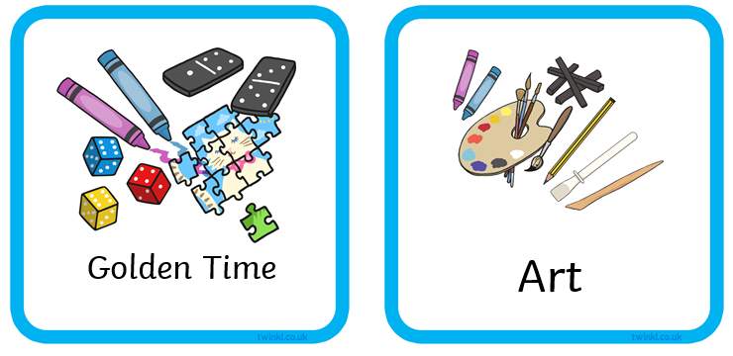
What are you most looking forward to?

Slide 3
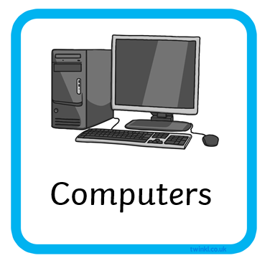
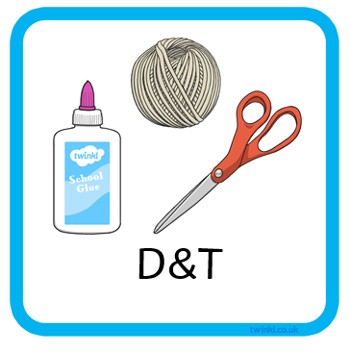
What are you most looking forward to?

Slide 4
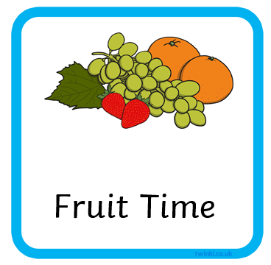
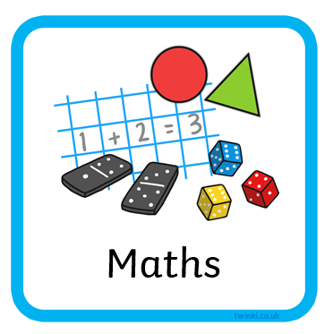
What are you most looking forward to?

Slide 5
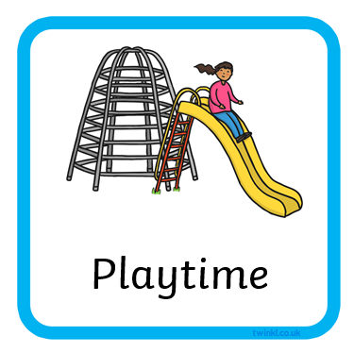
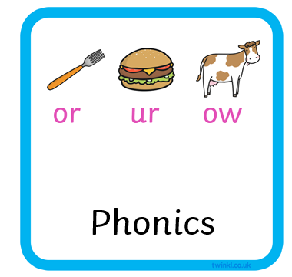
What are you most looking forward to?

Slide 6


