Slide 1

We are learning
To plan our own version of ‘The Elephant and the Bad Baby’ using a story path.

Slide 2
Before we write a story in Year 1, we always plan our ideas on a story path.
Tomorrow, we are going to write our own version of ‘The Elephant and the Bad Baby’ but we are going to make a couple of changes.
We are going to choose a different animal and three different places for the animal and the Bad Baby to visit together.

Slide 3
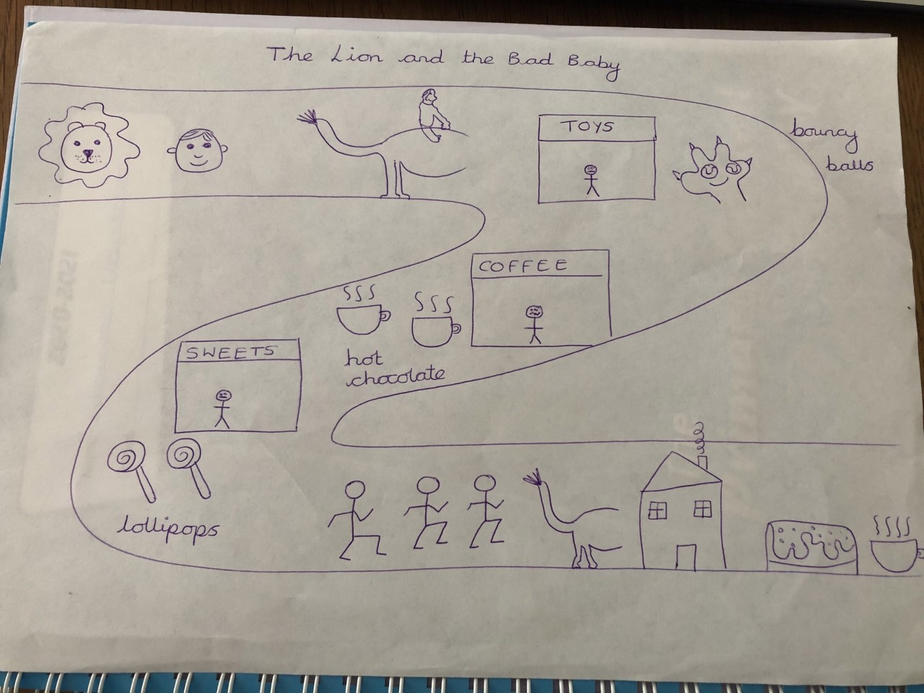

Slide 4
For today’s activity, you are going to plan your version of the story.
Choose:
A new animal
Three different places for the Bad Baby to visit.

