Slide 1
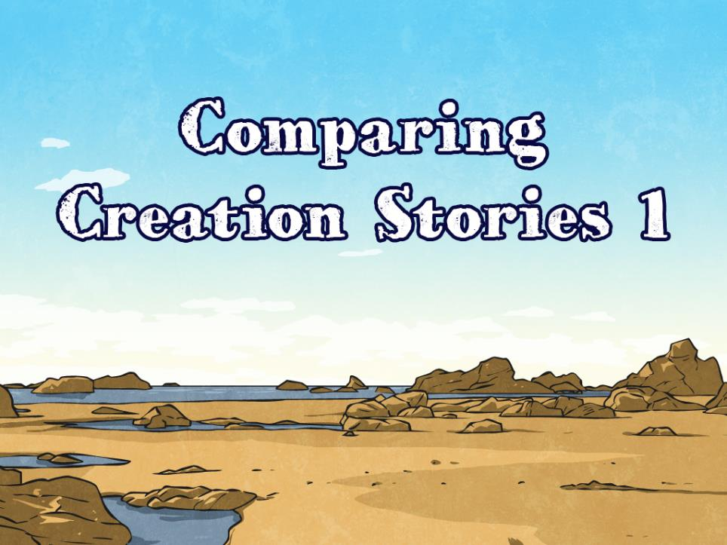


Slide 2
Aim
I can compare the creation stories of the Mayan People and Christians.
Success Criteria
I can explain what the Christian creation story
I can explain what the Mayan creation story
I can compare and contrast the Mayan and Christian creation stories.

Slide 3
Speed Words
Check your understanding of these word before you start. You may need to look these words up in a dictionary.
hardier determined crumbled
deafening worship paste
meaningless paste vision

Slide 4
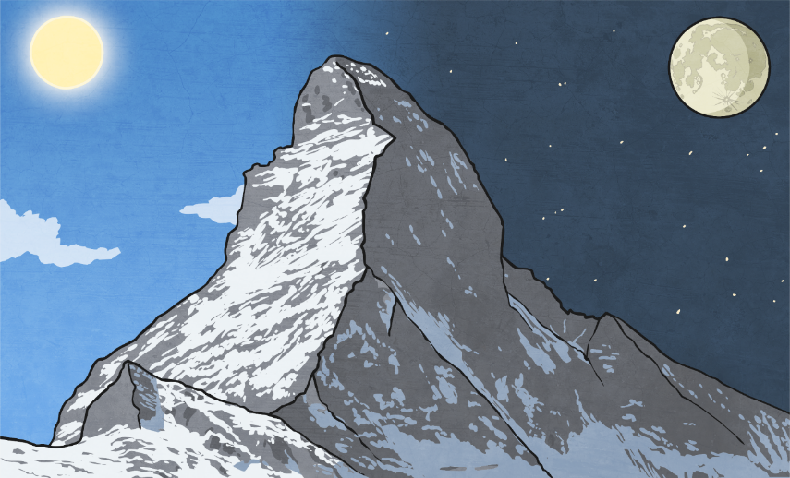
Christian
Creation Story

Slide 5
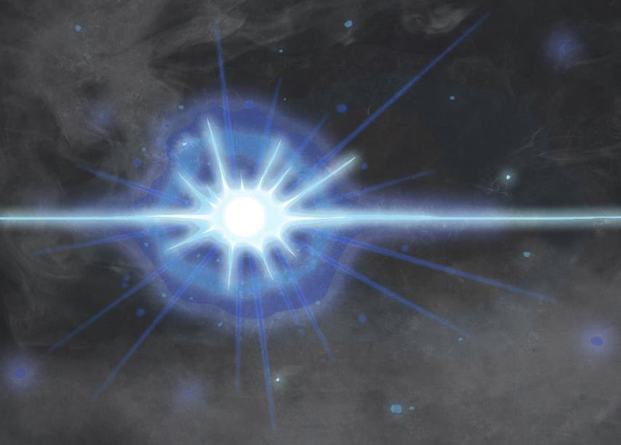
On the first day, God created light and separated it from darkness.

Slide 6

On the second day, God created the sky.

Slide 7
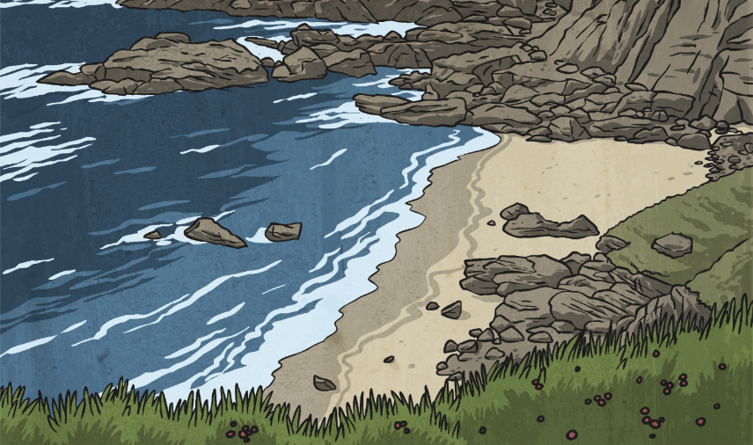
On the third day, God created the land and sea. He also created trees and plants.

Slide 8
On the fourth day, God created the sun, the moon and the stars.

Slide 9
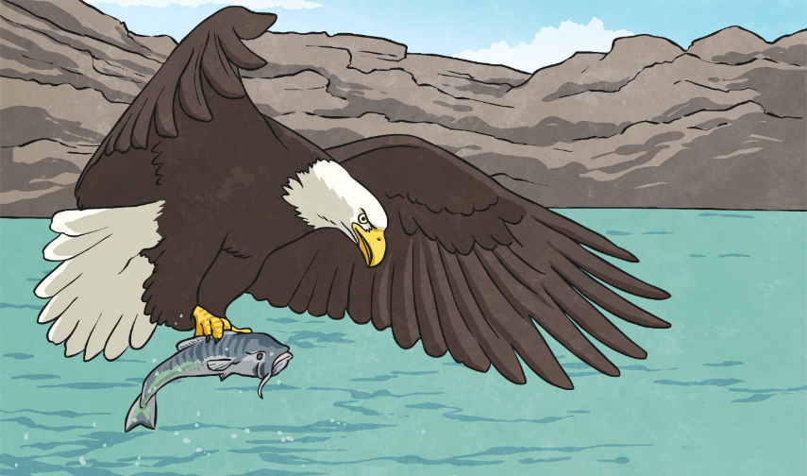
On the fifth day, God created birds and sea creatures.

Slide 10
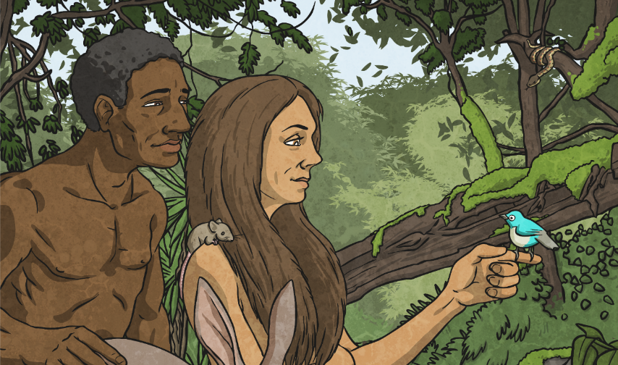
On the sixth day, God created all the other animals. He also created man and gave him great mental ability. God also gave man the power of speech and the responsibility to look after the animals on Earth.

Slide 11
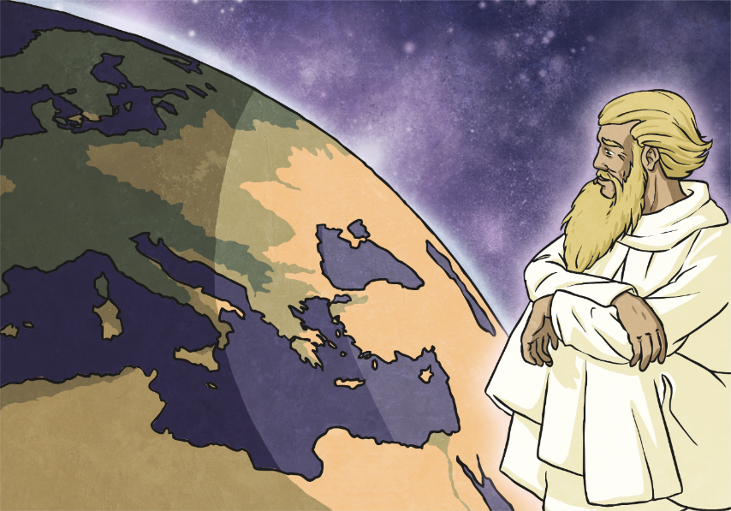
On the seventh day, everything was created and God rested. Christians believe that they should work for six days and rest on the seventh day. By doing this, Christians show that they believe in God as the creator of the world.

Slide 12

Maya
Creation
Story

Slide 13
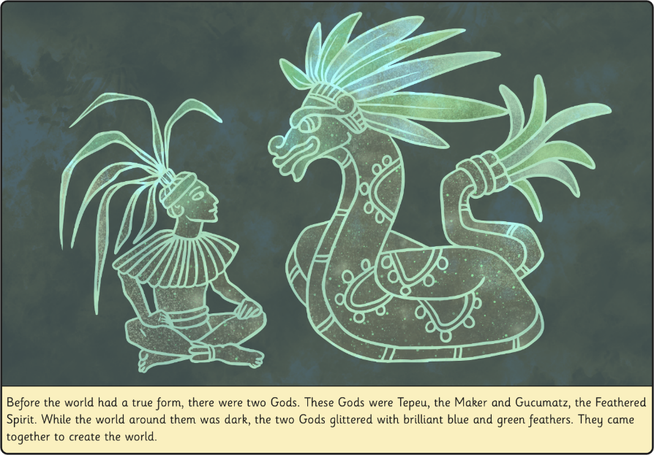

Slide 14
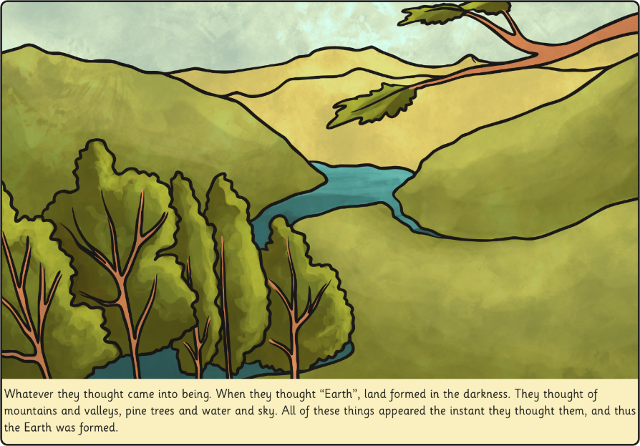

Slide 15
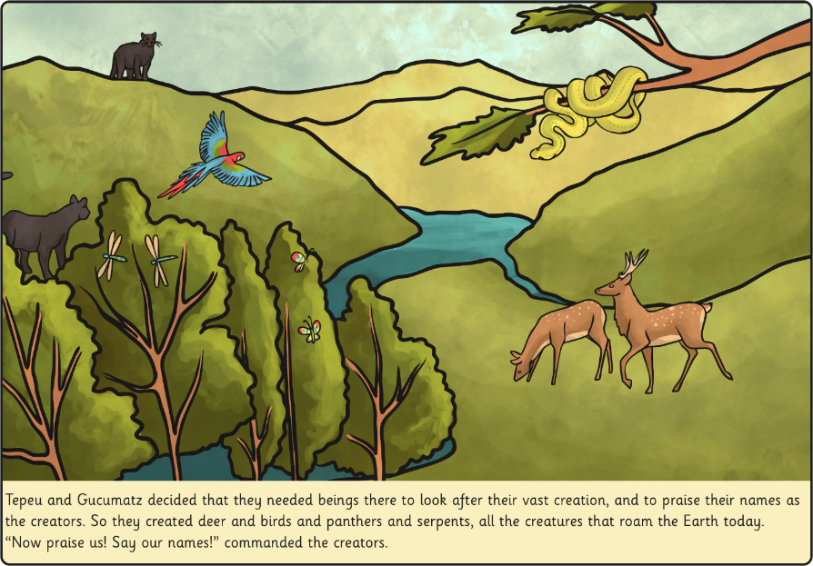

Slide 16
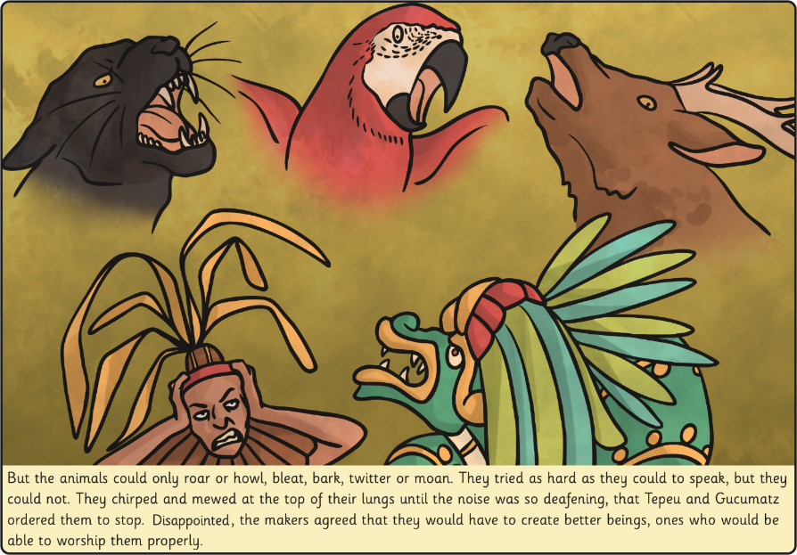

Slide 17
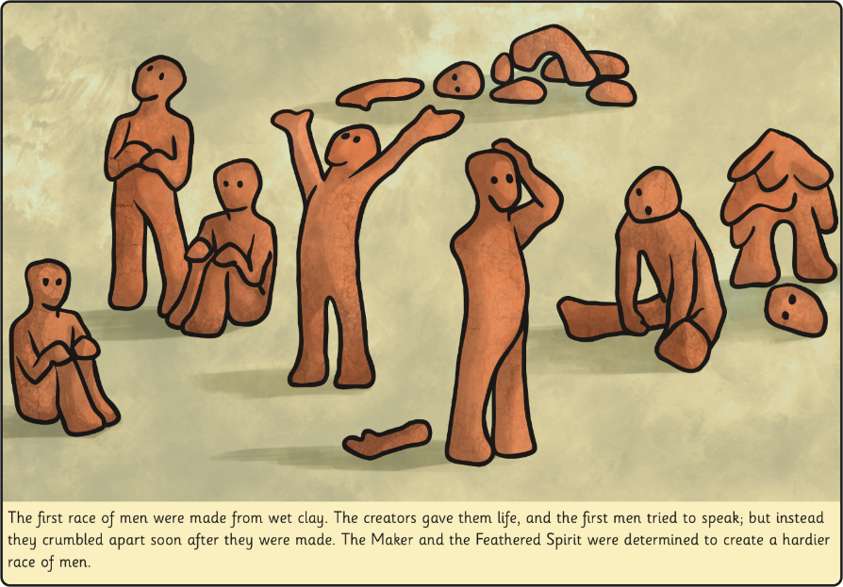

Slide 18
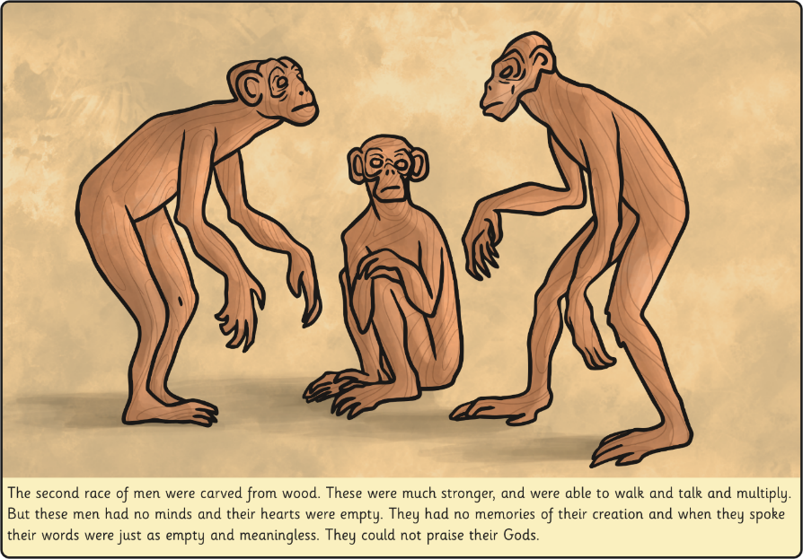

Slide 19
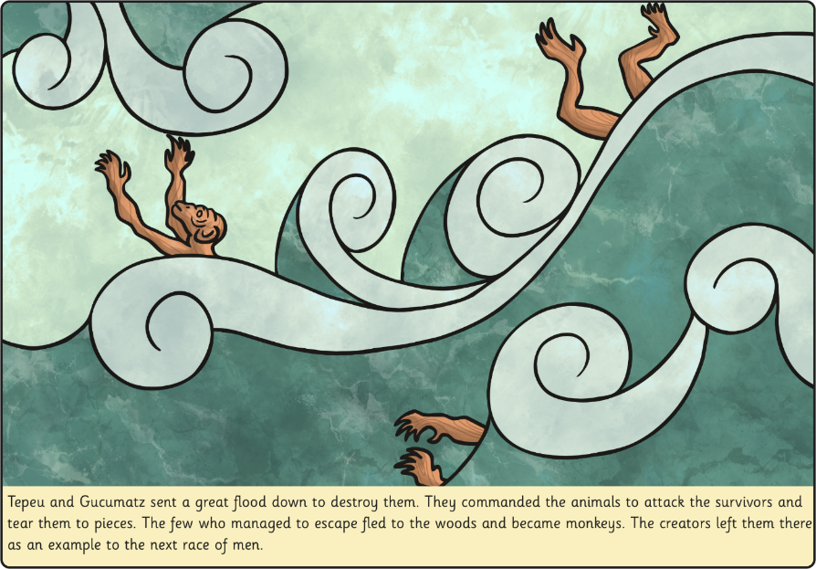

Slide 20
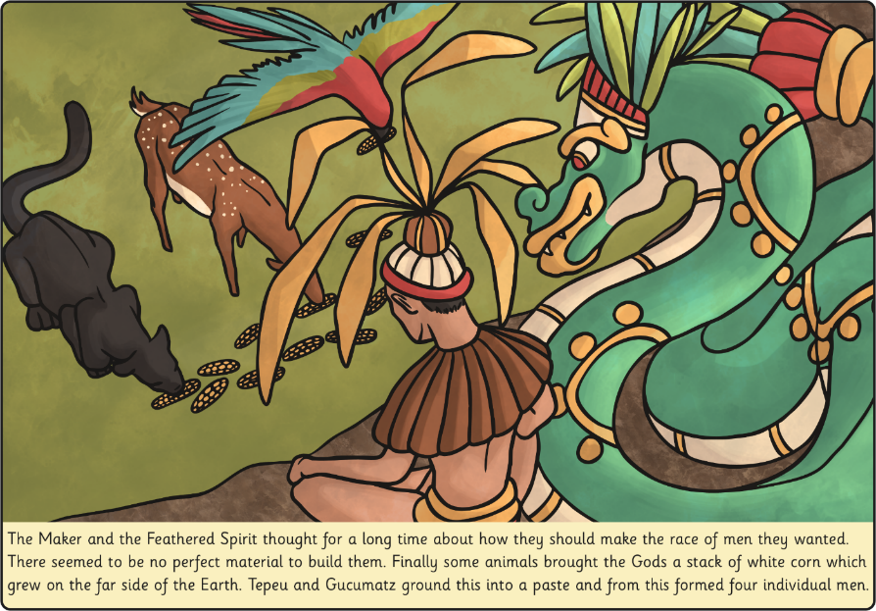

Slide 21
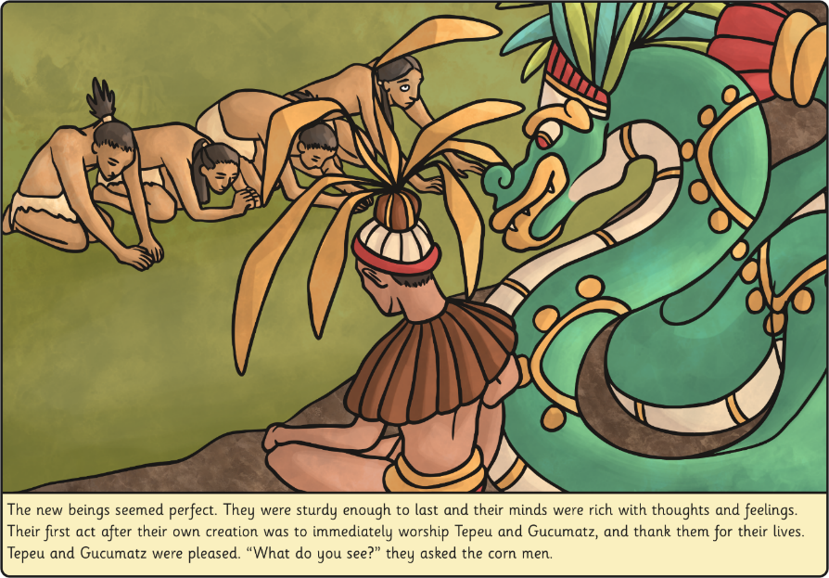

Slide 22
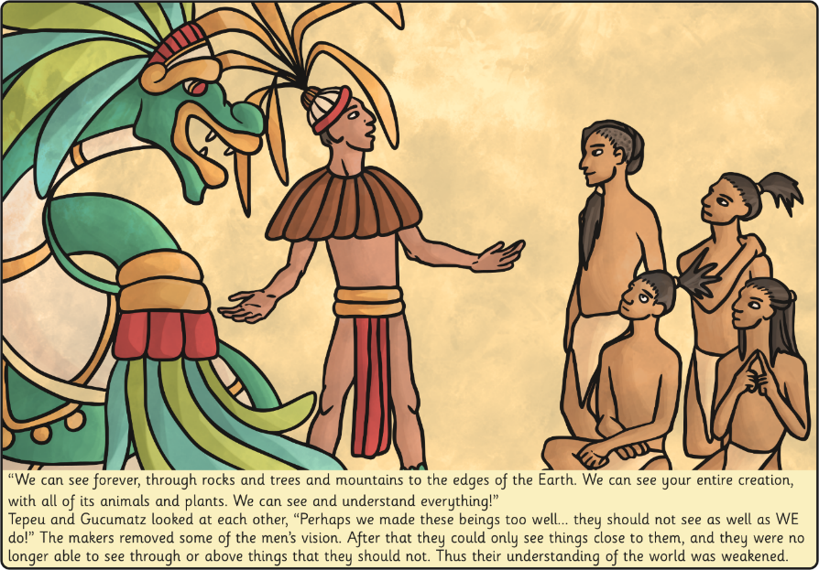

Slide 23
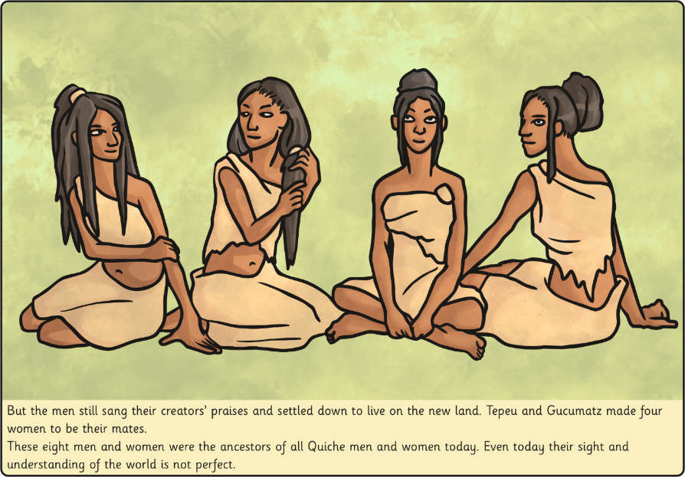

Slide 24
Task
Compare the two creation stories by drawing story maps for each including key vocabulary.
Use full sentences to compare the similarities and then the differences of the two stories.

Slide 25
Aim
I can compare the creation stories of the Mayan People and Christians.
Success Criteria
I can explain what the Christian creation story
I can explain what the Mayan creation story
I can compare and contrast the Mayan and Christian creation stories.

