Slide 1

Lesson 1

Slide 2
Aim
I can compare materials according to their properties.
Success Criteria
I can describe a material’s properties.
I can explain the uses of different materials based on their properties.

Slide 3
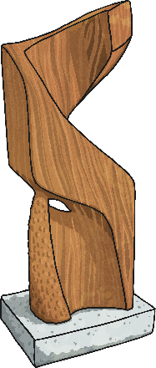
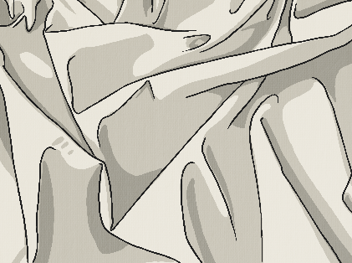
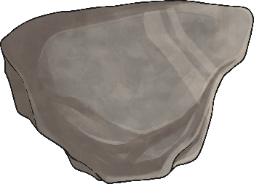
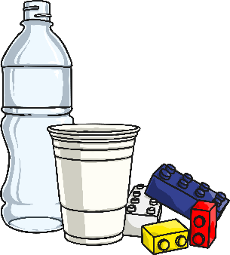

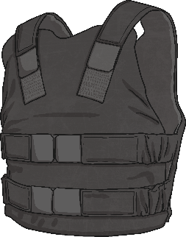
Describing Materials
Any substance that is used to
make something is a material.
Natural materials such as stone, wood and cotton are used or worked with in the way they are found in nature.
Synthetic or human-made materials are made from natural materials, but are altered with the help of heat or chemicals. Some examples include plastics,
polyester and Kevlar.
Natural
Human-made

Slide 4

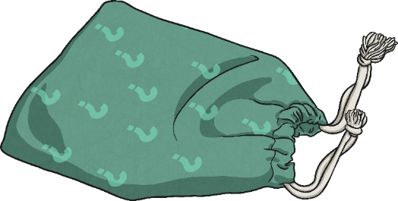


Describing Materials
Collect items from your home.
e.g. copper coin, a steel paper clip, a rock, a slate, a wooden spoon, a piece of tracing paper, a safety mirror, a plastic ruler. Put the items into a bag or pillow case to make a feely bags.
Can you identify the different materials just
by feeling them?
While you have a go at this activity, think of words to describe each material, such as hard, soft, cold or rough.

Slide 5
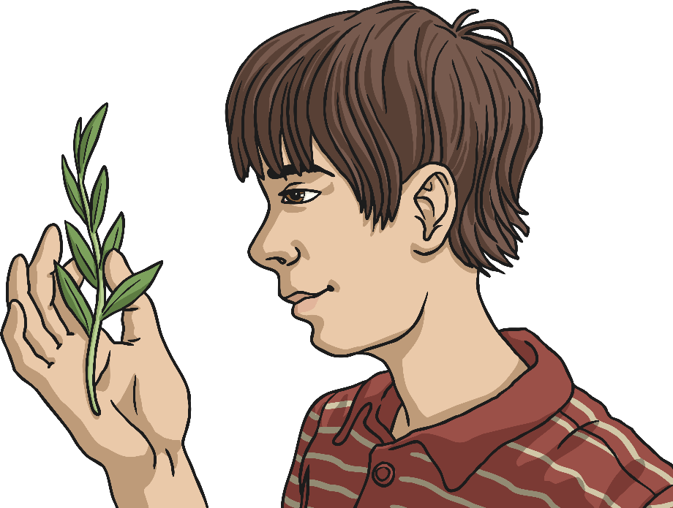
Describing Materials
Have a look inside the feely bags.
Were you right about any
of the materials?
What words did you think of to describe each material?

Slide 6


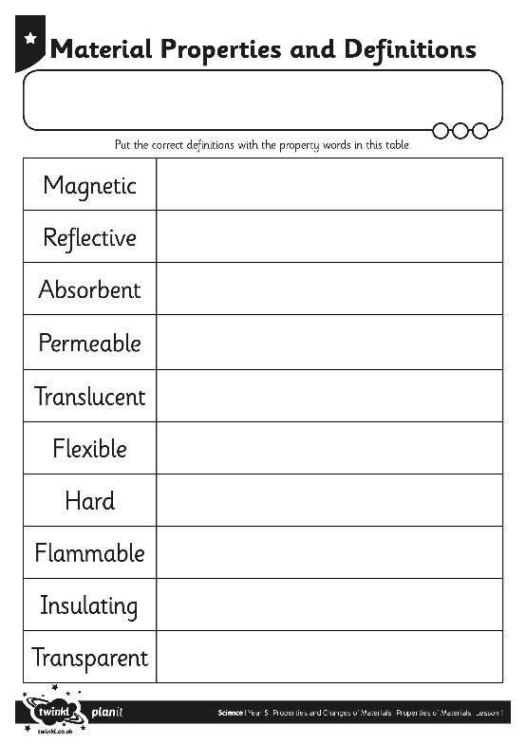
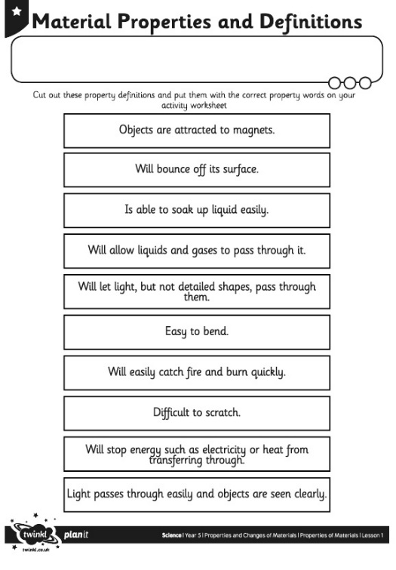
Properties
The words used to describe a material are known as its properties.
Each material has its
own set of properties.
These properties make different materials useful for
different purposes.
Can you match the properties with their definitions on your Material Properties
Activity Sheet?

Slide 7


Using Materials
Why is it useful to know the properties of a material?
  It is useful because if you know the properties of a material, you can then choose the best material for a purpose.
  Look again at the objects from the feely bags. Why was each material chosen to make these things?
If you can talk to someone about your findings.

