Slide 1

Lesson 2

Slide 2
Aim
I can compare materials according to their properties.
Success Criteria
I can explain the uses of different materials based on their properties.
I can sort and compare materials according to their properties.

Slide 3

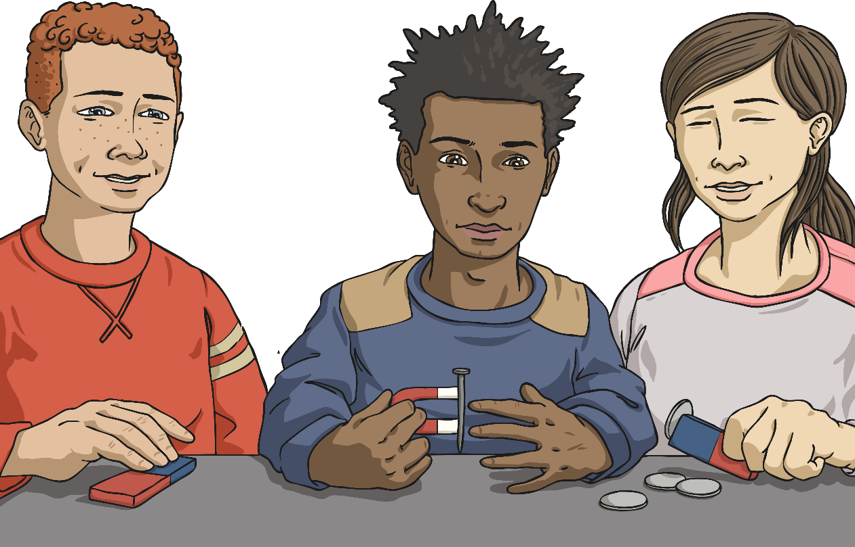
Testing Properties
To find out which properties a material has, they have to be tested.
You are going to test several different materials to find their properties.
You will test for:
magnetism;
hardness;
transparency;
flexibility;
permeability.

Slide 4

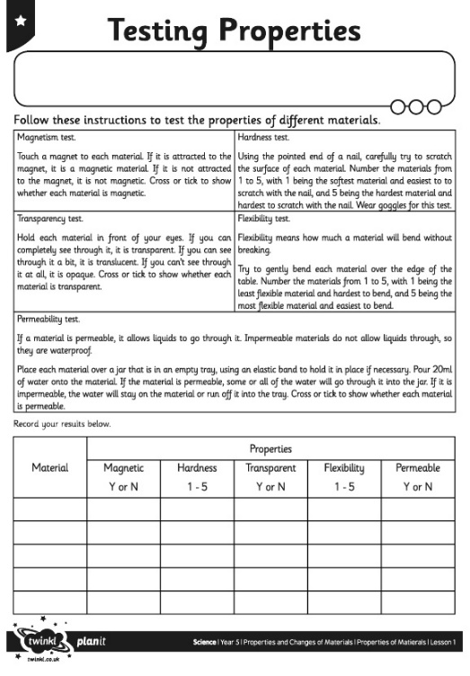

Testing Properties
Follow the instructions for each test, and try out each test with each material. (It you can’t find a magnet do not worry, do what you can. Please wear glasses to cover your eyes to carry out the hardness test, if you do not have any leave this test.)
Complete your Year 5 29th June 2020 Learning Pack Topic Lesson 2 Testing materials Activity Sheet with your results.

