Slide 1


Dissolving
Lesson 3

Slide 2
Aim
I can investigate materials which will dissolve.
Success Criteria
I can describe dissolving.
I can explain the difference between melting and dissolving.
I can identify materials which will dissolve in water.

Slide 3




Disappearing Act
These children have put some sugar cubes into a cup of tea. They watch as the sugar cubes seem to disappear. What has happened to them?
Talk to your partner about who you agree with.
The sugar particles have mixed with the water to make a see-through solution. The sugar cubes have dissolved.
The sugar cubes heated up in the cup of tea, which caused them to melt. They have changed state from a solid to a liquid
The particles of sugar in the sugar cubes heated up so much that they evaporated. They are in the air now.

Slide 4
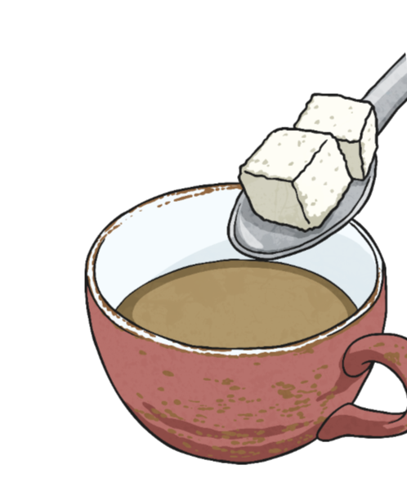
Disappearing Act
Did you agree with this girl?
She is correct! The sugar has dissolved in the tea.
Dissolving occurs when the particles of certain solids mix with the particles of certain liquids.
When a material dissolves, it looks like it disappears. But it has actually just dissolved in the liquid to make a transparent solution. A solution is formed when a solid dissolves in a liquid.
Not all solids will dissolve, and not all liquids will allow solids to dissolve.
When you mix sugar with water, the sugar dissolves to make a transparent solution.
The sugar particles have mixed with the water to make a see-through solution. The sugar cubes have dissolved.

Slide 5
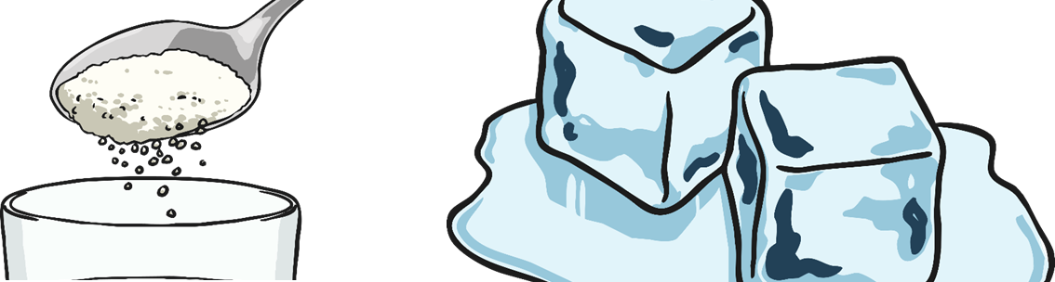
Dissolving or Melting?
Many people get confused between dissolving and melting, but there are several important differences:
Dissolving
Dissolving involves a liquid and another material, often a solid.
In dissolving, the solid mixes into the liquid to make a new liquid, called a solution.
Dissolving doesn't need heat to occur.
Melting
Melting involves only a solid.
In melting, the solid changes into a liquid that is the same material.
Melting needs heat to occur.

Slide 6

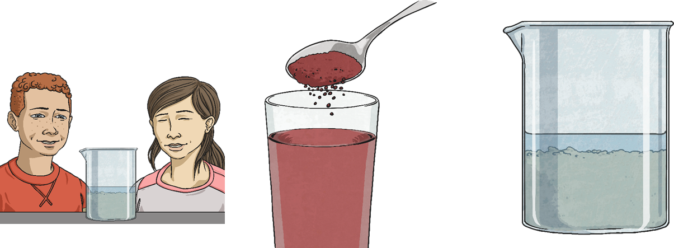
Soluble or Insoluble?
Materials that will dissolve are known as soluble.
Materials that won't dissolve are insoluble.
You are going to work in pairs to find out which materials are soluble and which are insoluble.
Mix a teaspoonful of each material with 50ml of water (or the same amount).
If the material does dissolve, the water will be transparent. It may have changed colour but will be see through. You will not see the particles of solid any more.
If the material does not dissolve, you will still see the particles of the solid in the water.

Slide 7
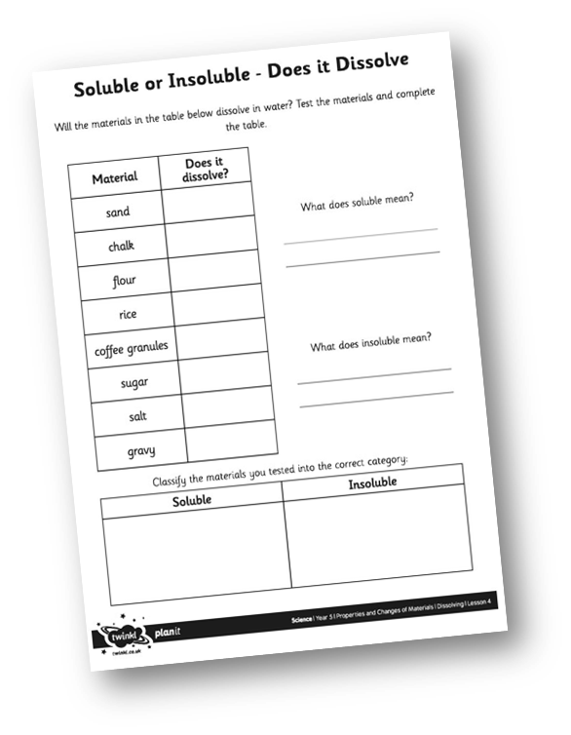

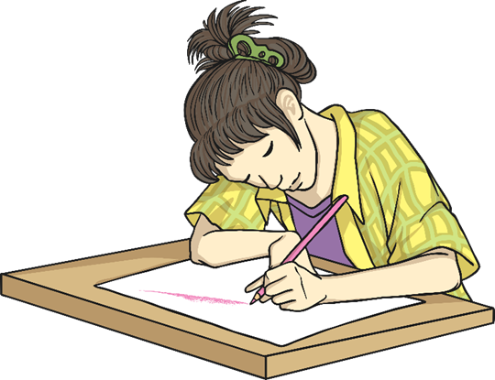
Soluble or Insoluble?
Complete your Year 5 29th June 2020 Learning Pack Topic Lesson 3 Soluble insoluble Activity Sheet to record whether the different materials will dissolve in water. These include sand, chalk, flour, rice, coffee granules, sugar, salt, gravy. (If you don’t have all of these at home do not worry!)
Don’t forget to describe what you see.

