Slide 1


Dissolving
Lesson 4

Slide 2
Aim
I can investigate factors that is affect the speed of dissolving.

Slide 3
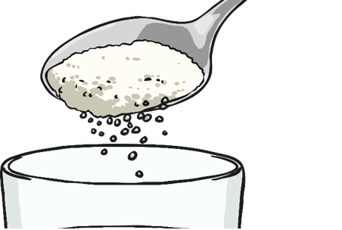
What is dissolving?
Many people get confused between dissolving and melting, but there are several important differences:
Dissolving
Dissolving involves a liquid and another material, often a solid.
In dissolving, the solid mixes into the liquid to make a new liquid, called a solution.
Dissolving doesn't need heat to occur.

Slide 4


Investigating Dissolving
You are going investigate dissolving.
You will need to consider the possible variables that might affect dissolving, then think of a question to ask about one of these variables. Talk to your partner about the possible variables.

Slide 5

Investigating Dissolving
Click on the speech bubbles to reveal some possible variables.
Number of stirs
?
?
Type of container
?
Mass of material
Type of water
?
?
Water temperature
Speed of stirs
How many of these variables did you think of? Did you think of any others?
?
?
?
Time to dissolve
Particle size
Time stirred
?

Slide 6

Investigating Dissolving
Now you need to decide on the question you are going to investigate.
Look at the variables, and choose your independent variable (the thing you will change) and your dependent variable (the thing that is affected by the independent variable, and the thing you will observe or measure).
Use these variables to form your question.
All the other variables should be the controlled variables, and should stay the same.
Record your choices on your on your Dissolving Investigation Activity Booklet.
Number of stirs
Mass of material
Type of water
Type of container
Speed of stirs
Time to dissolve
Particle size
Time stirred
Water temperature

Slide 7
Investigating Dissolving
For example: I would like to investigate if stirring speeds up dissolving.
The independent variable this means the one thing you change (the number of stirs).
The dependent variable the time which you will record.
The controlled variable this means what you will keep the same., for example, the amount of sugar, the temperature of the water and the cup that you are mixing in.
Number of stirs
Mass of material
Type of water
Type of container
Speed of stirs
Time to dissolve
Particle size
Time stirred
Water temperature

Slide 8
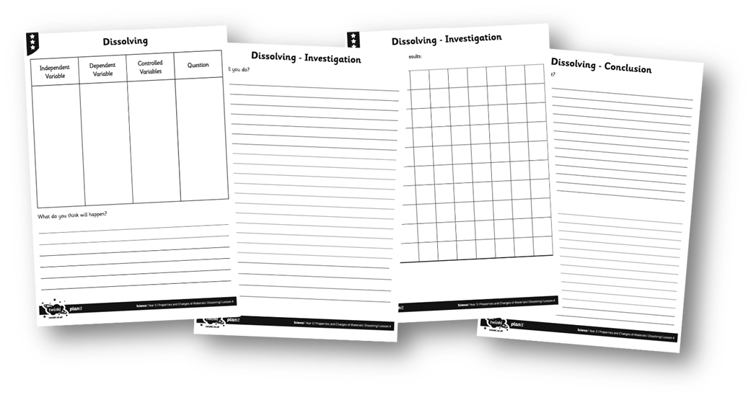

Investigating Dissolving
You decide what you would like to investigate. You can find an activity sheet, Year 5 29th June 2020 Learning Pack Topic Lesson 4 Investigation, either investigate using it or use it as a template for recording. Don’t forget to make a prediction, and record your findings.

