Slide 1


Irreversible Changes
Lesson 2

Slide 2
Aim
I can identify and explain irreversible chemical changes.
Success Criteria
I can identify irreversible chemical changes.
I can explain irreversible chemical changes.
I can describe the new materials created in irreversible chemical changes.

Slide 3


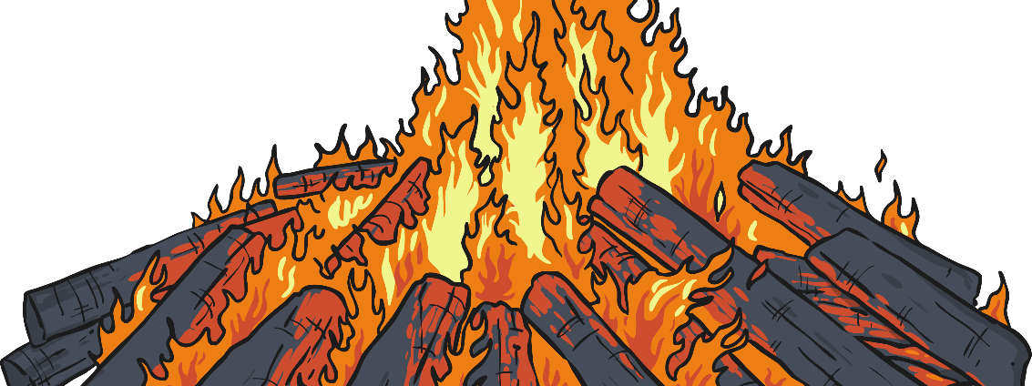
What are these changed called?
Irreversible reactions
Heat caused the chemical change to occur.

Slide 4


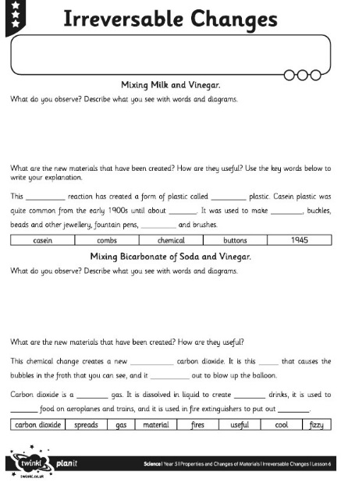

Try another irreversible changes experiment today.
Can you make any new materials? Complete your Year 5 6th July Learning Pack Topic Lesson 2 Experiment sheet as you carry out the activity.

Slide 5

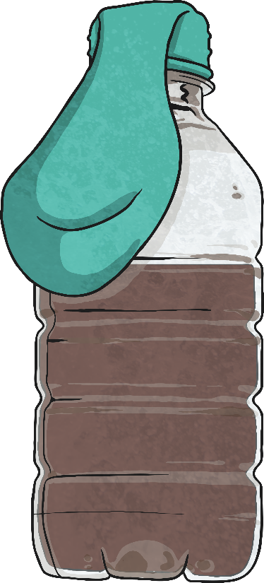
Seeing Changes – Mixing
Bicarbonate of Soda and Vinegar
Use a cardboard cone to put 50g of bicarbonate of soda into a balloon.
Pour 50ml of white vinegar into a plastic bottle.
Stretch the balloon over the top of the bottle without letting the bicarbonate of soda fall in.
Lift up the balloon to let the bicarbonate of soda fall into the vinegar.

Slide 6
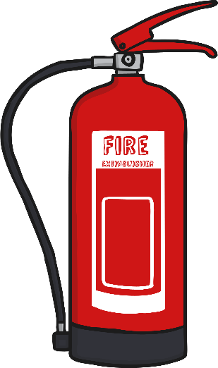


Seeing Changes – Mixing
Bicarbonate of Soda and Vinegar
As you mix the vinegar with the bicarbonate of soda, they react with each other. They create a new material - carbon dioxide. It is this gas that causes the bubbles in the froth that you can see.
The carbon dioxide gas spreads out to blow up the balloon.
What did you observe?
Carbon dioxide is a useful gas. It is dissolved in liquid to create fizzy drinks, it is used to cool food on aeroplanes and trains, and it is used in fire extinguishers to put out fires.

Slide 7
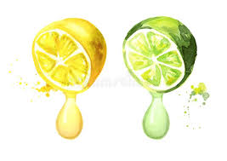
Seeing Changes – Mixing
Bicarbonate of Soda and …
As you mix the vinegar with the bicarbonate of soda, they react with each other. They create a new material - carbon dioxide. It is this gas that causes the bubbles in the froth that you can see.
The carbon dioxide gas spreads out to blow up the balloon.
Could you try the same experiment but with Lemon/lime juice?
What did you observe?
Did it create a bigger balloon?
Why or why not?

Slide 8


What makes a reaction irreversible?
The reaction makes something new.
Carbon
Gas like carbon dioxide

Slide 9

True or False?
Use what you have learnt to decide whether these questions are true or false. After you have made your decisions click on the questions to see if you were correct.
An irreversible change is one that cannot be changed back.
False
True
Melting chocolate is an irreversible change.
False
Heating materials always causes reversible changes.
Baking bread is an irreversible change.
False
True
Reversible changes create new materials.
True
Irreversible changes can create useful materials.

Slide 10

Aim
I can identify and explain irreversible chemical changes.
Success Criteria
I can identify irreversible chemical changes.
I can explain irreversible chemical changes.
I can describe the new materials created in irreversible chemical changes.

