Slide 1


Separating Mixtures
Lesson 4

Slide 2
Aim
I can use different processes to separate materials from a mixture to produce ‘clean water’.
Success Criteria
I can use sieving, filtering, evaporating and other processes to separate materials from a mixture.
I know when to use which processes to separate mixtures and what order would be best.

Slide 3

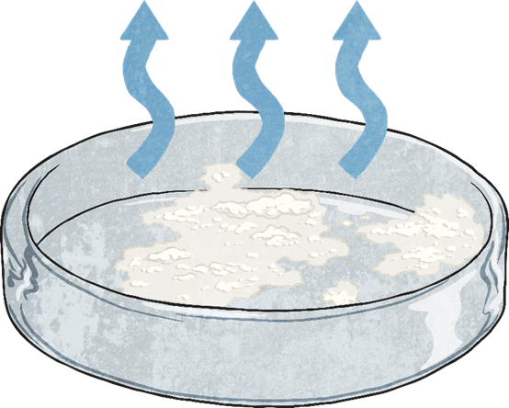

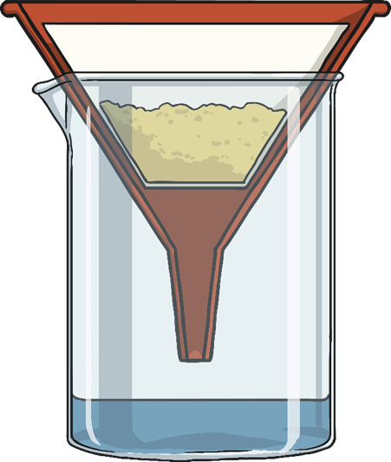
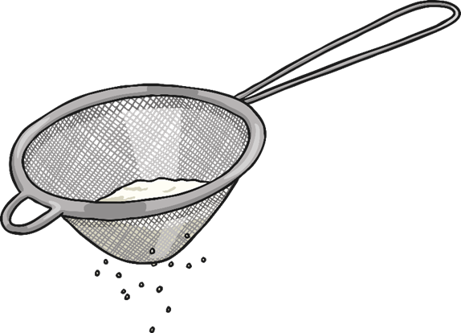
Separating Mixtures
Yesterday you separated different mixtures. Today you are going to have a go at separating materials from a mixture.

Slide 4


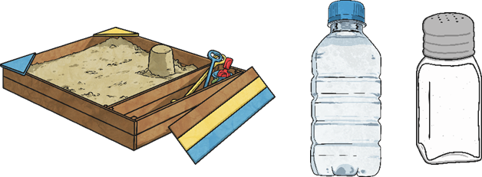
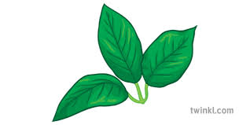
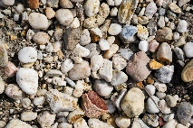
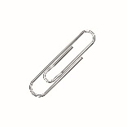
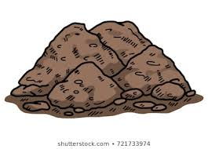
Clean Me!
First, make a mixture of ‘dirty water’. This could include; water, sugar, sand, soil, gravel, leaves, salt, and paperclips.

Slide 5
Clean Me Challenge!
Your challenge is to use some/all of the separating methods, to make your mixture of ‘dirty water’ as clean as possible.
Think carefully about the order of separating.
Please note the water will NOT be clean enough to drink at the end of the process! Bacteria and other microbes are microscopic and you will not have removed these. Some may be dangerous to health. Without proper water treatment our ‘cleaned’ water MUST NOT be consumed.
As you clean your water, record your process explain why you have chosen that separating technique.
Year 5 6th July 2020 Learning Pack Topic Lesson 4 Clean Me Challenge.

Slide 6
Answers
It is best to remove the larger materials first.
Sieve out the leaves and gravel.
Use a magnet to remove the paper clips.
sand
Then leave the salt/sugar water somewhere warm like a windowsill or you can gently boil the water to leave behind the salt/sugar.
water vapour
Filter out the soil and sand from the salt/sugar water.
salt/sugar water
salt/sugar

