Slide 1

We are learning
To understand what a contraction is.

Slide 2
What is a contraction?
A contraction is a grown up word for ​two words that are joined together, and made shorter.
did not = didn’t
have not = haven't

Slide 3
A word that has a contraction has ​an apostrophe in it. The apostrophe ​is in the place of a missing letter.
did not = didn’t
have not = haven't
What letter is ​missing in didn't?
What letter is ​missing in haven't?

Slide 4
he is = he’s
she is = she’s
have not = haven’t
should not = shouldn’t
would not = wouldn’t
they are = they’re
they have = they’ve

Slide 5
Can you guess what the ​contraction is?
she is =
she’s

Slide 6
Can you guess what the ​contraction is?
he is =
he’s

Slide 7
Can you guess what the ​contraction is?
did not =
didn’t

Slide 8
Can you guess what the ​contraction is?
have not =
haven’t

Slide 9
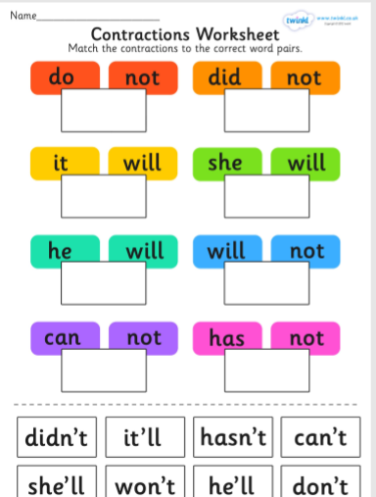
For today’s activity I would like you to match the contractions to the correct words.

