Slide 1
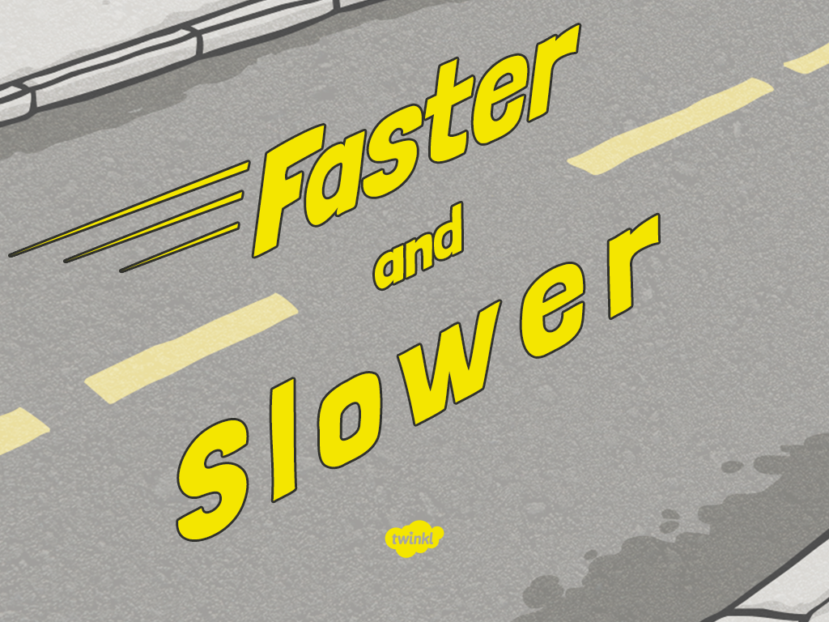

Slide 2
Aim
I can investigate the effects of friction on different surfaces.
Success Criteria
I can explain the force of friction.
I can make a prediction about which surface creates the most friction for a toy car.
I can take measurements and record my results in a table.
I can explain my results.

Slide 3
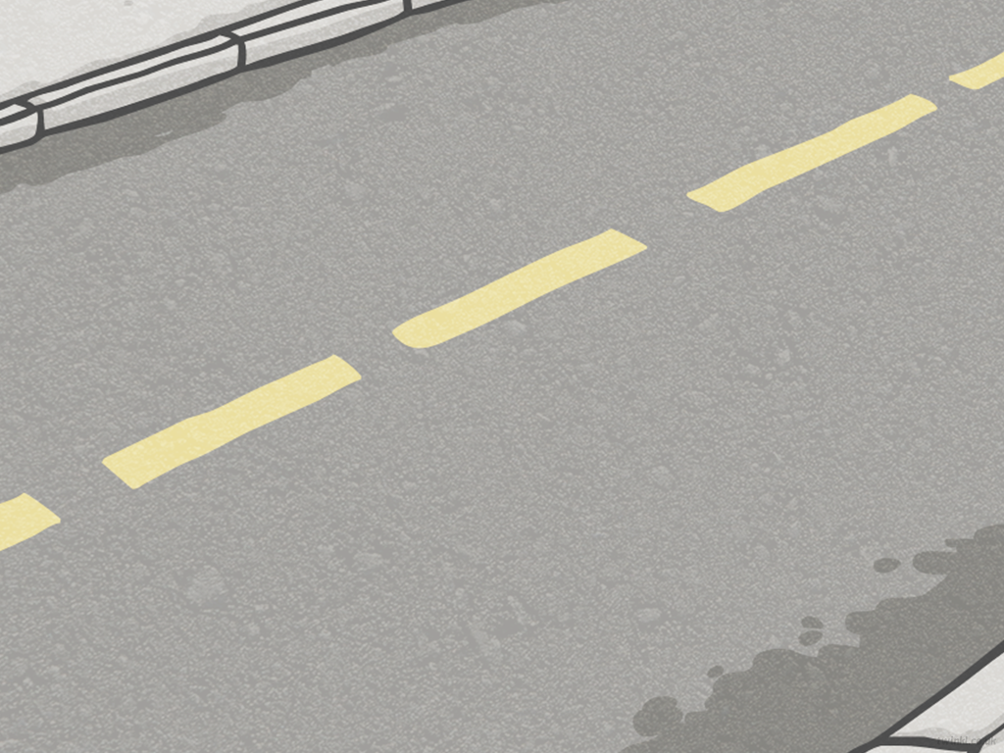
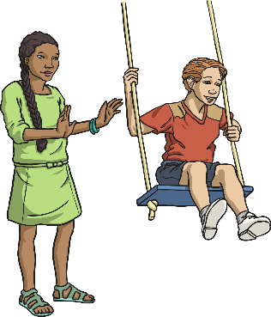
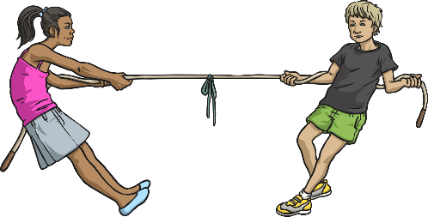
Making Things Move
Forces make things move. Whenever an object starts to move or moves faster, it is a force making this happen.
Forces can also make things stop moving or slow down.
But what is a force?
Forces are pushes and pulls.
These pushes or pulls will always change the motion of an object. They will either make it start to move or speed up, slow it down or even make it stop.
Talk to your partner about examples of forces changing the motion of different objects.

Slide 4
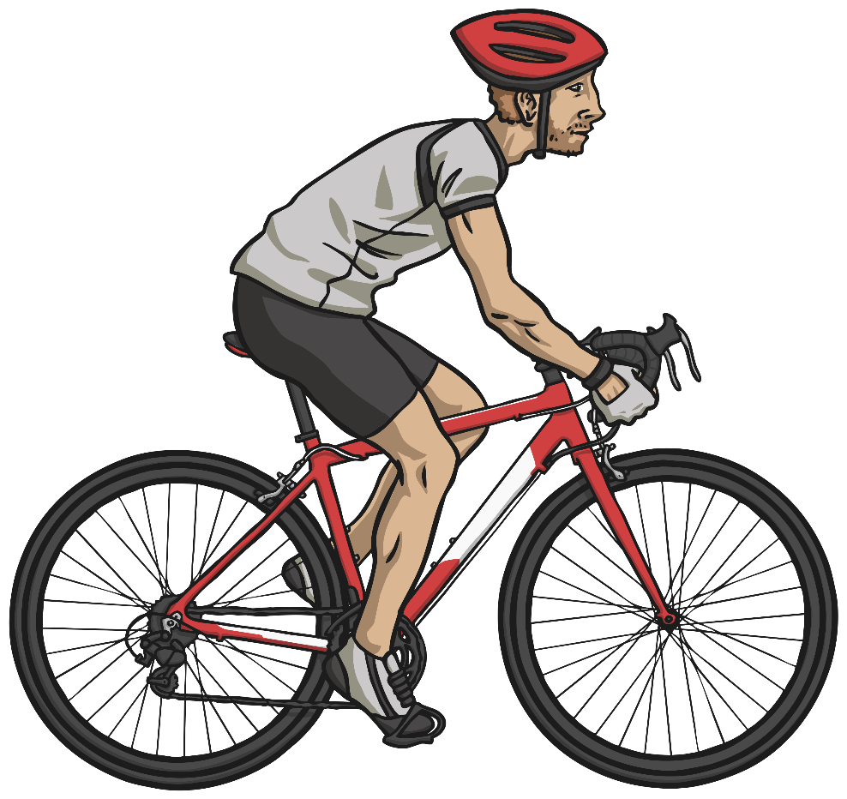
Making Things Move
Cyclists sometimes travel over different surfaces.
By pushing the pedals harder or faster, he can change the motion of the bicycle. It will speed up.
When the cyclist pulls on the brakes, the brake pads will push on the wheels, changing the bicycle's motion. It will slow down, and eventually stop.

Slide 5
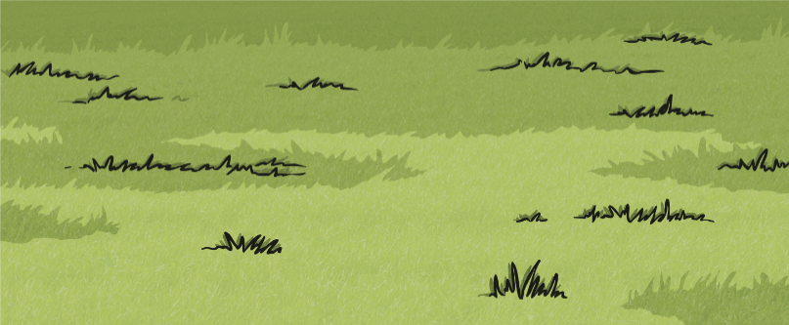
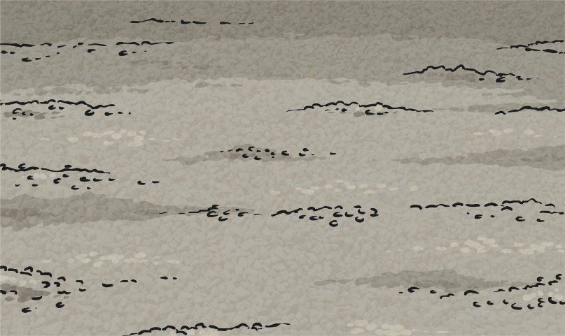
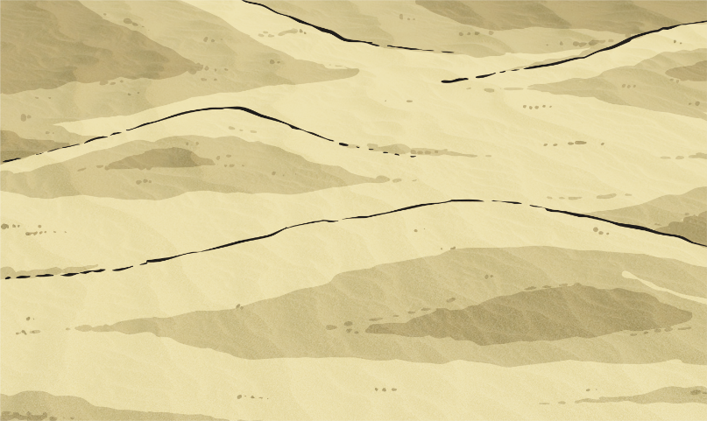
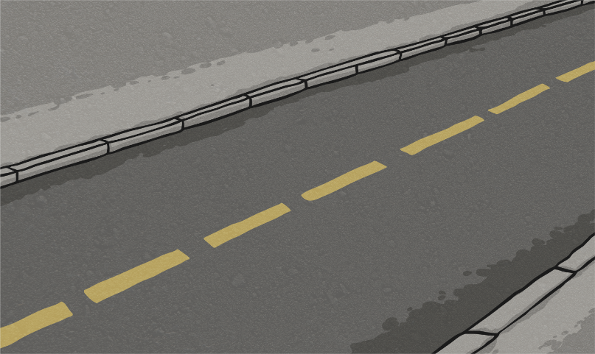
Different Surfaces
Cyclists sometimes travel over different surfaces.
Grass
Gravel
Sand
Road

Slide 6
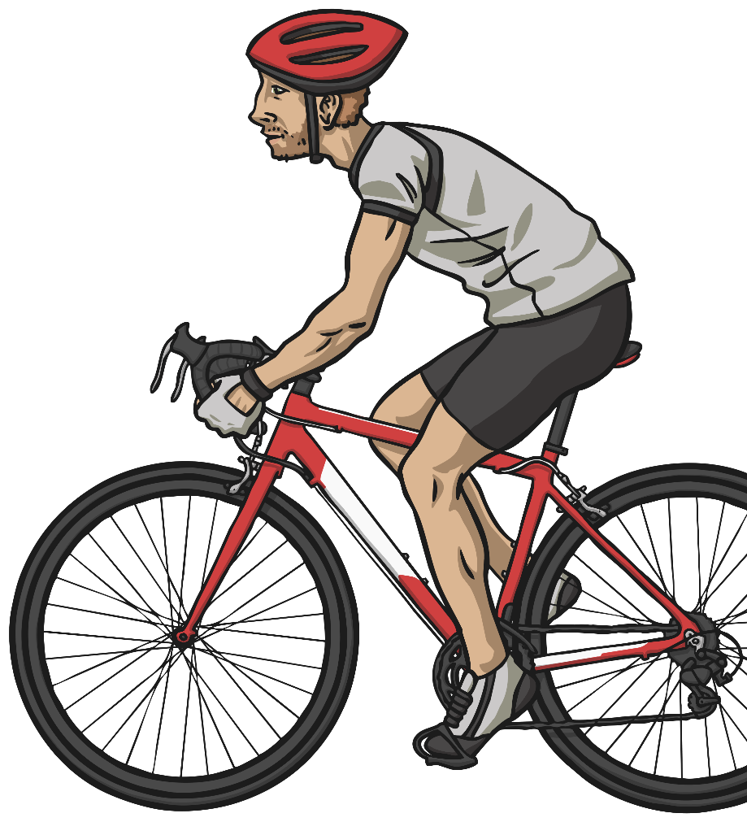
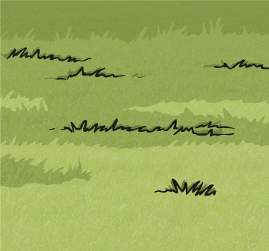
Different Surfaces
How do the different surfaces affect the motion of the bicycle?
Grass
Gravel
Sand
Road

Slide 7

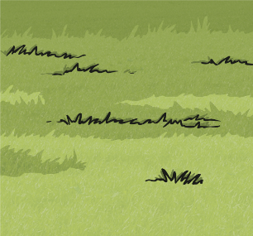
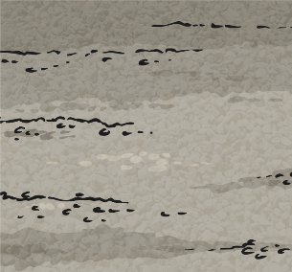
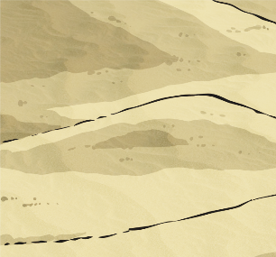

Different Surfaces
These surfaces all exert a force on the bicycle. This force is called friction.
Friction is a force that holds back the movement of an object. Friction acts in the opposite direction to the movement of the object.
The driving force pushes the bicycle, making it move.
Friction pushes on the bicycle, slowing it down.
Grass
Gravel
Sand
Road

Slide 8
Different Surfaces
Different surfaces create different amounts of friction.
The amount of friction created by an object moving over a surface depends on the roughness of the surface and the object, and the force between them.
The driving force pushes the bicycle, making it move.
Friction pushes on the bicycle, slowing it down.
Grass
Gravel
Sand
Road

