Slide 1


Slide 2

Friends
How are you and your friends similar?
What makes a good friend?

Slide 3
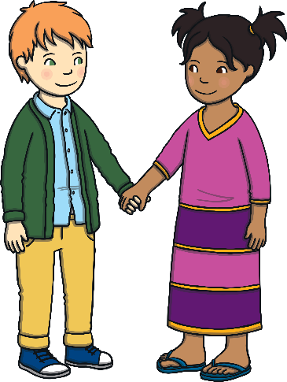
Friends…
Play with us.
Share with us.
Choose to be our partners.
Compliment us.
Make us laugh.
Listen to us.

Slide 4
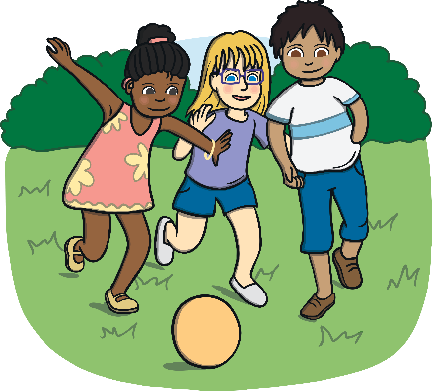
Friends
What do you like to do with your friends?

Slide 5

Friends
Do you think that all friends last forever?
Can everyone be a friend?
Can we be friends with someone all the time?
Could you be friends with someone after you have fallen out?

Slide 6

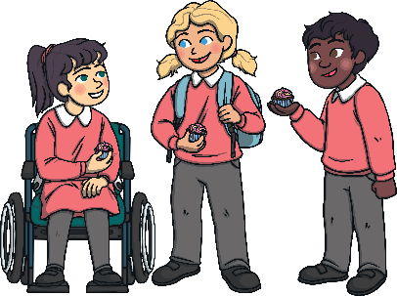
Friends
Try and remember how to be a good one!

