Slide 2

What Is a Rainbow?
Rainbows are lovely to look at.
A rainbow is an arc made up of seven colours.
A rainbow appears in the sky
when it is raining and sunny
at the same time.
A rainbow will appear
opposite the sun.
Have you ever seen a rainbow?

Slide 3
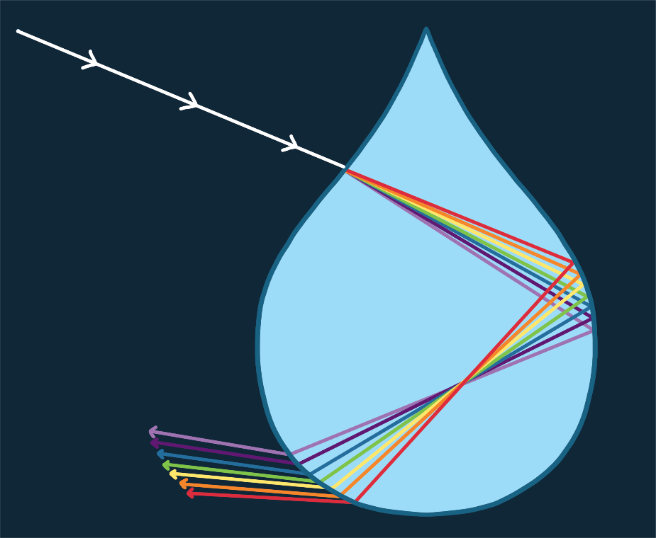
How Does a Rainbow Happen?
When it is raining, light passes through the raindrops.
The white light all around us is made up of different colours, all blended together.
When the white light passes through the raindrops, it splits up into separate colours. That’s what we see when a rainbow forms!

Slide 4

Why Is a Rainbow Arc-Shaped?
The light makes an arc shape because
the separate colours have different wavelengths.
This means that some are short and some are longer.
When the colours are seen together, they form an arc shape.

Slide 5

The Colours of the Rainbow
Do you know the colours of
the rainbow?
Here is a sentence to help you remember the colours of the rainbow:
Richard
red
Of
orange
York
yellow
Richard of York gave battle in vain.
Gave
green
Battle
blue
In
indigo
Vain
violet

Slide 6
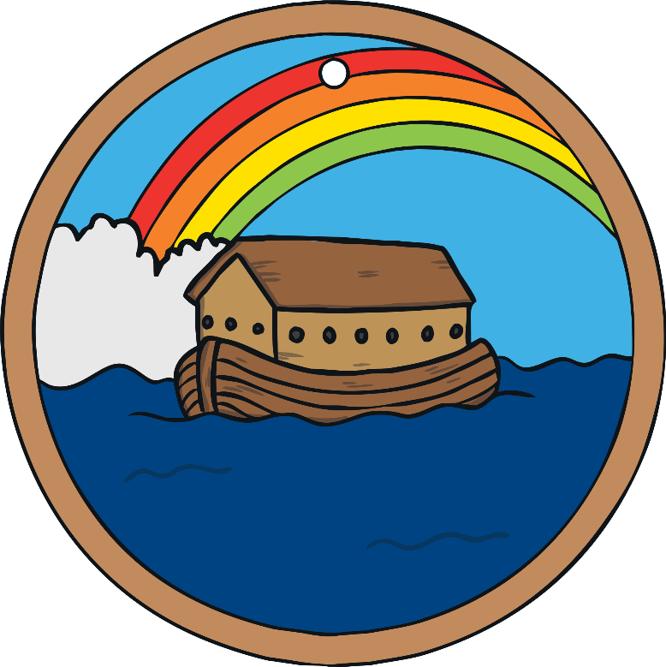
Rainbow Symbolism
Rainbows are often seen as signs of hope and peace.
In the Bible, there is a story about Noah building a wooden arc to save himself and his family from a great flood.
God sent a rainbow as a promise that the world would never be destroyed by a flood again.

Slide 7

Rainbow Symbolism
LGBTQ+ groups use rainbow flags during Pride marches to celebrate people’s
differences.
The rainbow represents freedom and diversity.
It can be a symbol of hope during difficult times.

Slide 8
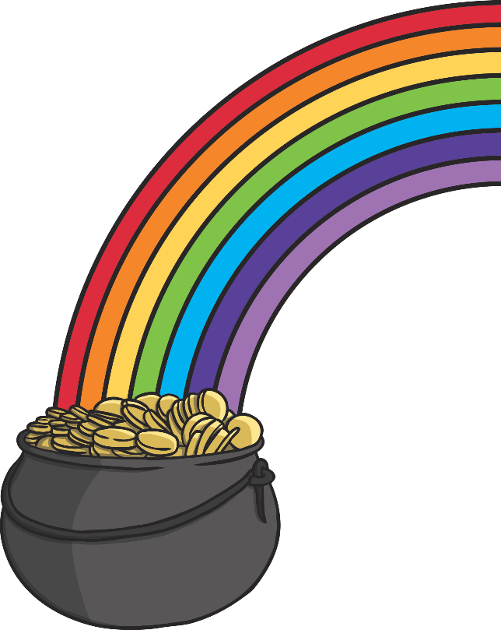
Gold at the End of a Rainbow
Some people believe that there is gold at the end of a rainbow.
It is said that a leprechaun will hide their pot of gold at the end
of a rainbow.
A leprechaun is a fairy-like creature in Irish folk stories.
It is believed that they can grant wishes and give
treasure away. They can also play tricks on people.
Have you ever reached the end of a rainbow?

Slide 9
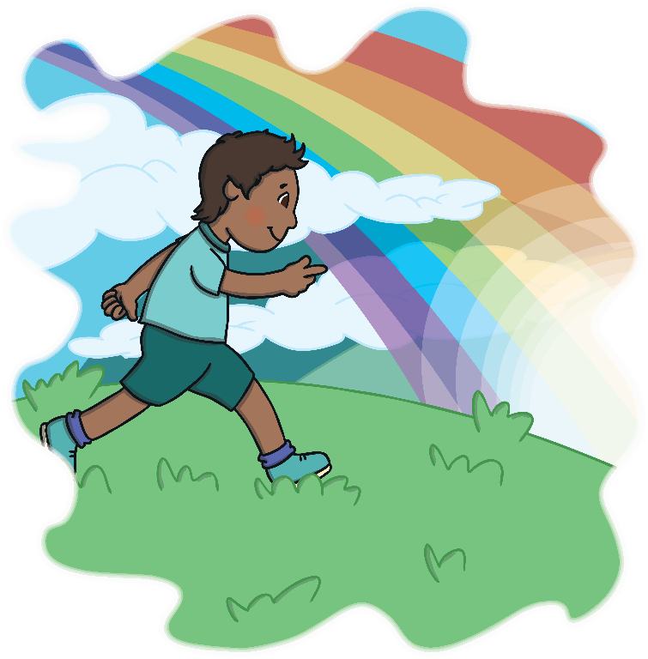
Rainbows in Stories
One of the most famous songs about rainbows is in the story ‘The Wizard of Oz’. The song is called ‘Somewhere Over the Rainbow’.
Can you think of any other songs or stories that mention rainbows?

