Slide 1

We are learning
To identify a goal that I would like to achieve.

Slide 2
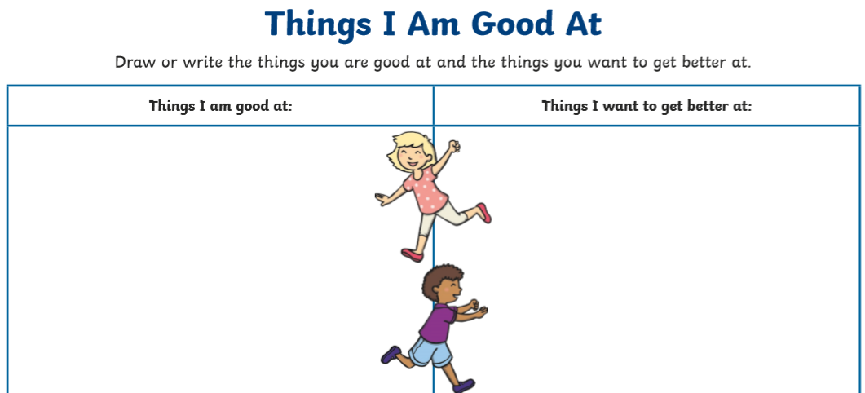
Is there something that you would like to become better at doing?

Slide 3
We call this a goal.
A goal is something we would like to achieve.

Slide 4
I’ve been thinking about a goal that I would like to achieve.
I would like to become better at running for longer.

Slide 5


