Slide 1

We are learning
To predict what will happen in a story.

Slide 2
For the rest of our English lessons this week, all of our activities will be based on a story. Have a look on the next slide to find out what it is.

Slide 3
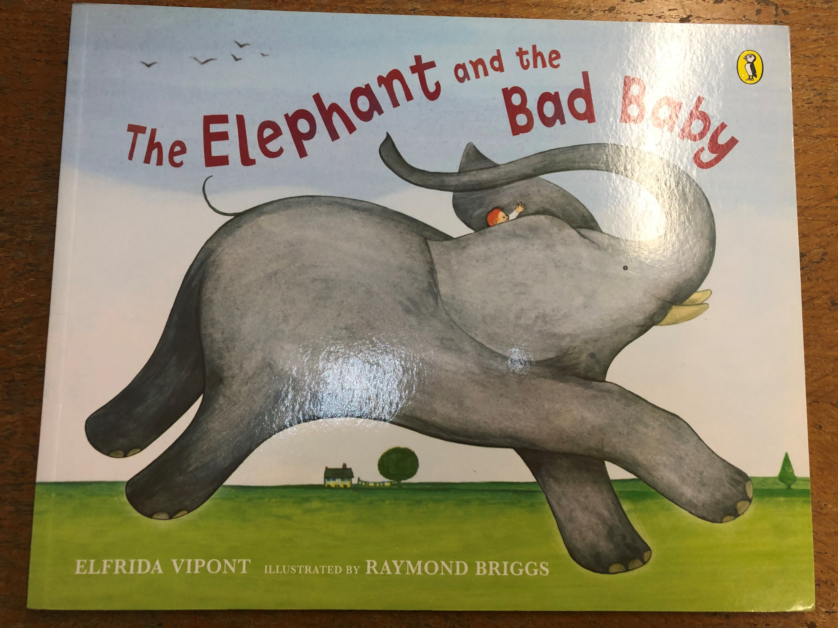

Slide 4
Sometimes we read a new story straight away and sometimes, we make a prediction about what might happen in the story.

Slide 5
To help us with our prediction today, lets think about:
Who the characters might be?
What the setting might be?
What may happen in the story?
Will the story have a happy ending?

Slide 6
Today, I would like you to write your prediction for the story ‘The Elephant and the Bad Baby’. I would also like you to draw a picture.
Your prediction might be:
I think this story is about a baby and an elephant who go to the park. They are both cheeky and do mischievous things.

