Slide 1

We are learning
To identify what we are good at and what we are not so good at.

Slide 2
What sorts of things are you good at doing?

Slide 3
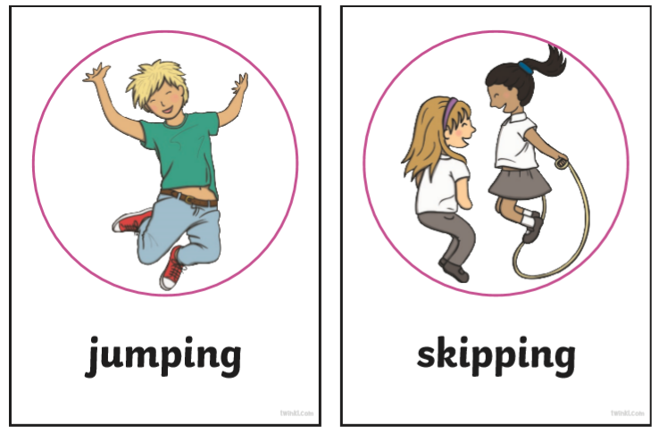

Slide 4
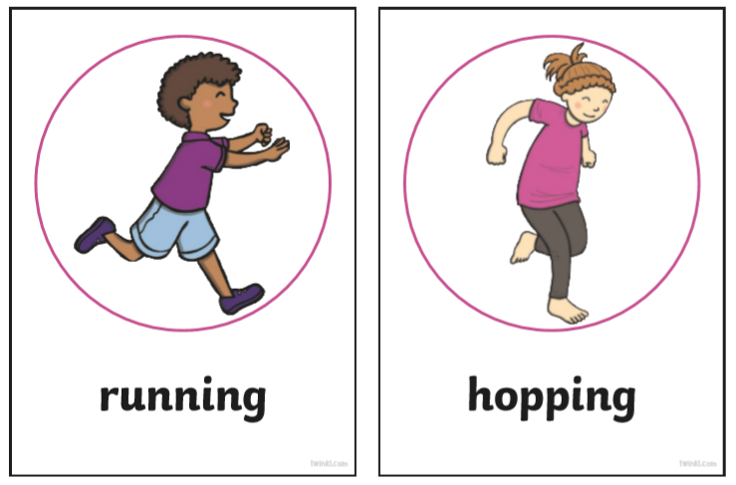

Slide 5
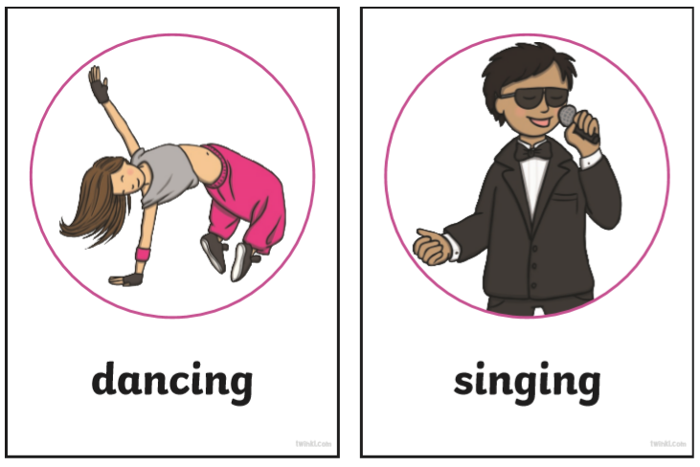

Slide 6
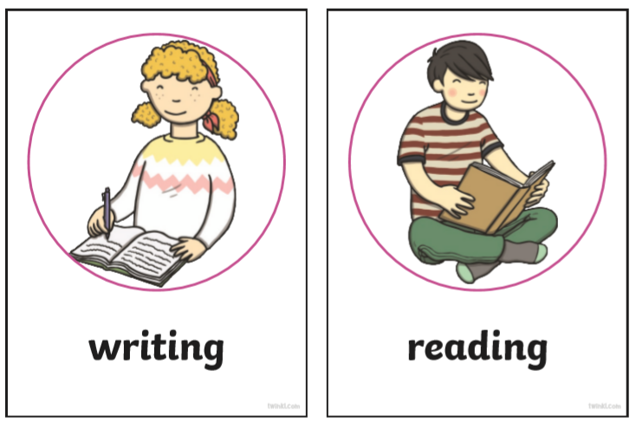

Slide 7
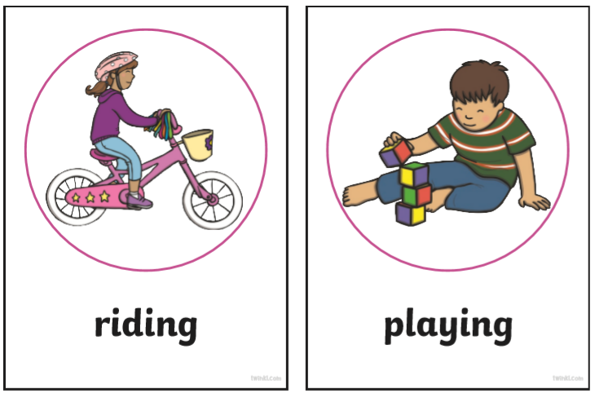

Slide 8
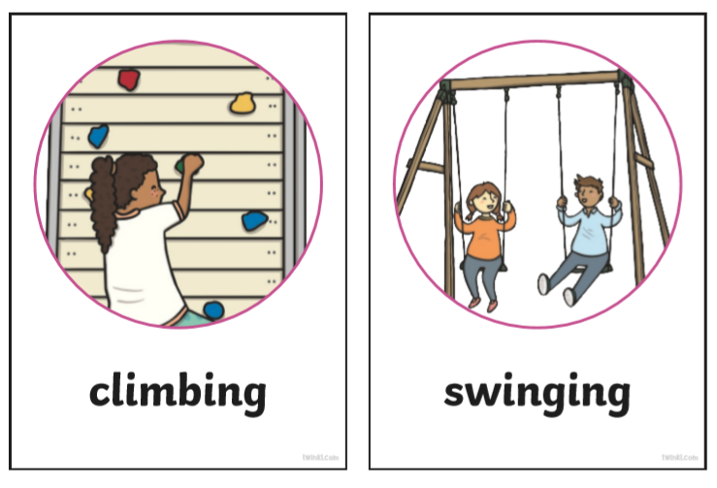

Slide 9
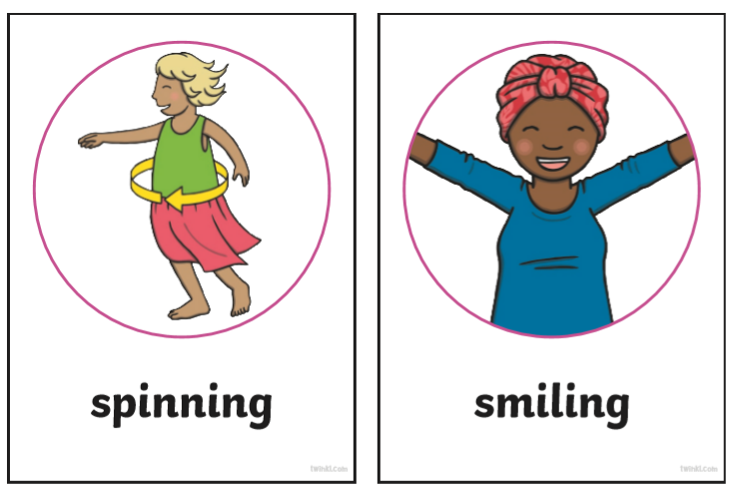

Slide 10


