Slide 1

We are learning
To solve addition calculations.
To use a hundred square to help us.

Slide 2
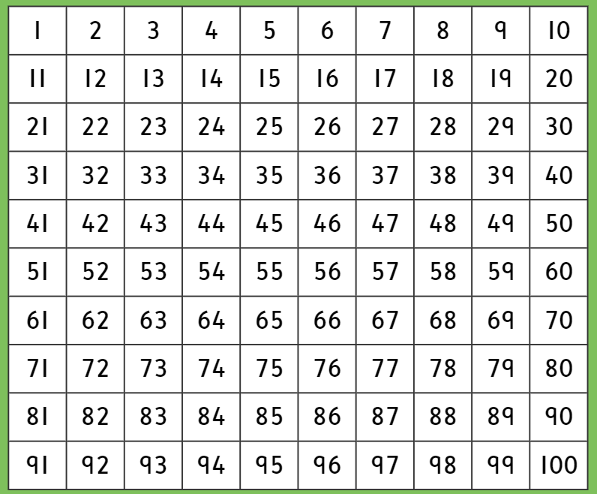
Here is a hundred square. I’m sure you recognise it.

Slide 3
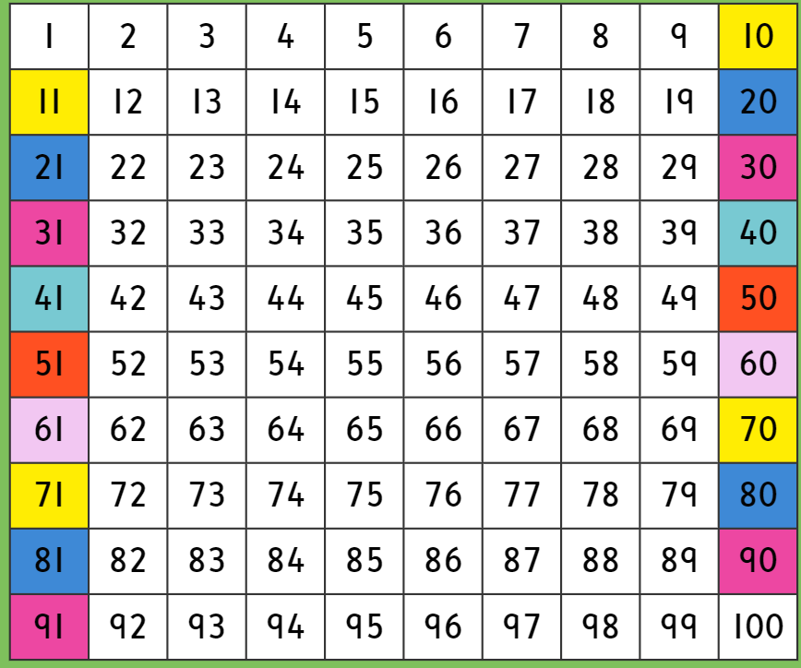
Have a look at how I have painted the numbers on the hundred square. They show you which number to go to once you have reached the end of a line. Follow the colours.

Slide 4
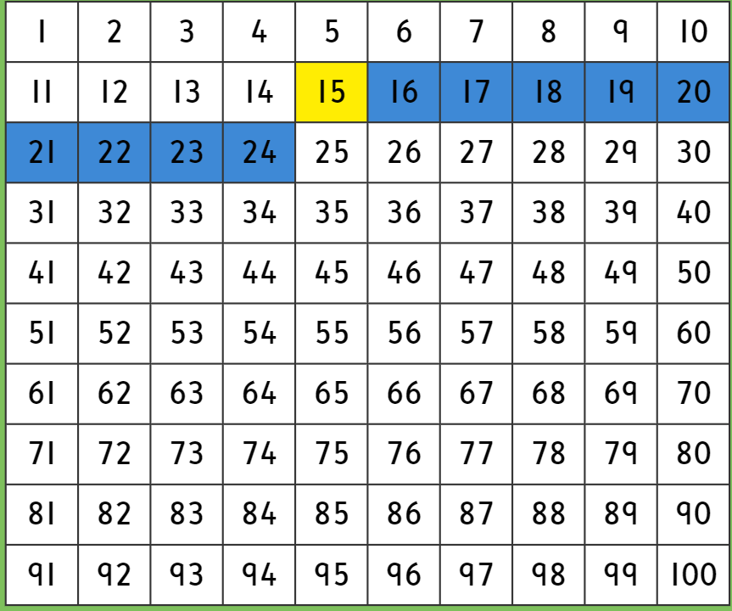

Read this addition calculation with me……
15 + 9 =

Slide 5
Try and solve these calculations on your own. Use your hundred square to help you and remember, jump forwards!
23 + 8 = 31
38 + 9 = 47
15 + 15 = 30
50 + 7 = 57
22 + 10 = 32

Slide 6
It’s time to solve some addition calculations on your own. The calculations are on a piece of paper.
Don’t forget………………………….
No backwards numbers!

