Slide 1
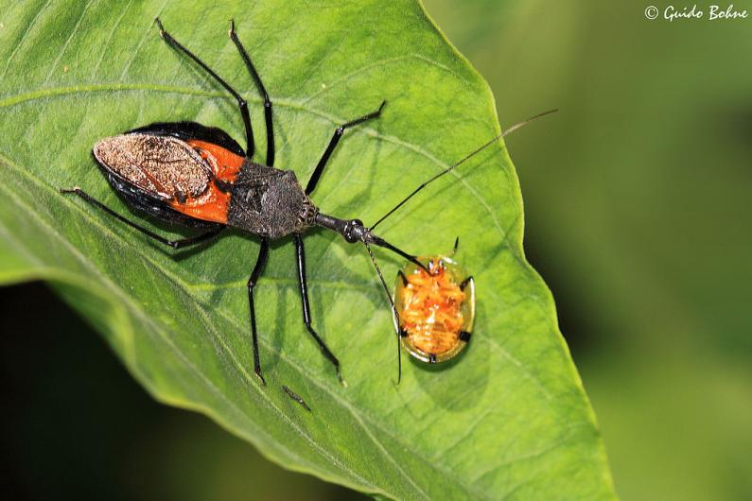
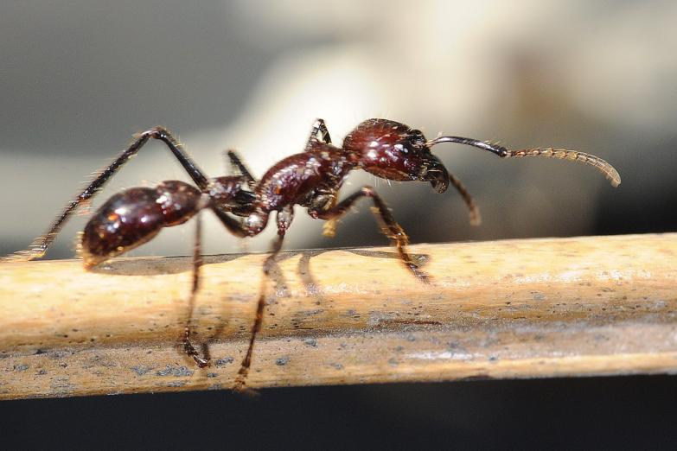
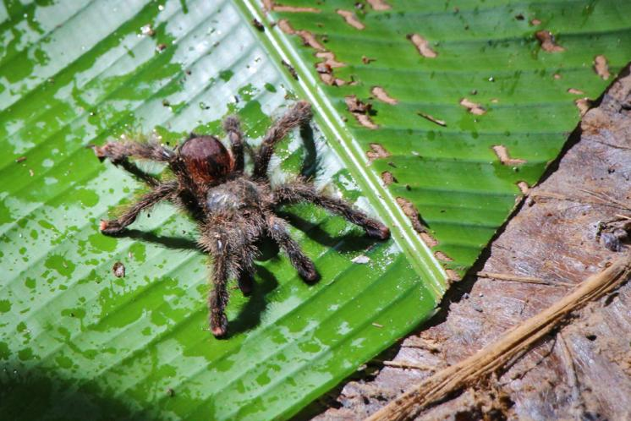
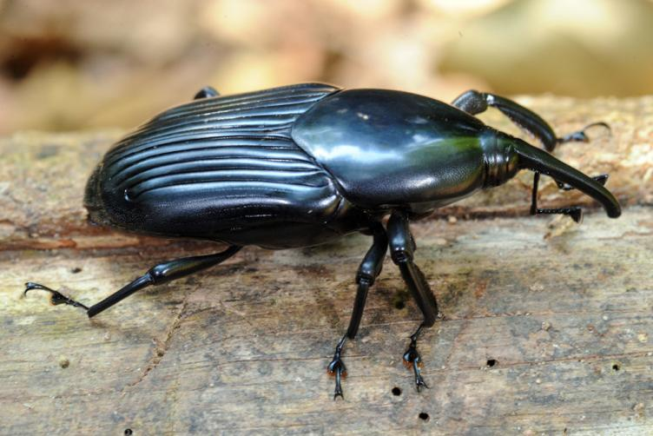

Insects of the
Amazon Rainforest

Slide 2
We are learning
To find out about an amazing creature.
To write facts about it.

Slide 3
Today we will be learning about a fascinating creature.
Look on the next slide to find out what it is......

Slide 4
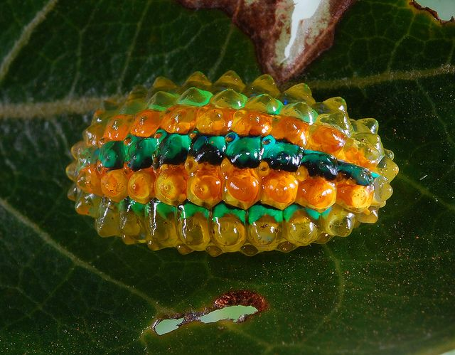
The Jewel Caterpillar

Slide 5
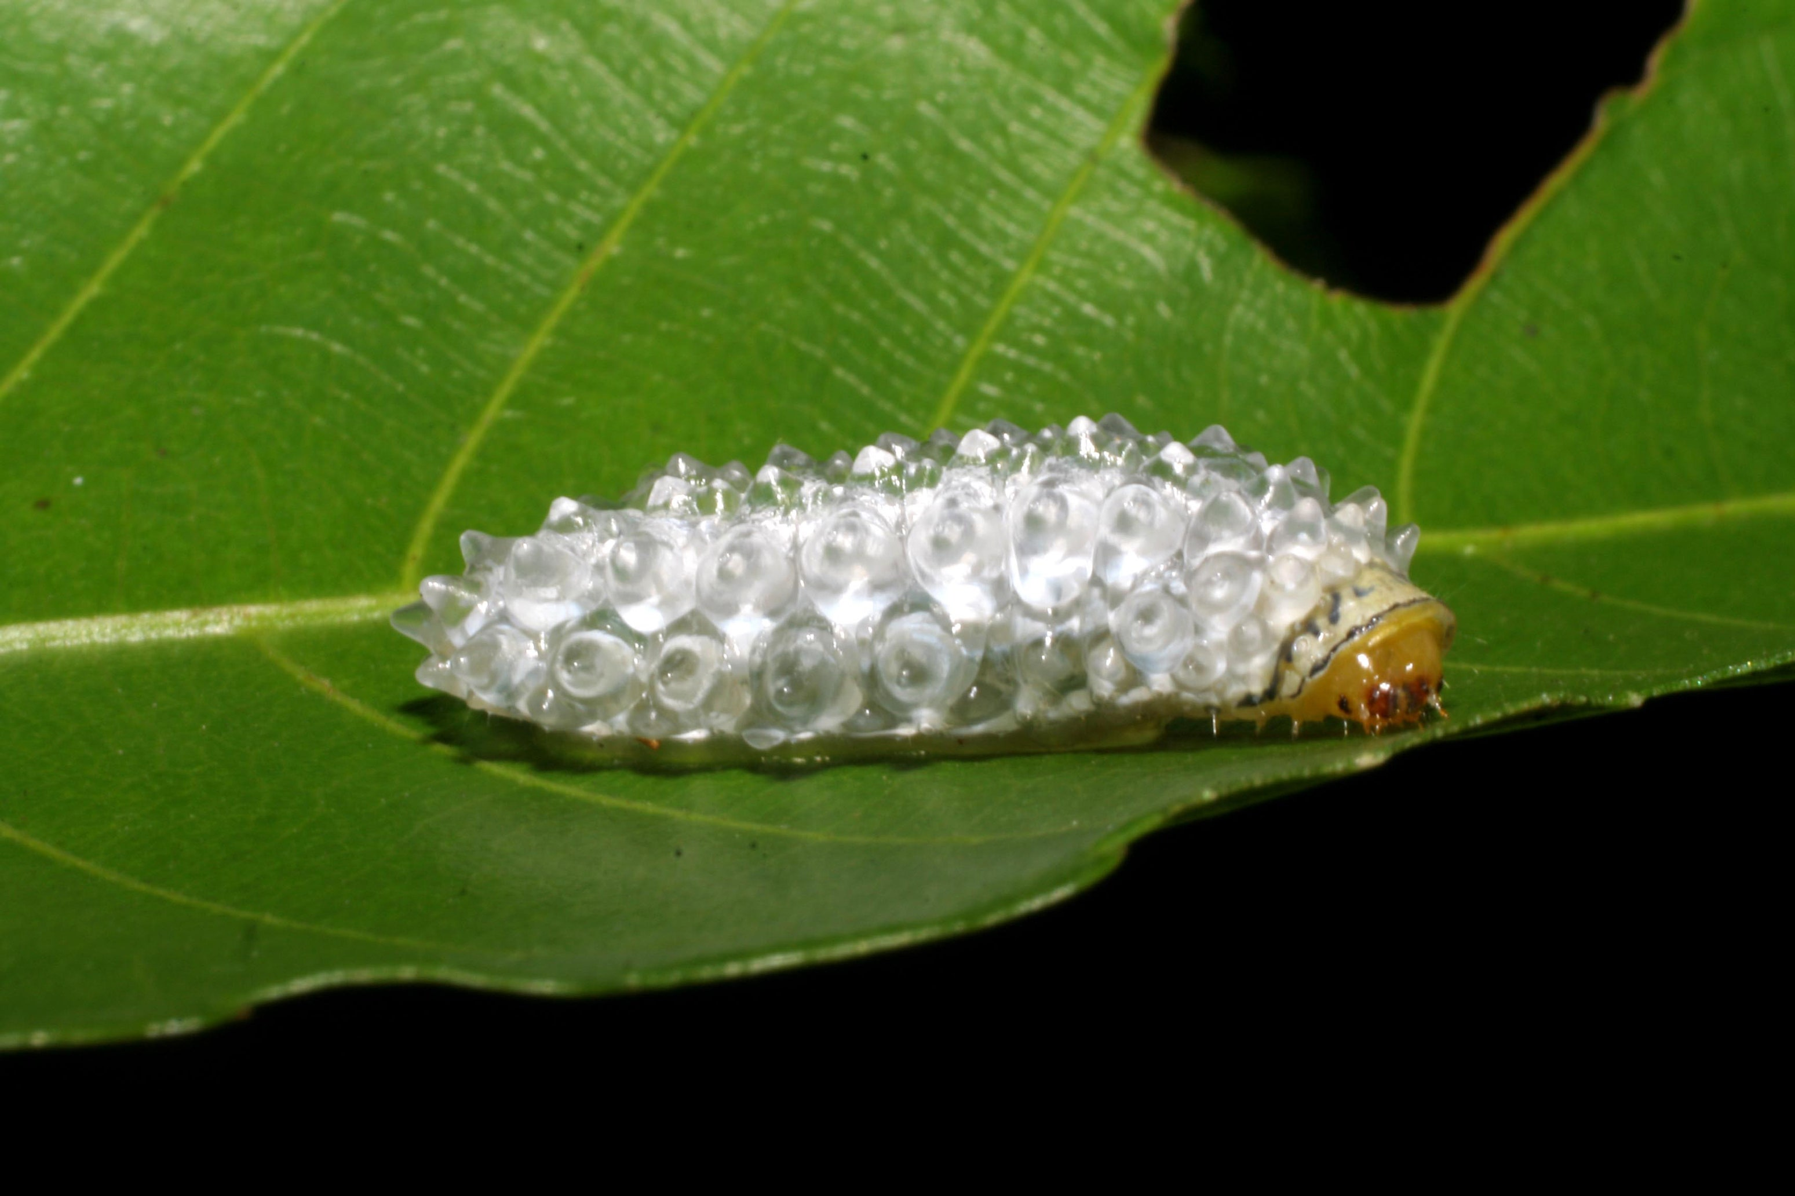
Habitat:
The Jewel Caterpillar can be found in the lower layers of the rainforest.

Slide 6
Appearance:
Their bodies are covered in a sticky substance although it looks like they are made of beads and glass. Their sticky bodies makes it hard for predators to eat them. Jewel caterpillars eventually turn into moths, not butterflies.

Slide 7
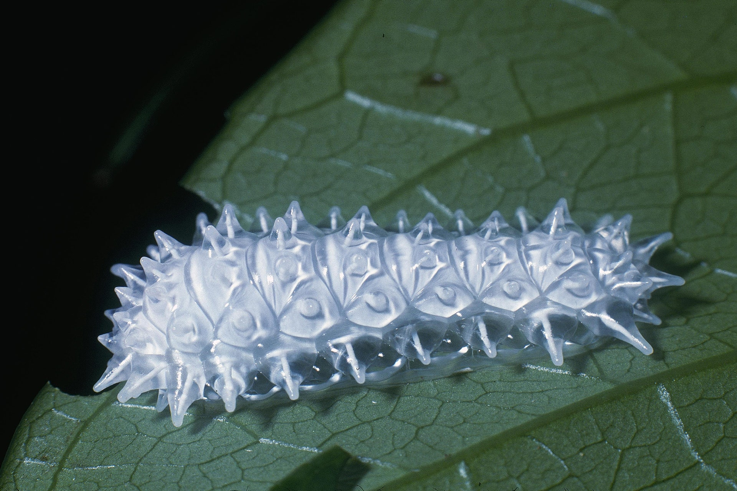

Slide 8
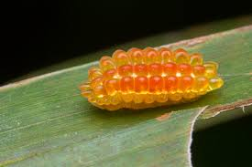
What they eat:
Jewel caterpillars eat leaves, plants, petals and fruit.

Slide 9
For today’s lesson, I would like you to write facts about the Jewel caterpillar. I would also like you to draw a picture of one too.

