Slide 1



RE
Caring for Others
Year One
RE | Year 1 | Caring for Others | Be My Guest | Lesson 5

Slide 2
We are learning
I can explain the message in the story Be My Guest.

Slide 3
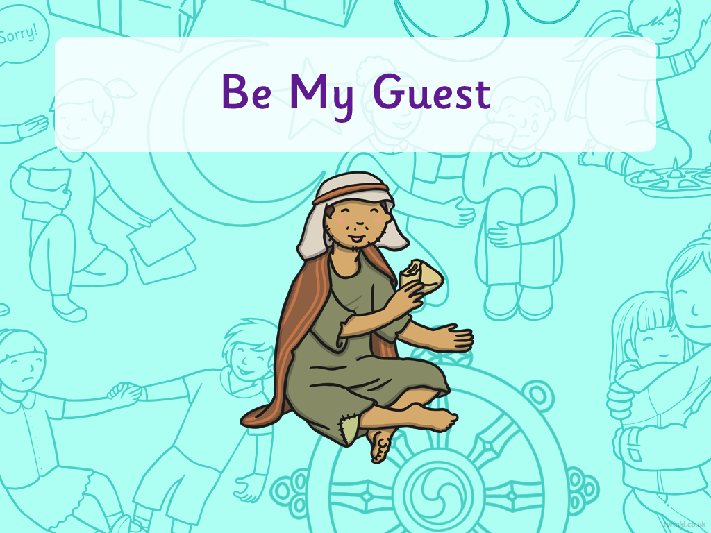


Title slide (themed) here

Slide 4

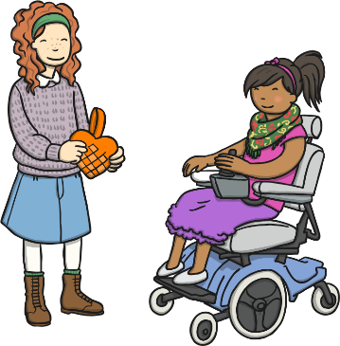
Putting Others First
Have you ever given someone else your last sweet or chocolate, even though you really wanted to eat it?
Have you ever let someone else have a turn with a toy, even though you really wanted a turn yourself?
Have you ever done something kind like this?
How did it make you feel?
How do you think it made the other person feel?

Slide 5

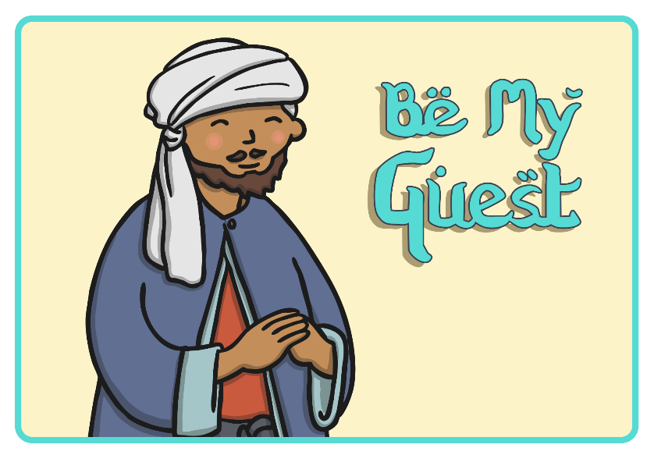

Slide 6
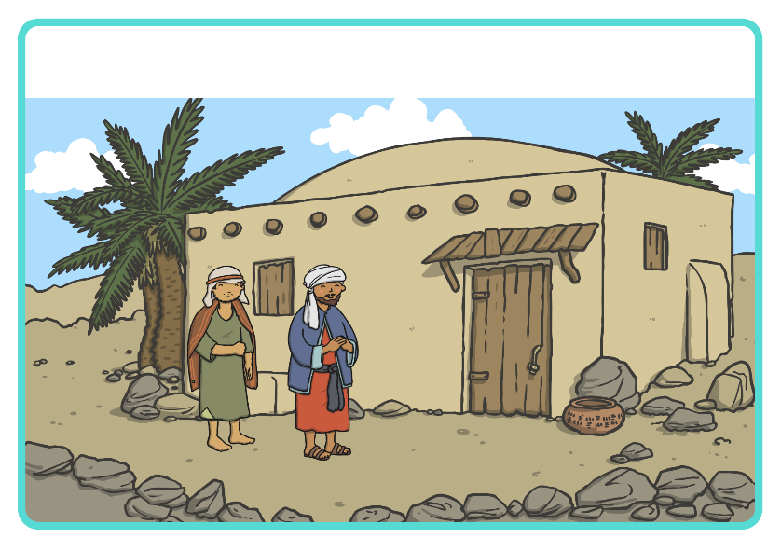
Prophet Muhammad asked a man called Abdul to take a poor and very hungry man home, to feed him and look after him.

Slide 7
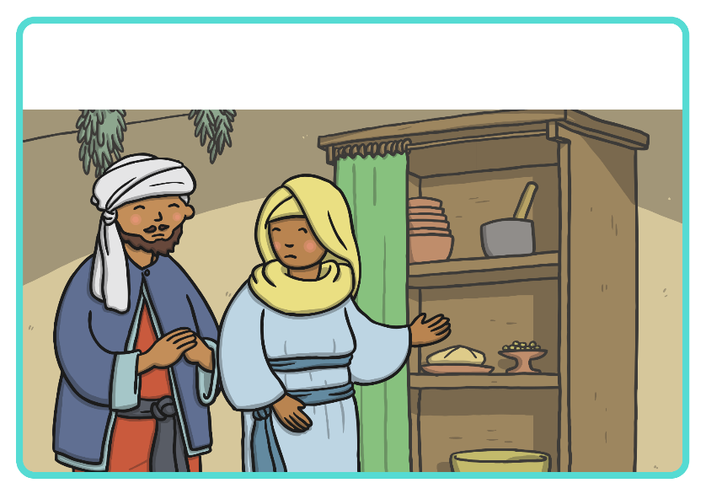
Abdul returned home and told his wife what Prophet Muhammad had asked him to do. His wife told Abdul that sadly, they only had enough food for their children that night.

Slide 8
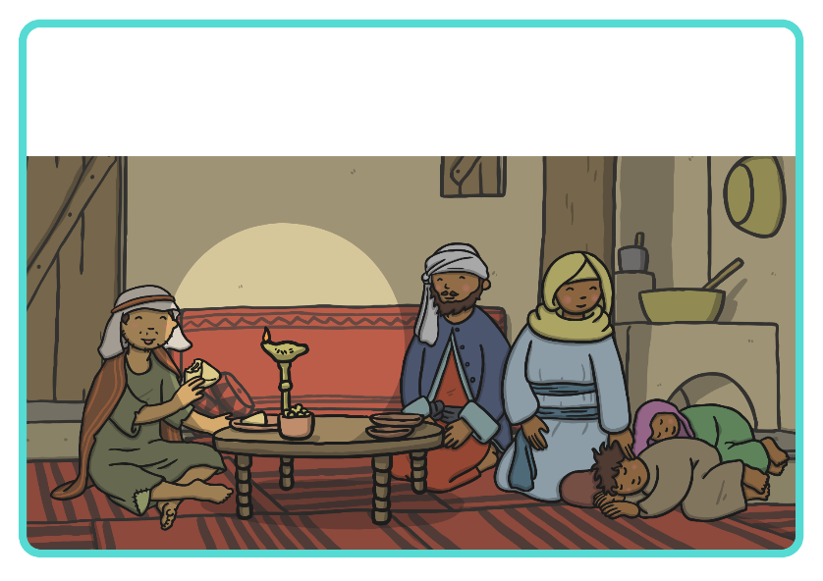
Abdul had to make a difficult decision and sent his children to bed.
A meal was prepared for their visitor using the food that they had.
To save the visitor from feeling sad, Abdul and his wife turned down the lamp so that he couldn’t see that they both had empty plates.

Slide 9
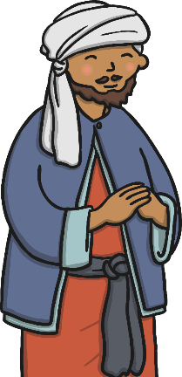
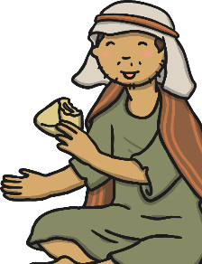
Putting Others Before Yourself
How did Abdul put the poor man’s needs before the needs of himself and his family?

Slide 10


Be My Guest Activity

Slide 11


How Can The Story Help Us?
Think of a time when someone has put what you wanted before what they wanted.
What did they do and how did it make you feel?
What could you do to help other people?

Slide 12
Aim
I can explain the message in the story Be My Guest.
Success Criteria
I can tell you what making a sacrifice means.
I can tell you why it’s important to think of others, before yourself.
I can say how the story can help me in my own life.

