Slide 1
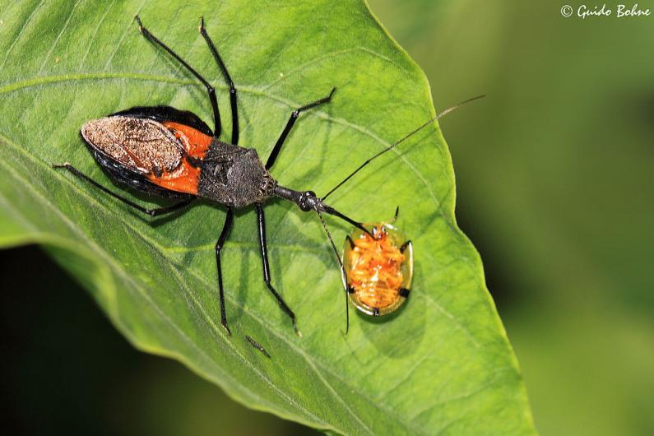
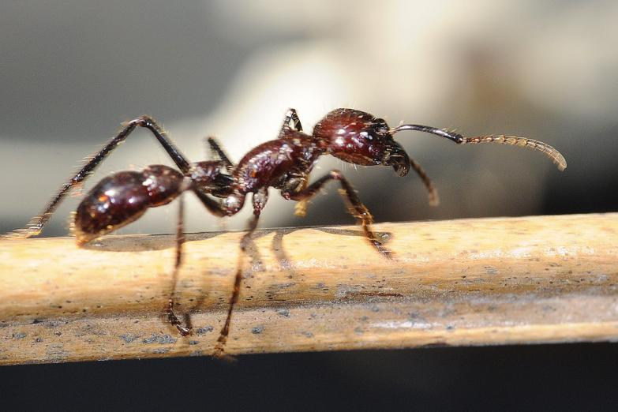
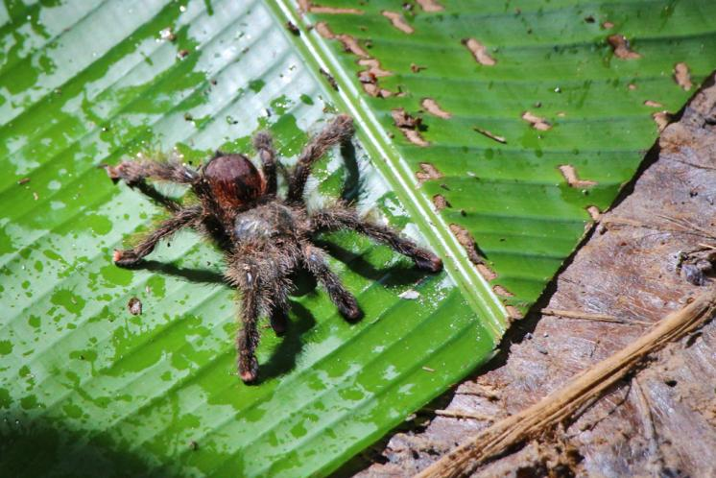
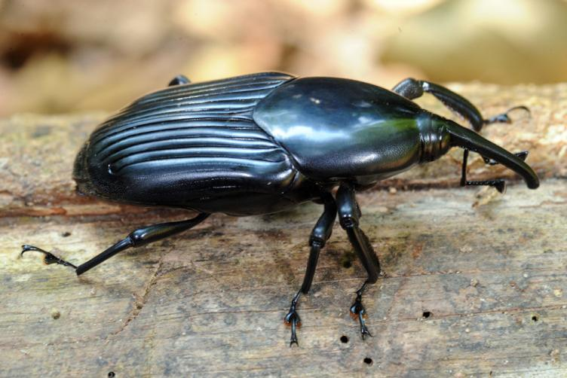

Insects of the
Amazon Rainforest

Slide 2
We are learning
To find out about an amazing creature.
To write facts about it.

Slide 3
Today we will be learning about a fascinating creature.
Look on the next slide to find out what it is......

Slide 4
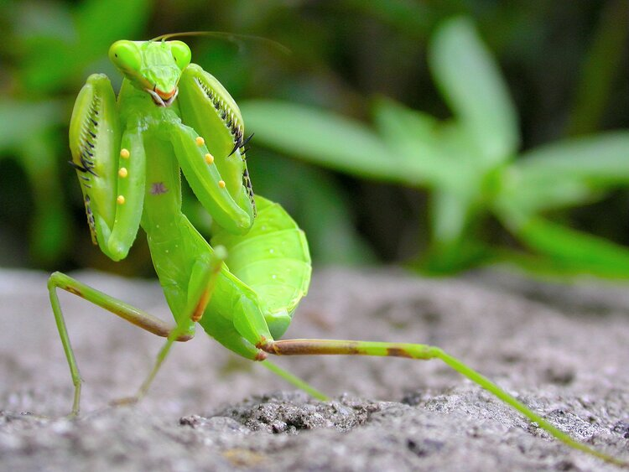
The Praying Mantis

Slide 5
Habitat:
The Praying Mantis can be found in the lower layers of the rainforest. They will make homes in warm habitats but mantes can also survive in deserts, meadows, and open fields.

Slide 6
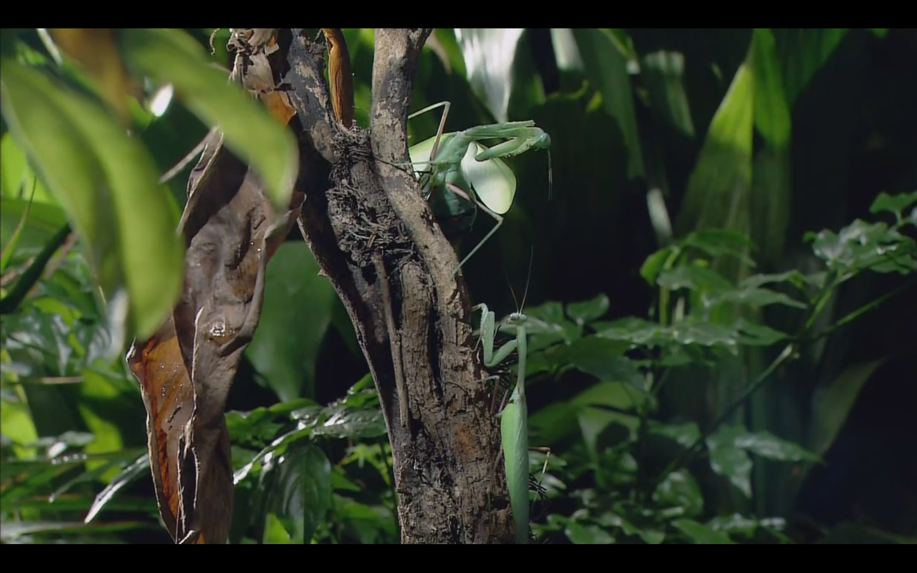
Habitat:

Slide 7
Appearance:
The praying mantis is a skinny insect with long, curved legs in the front. The position of these legs make the mantis look like it is praying. It has a triangular shaped head.Most mantes are green or brown but some are black or even pink! The mantis uses it’s colour to blend in with its surroundings to catch prey.

Slide 8
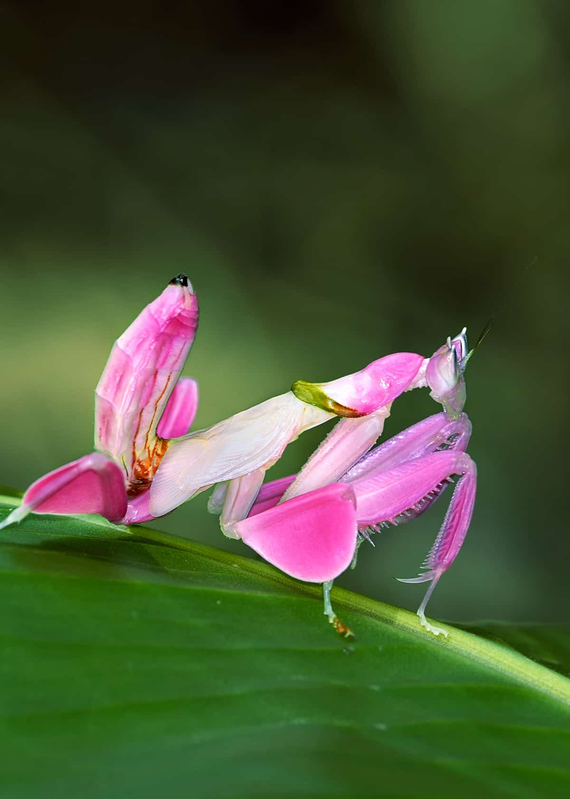
Orchid mantis

Slide 9
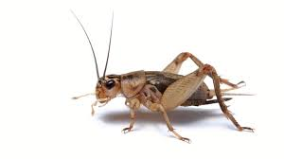
What they eat:
Praying mantes mostly feed on crickets, grasshoppers, spiders, monarch butterflies and beetles. Sometimes, female praying mantes eat male praying mantes!
cricket

Slide 10
For today’s lesson, I would like you to write facts about the Praying Mantis. I would also like you to draw a picture of one too.

